Slide 1
Fractions and Division

Slide 2
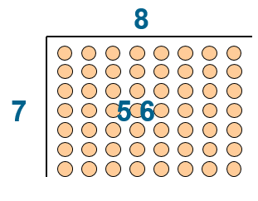
Here is an array
On whiteboards
Can you give a maths sentence where the multiplier is 7?
Now give 3 more maths sentences associated with this array
Use the key words to describe each number

Slide 3
8 x 7 = 56
Multiplicand x multiplier = product
7 x 8 = 56
Multiplicand x multiplier = product
56 ÷ 8 = 7
Dividend ÷ divisor = quotient
56 ÷ 7 = 8
Dividend ÷ divisor = quotient

Slide 4
On whiteboards…
Draw a representation of
2 x 8
Notes:
Discuss multiplicand/multiplier

Slide 5
On whiteboards…
Draw a representation of
3 x 4
Notes:
Discuss multiplicand/multiplier

Slide 6
On whiteboards…
Draw a representation of
12 ÷ 2
Notes:
Discuss multiplicand/multiplier

Slide 7
On whiteboards…
Draw a representation of
18 ÷ 6
Notes:
Discuss multiplicand/multiplier

Slide 8
Whiteboards away

Slide 9

If I want to divide 18 cakes into two equal parts. How many cakes in each part?
18 ÷ 2 = 9
Notes:
How many other ways?

Slide 10
What other ways are there to represent this?
18 ÷ 2 = 9
Notes:
How many other ways?

Slide 11
If I want to divide 6 cakes into two equal parts. How many cakes in each part?
6 ÷ 2 = 3

Slide 12
If I want to divide 6 cakes into three equal parts.
How many cakes in each part?
6 ÷ 3 = 2

Slide 13

=
If I want to divide 1 cake into two equal parts. How many cakes in each part?
1 ÷ 2
=

Slide 14
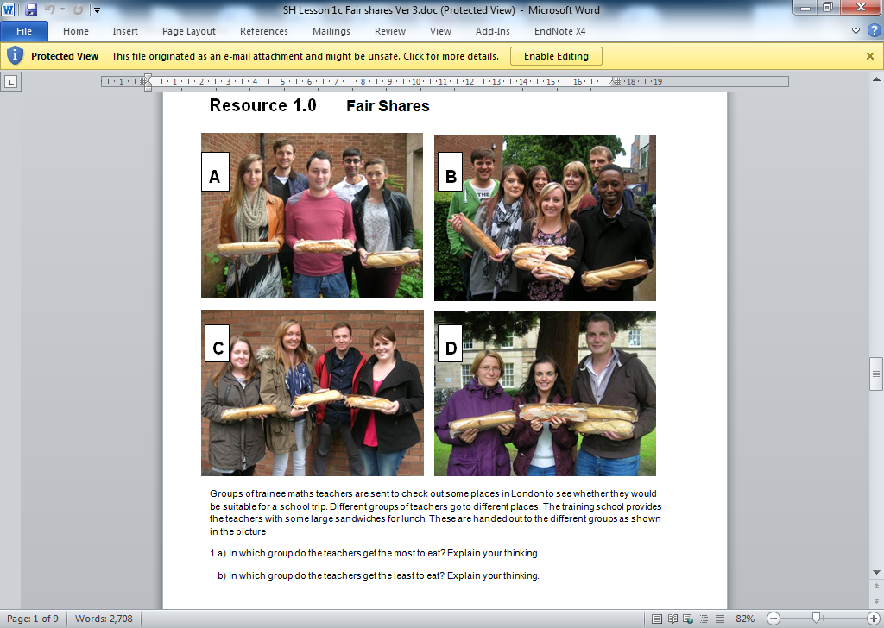
These teachers are sharing baguettes between themselves. How much of a baguette will they each get.

Slide 15
Draw a picture to show how you would share out the baguettes in group A to ensure everyone has the same amount
b) Write down how much each person in group A will get.

Slide 16
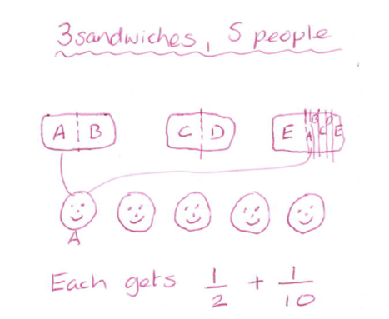
Here is one strategy for sharing 3 baguettes between 5 people:

Slide 17
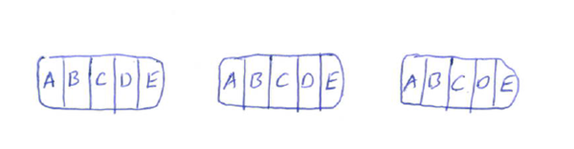
Here is another strategy for sharing 3 baguettes between 5 people:
Describe how the sandwiches have been cut up
b) How much does each person get?
(Is there more than one way of describing this?)

Slide 18
d) Do you get the same amount, whichever way you share them out?

Slide 19
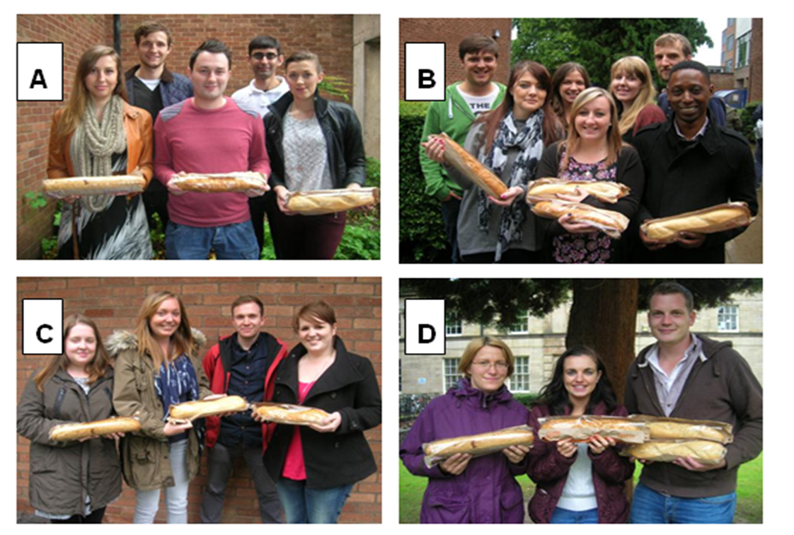
Draw pictures to show ways of sharing out the baguettes in the other groups.
In each case write down how much each person gets.

Slide 20
Draw pictures to show ways of sharing out the baguettes in the other groups.
In each case write down how much each person gets.
 | People | Baguettes | Fraction
A
B
C
D

Slide 21
Choose your own numbers of teachers and baguettes.
Show how to share out the sandwiches equally.
Describe how much each teacher will get.
Challenge
Is it possible to think of a group situation where the teachers would end up with more than those in group A, but less than those in group C?

Slide 22
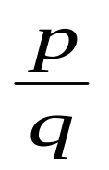

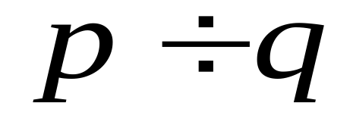
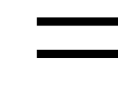
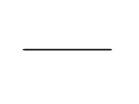
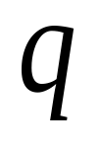
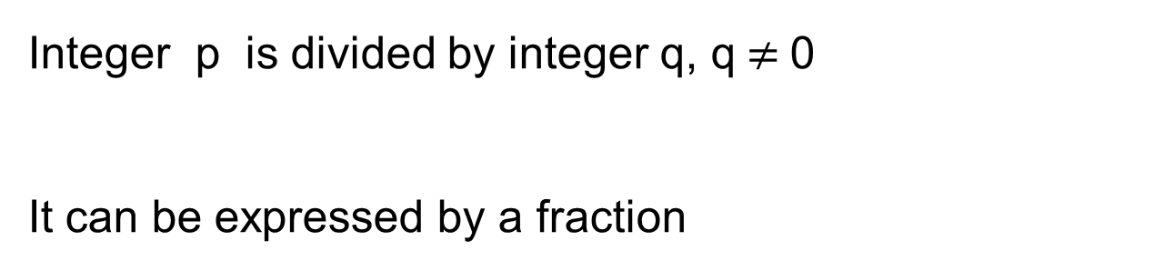
Fraction and Division
Integer p is divided by integer q, q$≠$0
It can be expressed by a fraction
Dividend
Division sign
Numerator
Fractional line (vinculum)
Denominator
Divisor

Slide 23
In each picture, what is the dividend, and what is the divisor?

Slide 24
Fractions and division
The difference between fractions and division:
the fraction is a number
the division is an operation
Notes:
24

Slide 25


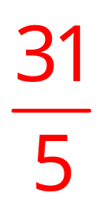

On your whiteboards:
use fractions to express the quotients.
（1）2 ÷ 9 （2）8 ÷ 6
（3）31 ÷ 5 （4）7 ÷ 13
If each of these represented teachers sharing baguettes, how many teachers, and how many baguettes would there be?

Slide 26
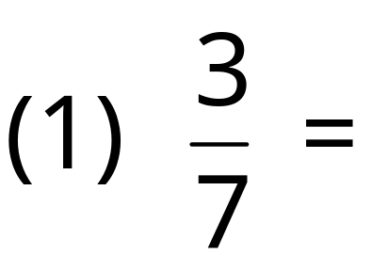
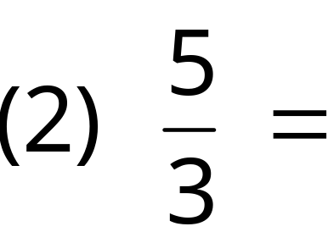
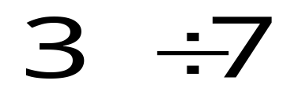
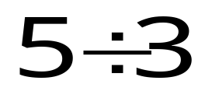
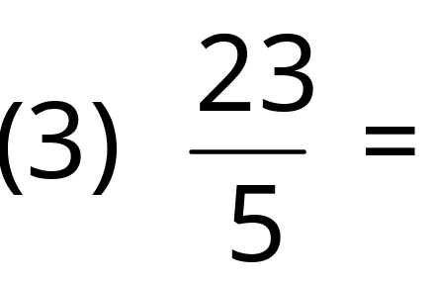
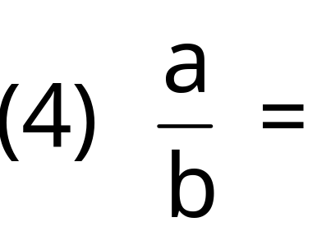
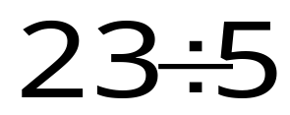
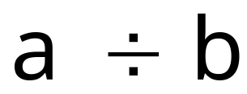
Change the following fractions into a division
For each one, which number represents the dividend, and which number represents the divisor?

Slide 27
What have we learned today?

Slide 28
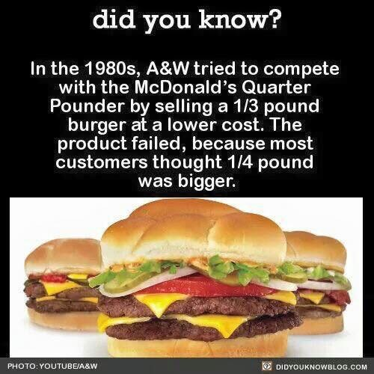

Slide 29
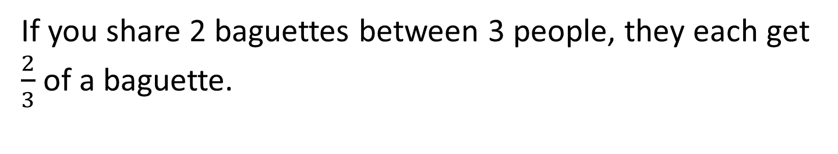
Exit ticket
If you share 2 baguettes between 3 people, they each get $\frac{2}{3}$ of a baguette.
Show this by using diagrams in the space below.

