Slide 1
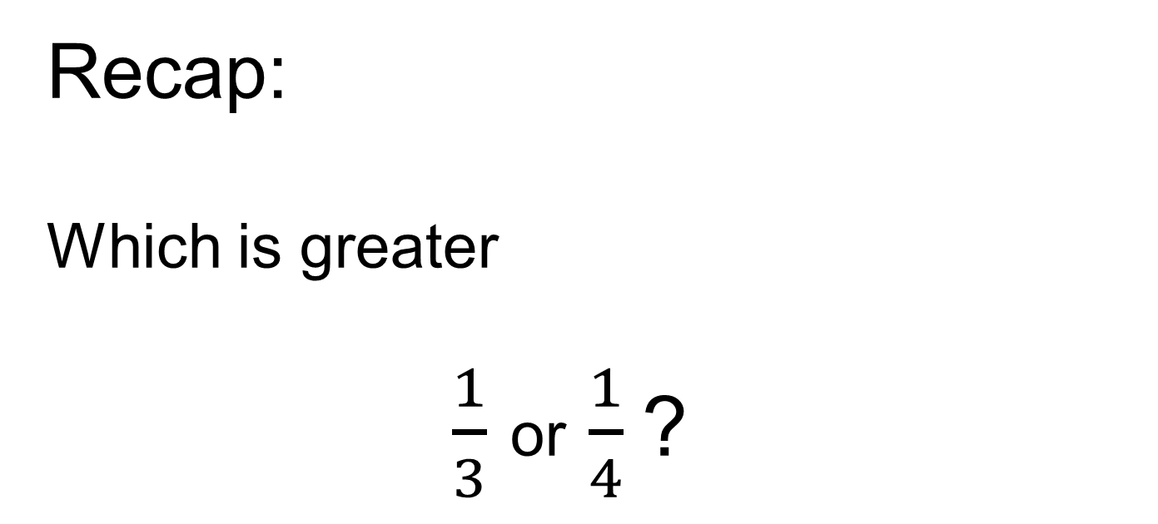
Recap:
Which is greater
$\frac{1}{3}$ or $\frac{1}{4}$?
How could you convince me?

Slide 2
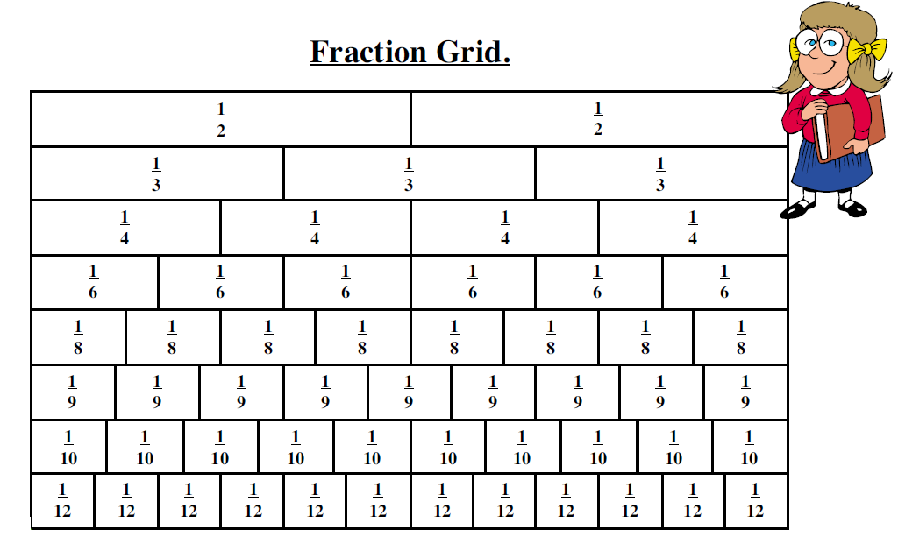
Using a Fraction Wall
What is the whole?

Slide 3

Using a Fraction Wall

Slide 4

Using a Fraction Wall

Slide 5
Using a Fraction Wall
Use the wall to show me another pair of equivalent fractions

Slide 6
Using a Fraction Wall
Use the wall to show me a set of three equivalent fractions

Slide 7
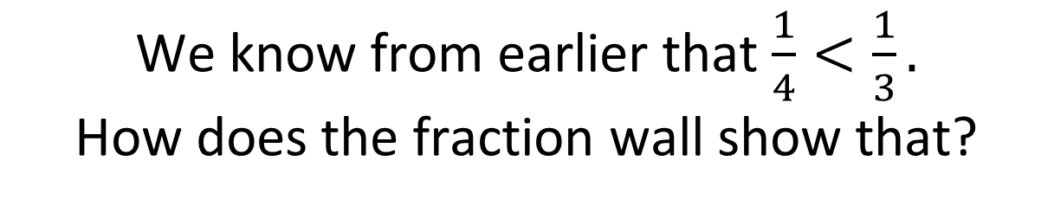
Using a Fraction Wall

Slide 8

Using a Fraction Wall

Slide 9
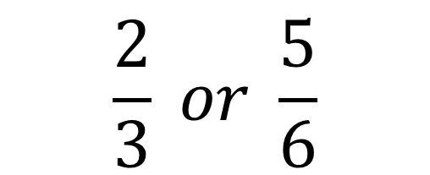
Without looking at the fraction wall:
Which is greater?
$$\frac{2}{3} or \frac{5}{6}$$
How could you convince me?

Slide 10
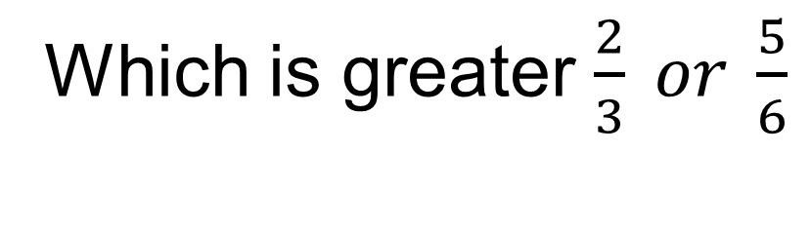
Let’s check if we were correct
Which is greater $\frac{2}{3} or \frac{5}{6}$

Slide 11
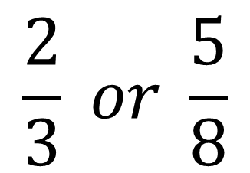
Without looking at the fraction wall:
Which is bigger?
How could you convince me?

Slide 12

Let’s check if we were correct

Slide 13
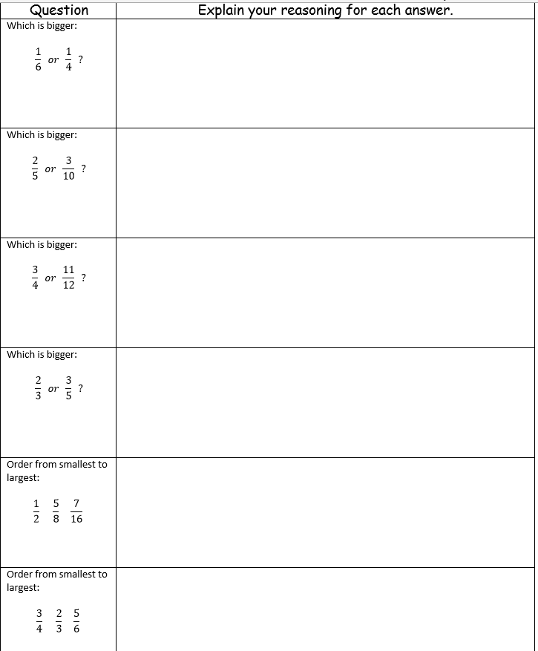
Worksheet
For each question, you have to CONVINCE me that you are correct.

Slide 14
Worksheet
For each question, you have to CONVINCE me that you are correct.

Slide 15
Compare the following groups of fractions using “>,<,=” (Work down, not across)
2
1
3
4
3
2
8
10
2
3
3
5
3
4
8
12
2
8
3 8
1
3
12
3
2
7
3
5
3
10
8
11
Notes:
Short task of mixed questions
Draw attention to variation towards the end
3/3 < 3
15/15 = 14/14
3/6 > 2/7 requires simplifying first

