Slide 1
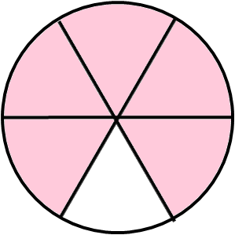
Which diagrams show $\frac{5}{6}$of the whole?
1
6
1
6
0
1
5
6
Notes:
Different representations
Part-whole relationship
Accurate definition for 1/6
Check understanding of prior knowledge

Slide 2
What fraction is shaded?
2
10
7
10
Compare and fill in the blank with “<,>,=”
2
<
7
10
10
Notes:
Small steps

Slide 3


Compare these fractions.
Think of the reason and fill in the blank.
2
3
6
4
<
>
5
5
7
7
a
b
>
c
c
（a > b > 0 c ≠ 0 ）
Notes:
Short task
Explanation leading to Generalisation

Slide 4
Comparing fractions:
When the denominators are the same, we can compare the numerators.
When the numerator is bigger, the fraction is bigger.
b
c
c
b
>
a
a
a
a
（when b > c and a ≠ 0, b ≠ 0, c ≠ 0）
Notes:
Conclusion
Use algebra to generalise
Show me an example on your whiteboards where this is true

Slide 5
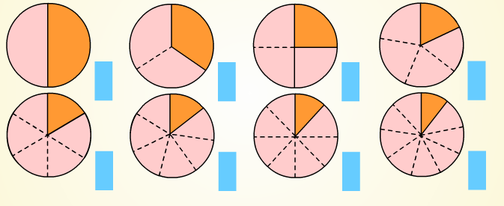
What fraction of each shape is shaded?
What do you notice?
Notes:
Unit fraction, same numerator of 1
Draw students attention to what is varying
What are implications
Next small step

Slide 6
These are all unit fractions.
Unit fractions get smaller as the denominator gets larger.
Notes:
Unit fraction, same numerator of 1
Draw students attention to what is varying
What are implications
Next small step

Slide 7
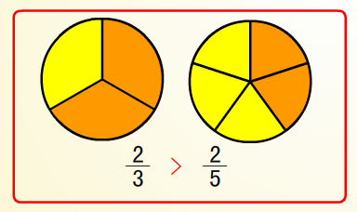
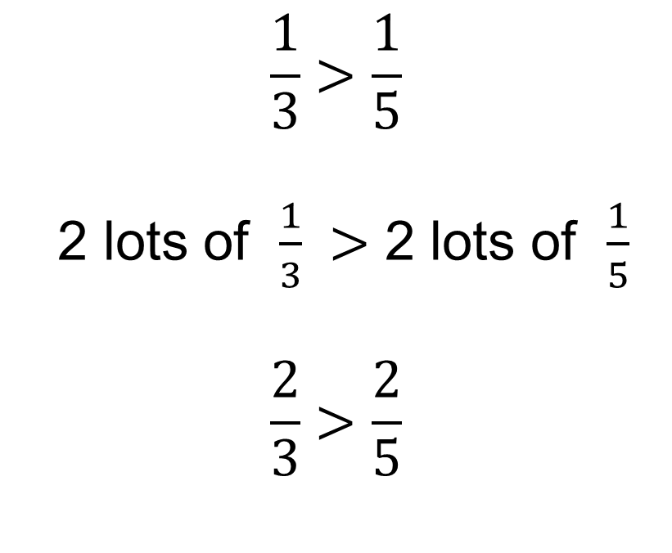
Compare these fractions using < , > or =
2
>
2
3
5
$$\frac{1}{3}>\frac{1}{5}$$
2 lots of $\frac{1}{3} >$ 2 lots of $\frac{1}{5}$
$$\frac{2}{3}>\frac{2}{5}$$
Notes:
Same denominator (not 1)
Next small step
Reasoning using prior knowledge of unit fractions
Clear stages in working
Diagram to support explanation

Slide 8
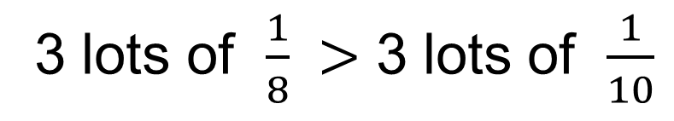
Compare these fractions:
3
3
>
8
10
Reasoning：
3 lots of $\frac{1}{8} >$ 3 lots of $\frac{1}{10}$
0
3
1
8
0
1
3
10
Notes:
Short task
Reasoning supported by number line diagram

Slide 9
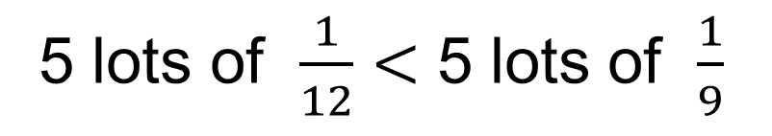
Compare these fractions:
5
5
<
12
9
Reasoning：
5 lots of $\frac{1}{12}<$ 5 lots of $\frac{1}{9}$
0
5
1
12
0
5
1
9
Notes:
Short task
Now <
Opportunity for pupils to practice verbal explanation

Slide 10
Comparing fractions:
When the numerators are the same, we can compare the denominators.
When the denominator is bigger, the fraction is smaller.
a
a
a
a
<
b
c
c
b
（when b > c and a ≠ 0, b ≠ 0, c ≠ 0）
Notes:
Conclusion
Use algebra to generalise
Show me an example of this

Slide 11
Compare the following groups of fractions using “>,<,=” (Work down, not across)
2
>
2
9
>
6
9
7
28
28
7
>
3
3
>
3
16
16
3
8
>
8
1515
=
14
5
8
14
23
23
3
2
>
>
47
16
6
7
Notes:
Short task of mixed questions
Draw attention to variation towards the end
3/3 < 3
15/15 = 14/14
3/6 > 2/7 requires simplifying first

Slide 12
Compare the size of these fractions using inequalities, from biggest to smallest
8
11
8
15
15
18
11
>
8
15
15
11
8
8
>
>
15
15
18
8
>
8
15
18
Notes:
Short task – apply knowledge to comparing 3 fractions
Test understanding

Slide 13
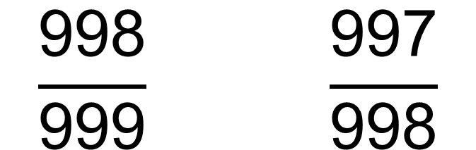
Compare these fractions using inequalities:
$$\frac{\text{998}}{\text{999}} \frac{\text{997}}{\text{998}}$$
<

