Slide 1

Year 8
Progress Check
Spring 1

Slide 2
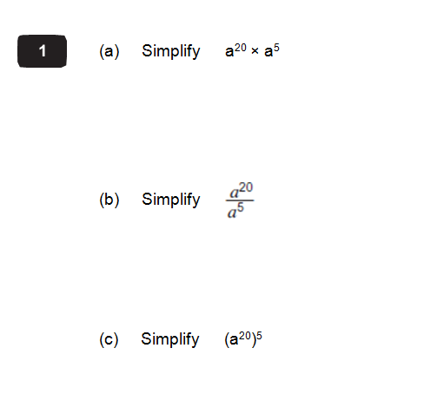

All three correct
= a full box
a²⁵
At least one correct
= half a box
a¹⁵
None correct
= blank box
a¹⁰⁰

Slide 3
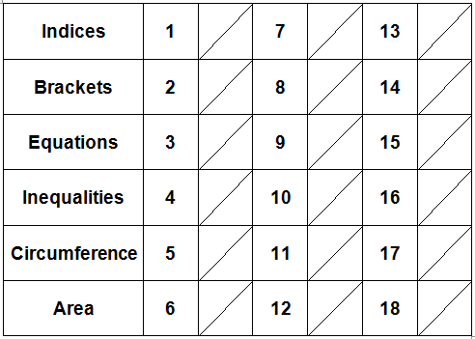
Now fill in the box for question 1 on the recording grid
You will do this after every question.

Slide 4
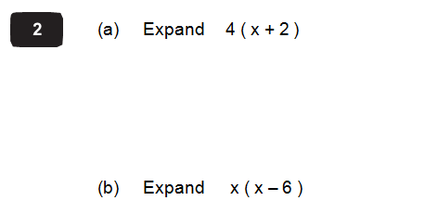
Both correct
= a full box
4x + 8
x² – 6x
One correct
= half a box
Neither correct
= blank box

Slide 5
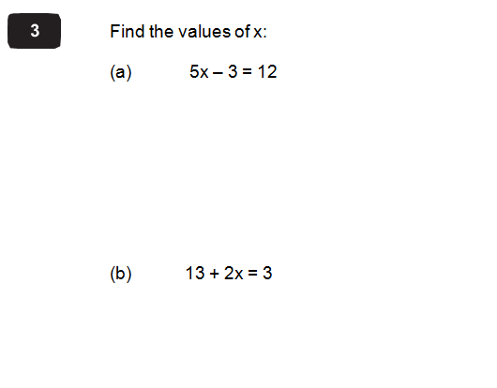
Both correct
= a full box
x = 5
x = - 5
One correct
= half a box
Neither correct
= blank box

Slide 6
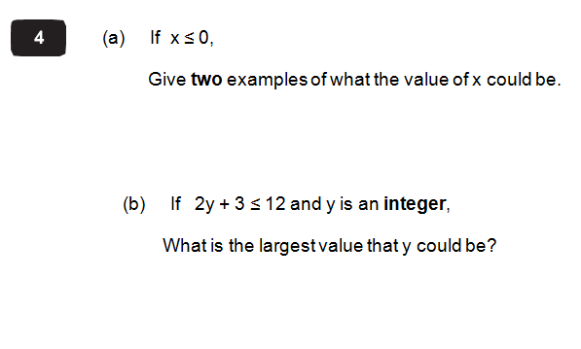
Both correct
= a full box
Any two correct answers
4
One correct
= half a box
Neither correct
= blank box

Slide 7
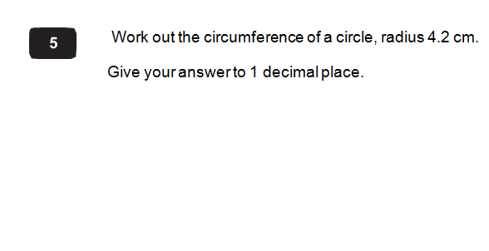
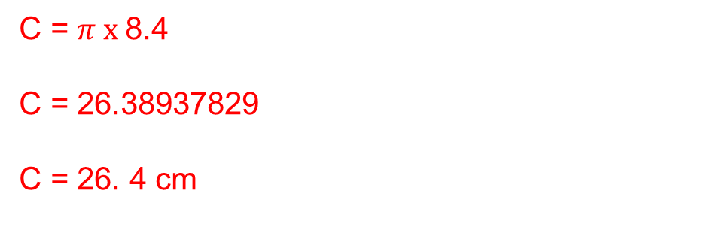
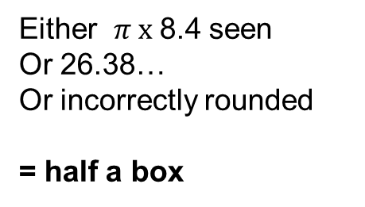
26.4
= a full box
C = $π x$8.4
C = 26.38937829
C = 26. 4 cm
Either $π x$8.4 seen
Or 26.38…
Or incorrectly rounded
= half a box
Incorrect answer with no working out
= blank box

Slide 8
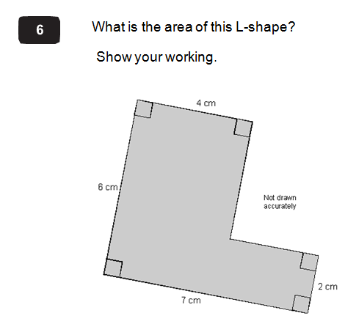
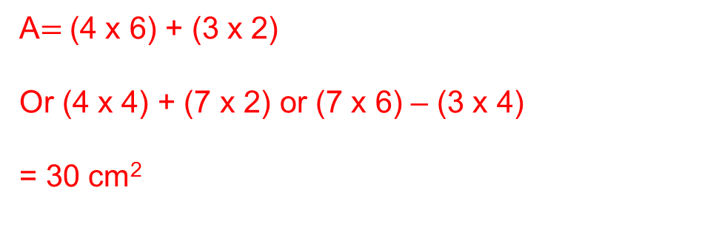
30 (cm²)
= a full box
Correct partitioning of shape with correct measurements and working with one mistake
= half a box
Incorrect answer with no working out
= blank box
A$=$(4 x 6) + (3 x 2)
Or (4 x 4) + (7 x 2) or (7 x 6) – (3 x 4)
= 30 cm²

Slide 9
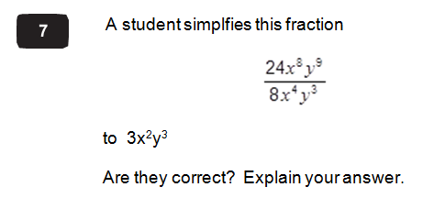
No, with correct explanation
= full box
Just correct answer given with no explanation
= half a box
No, with explanation:
They have divided the indices rather than subtracted.
Incorrect answer or just ‘No’
= blank box

Slide 10
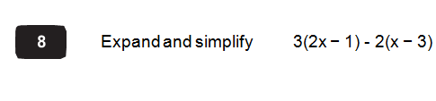
4x + 3
= full box
6x – 3 – 2x + 6
4x + 3
Both brackets correctly expanded but not simplified, or simplified incorrectly
= half a box
Incorrect answer
= blank box

Slide 11
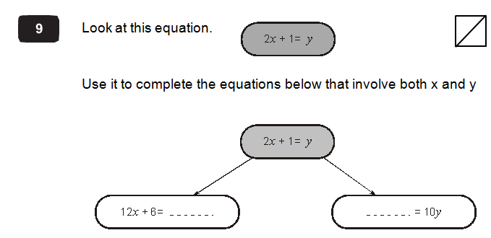
Both correct
= full box
Both brackets correctly expanded but not simplified, or simplified incorrectly
= half a box
6y 20x + 10
Incorrect answer
= blank box

Slide 12
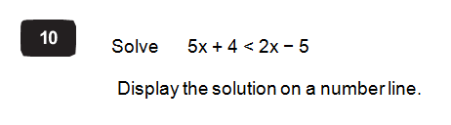
x < -3
And number line
= full box
3x < -9
x < -3
Just x < -3
Or 3x < -9 seen
= half a box
-3
Incorrect answer
= blank box

Slide 13
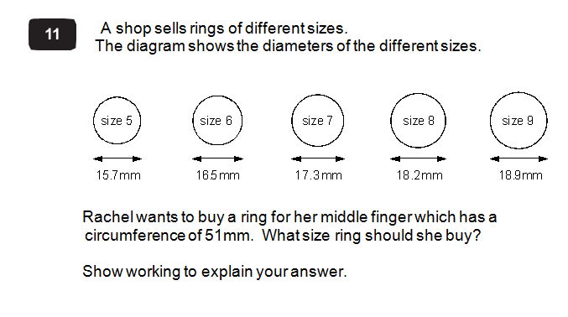
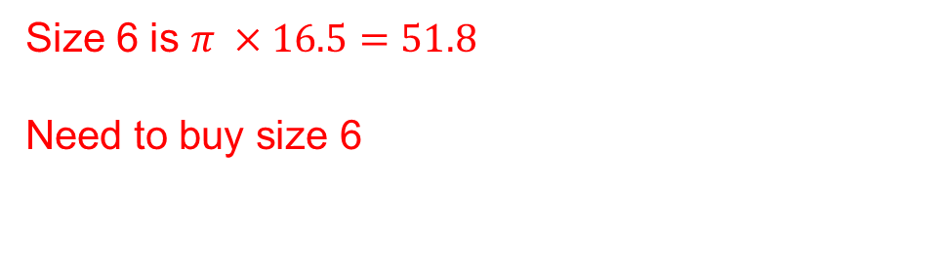
Size 6 with working for 5 and 6
= full box
Any one correct circumference found
= half a box
Size 5 is $π ×15.7=49.3 too small$
Size 6 is $π ×16.5=51.8$
Need to buy size 6
Incorrect answer
= blank box

Slide 14
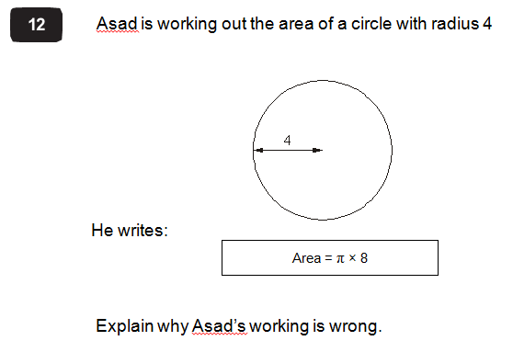
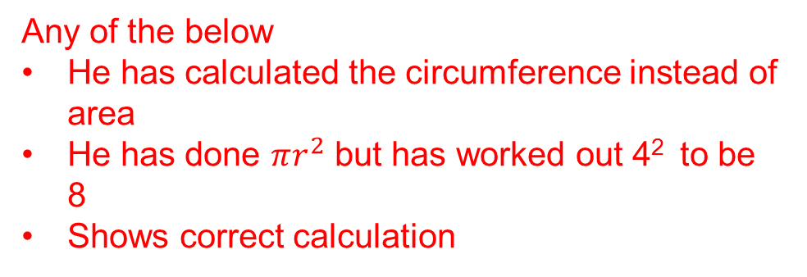
One of the correct explanations
= full box
Incorrect answer
= blank box
Any of the below
He has calculated the circumference instead of area
He has done $πr^{2}$ but has worked out 4² to be 8
Shows correct calculation

Slide 15
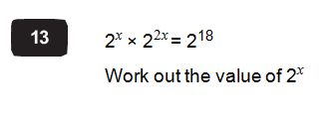
x = 6
= full box
2^{3x} = 2¹⁸
x = 6
First line of working
Or at least two values tried with trial and improvement
= half a box
Incorrect answer
= blank box

Slide 16
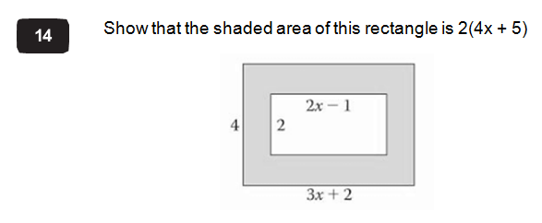
Correct and convincing working
= full box
Any of the lines of working out seen
= half a box
4(3x + 2) – 2(2x-1)
12x + 8 – 4x + 2
8x + 10
2(4x + 5)
Incorrect answer
= blank box

Slide 17
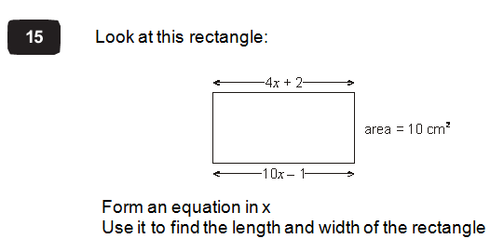
4cm and 2.5cm
= full box
x = 0.5
Or 4 or 2.5 seen
= half a box
4x + 2 = 10x – 1
3 = 6x
0.5 = x
Length = 4 x 0.5 + 2 = 4 cm
Width = 10/4 = 2.5 cm
Incorrect answer
= blank box

Slide 18
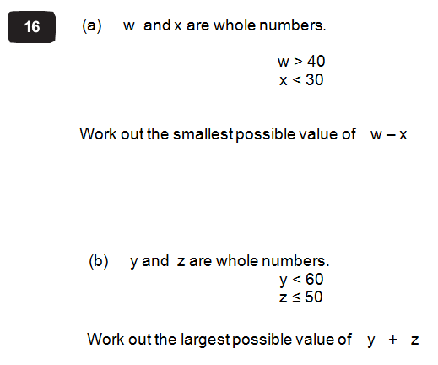
Both answers correct
= full box
w = 41, x = 29
So smallest possible value is 12
y = 59, z = 50
Largest possible value is 109
Either answer correct
Or w & x correct
Or y & z correct
= half a box
Incorrect answer
= blank box

Slide 19
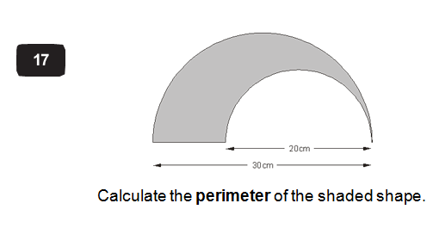
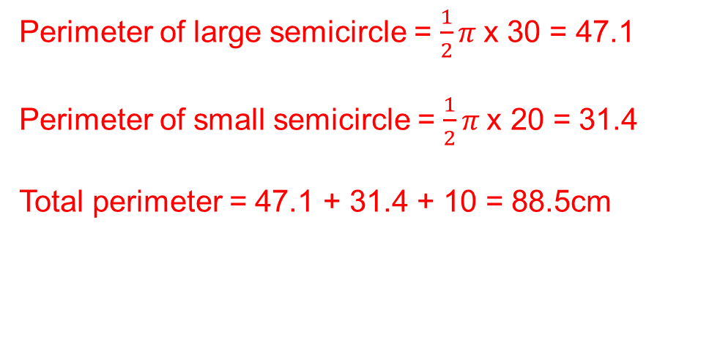
Correct answer
= full box
Either semicircle calculated
Or full calc done but forgotten to halve
for semicircle.
= half a box
Perimeter of large semicircle = $\frac{1}{2}π$x 30 = 47.1
Perimeter of small semicircle = $\frac{1}{2}π$x 20 = 31.4
Total perimeter = 47.1 + 31.4 + 10 = 88.5cm
Incorrect answer
= blank box

Slide 20
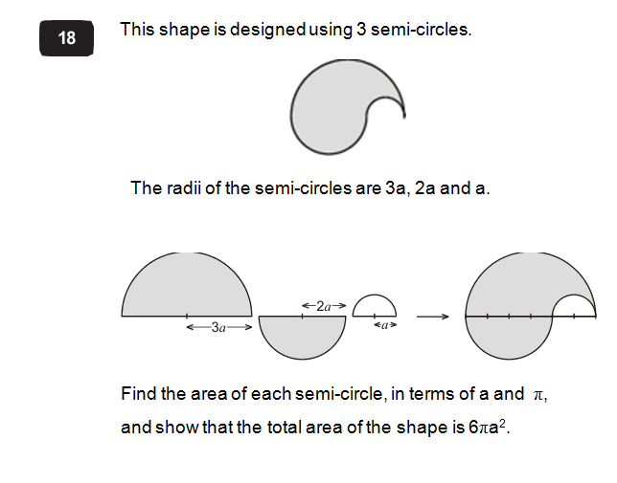
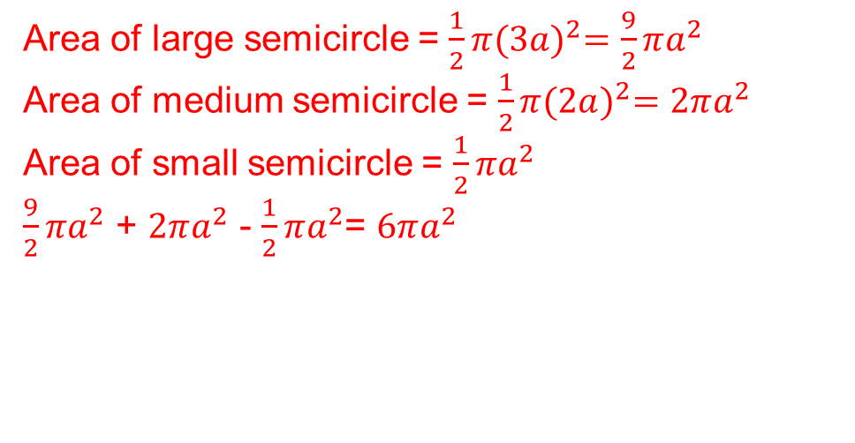
Correct area of each and shows correct total
= full box
Either of the large or medium areas calculated correctly
= half a box
Area of large semicircle = $\frac{1}{2}π{(3a)}^{2}=\frac{9}{2}πa^{2}$
Area of medium semicircle = $\frac{1}{2}π{(2a)}^{2}=2πa^{2}$
Area of small semicircle = $\frac{1}{2}πa^{2}$
$\frac{9}{2}πa^{2}$ + $2πa^{2}$ - $\frac{1}{2}πa^{2}$= $6πa^{2}$
Incorrect answer
= blank box

