Slide 1

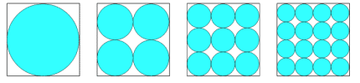
BLUE AND WHITE
In the examples below identical squares contain some circles shaded in blue.
Which of the four examples has the most white space?

