Slide 1
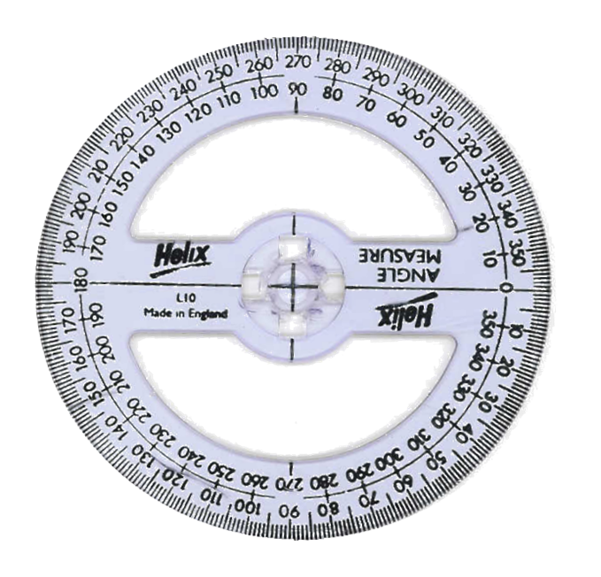
Using a ruler and protractor, construct a triangle $ABC$ where $AB=6cm$, $AC=4cm$ and $∠BAC=50°$.
C
Use a ruler to measure 4 cm
4cm
50°
A
B
6cm

Slide 2
Using a ruler and protractor, construct a triangle $ABC$ where $AB=6cm$, BC $=4cm$ and $∠ABC=50°$.
C
Use a ruler to measure 4 cm
4cm
50°
A
B
6cm

Slide 3
Using a ruler and protractor, construct a triangle $ABC$ where $AB=8cm$,
$∠CAB=30°$ and $∠CBA=50°$.
C
A
30°
50°
B
8cm

Slide 4
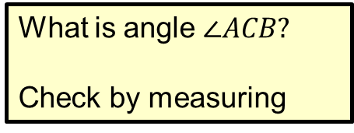
Using a ruler and protractor, construct a triangle $ABC$ where $AB=8cm$,
$∠CAB=30°$ and $∠CBA=50°$.
What is angle $∠ACB?$
Check by measuring
C
A
30°
50°
B
8cm

Slide 5
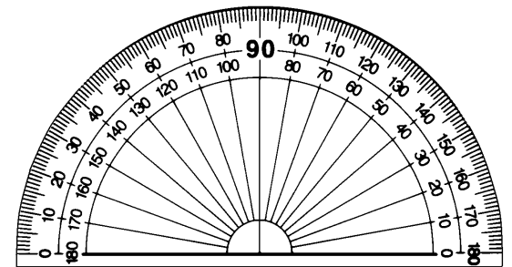
Using a ruler and protractor, construct a triangle $ABC$ where $AB=6cm$, BC $=4cm$ and $∠ABC=50°$.
C
Use a ruler to measure 4 cm
4cm
50°
A
B
6cm

Slide 6
Using a ruler and protractor, construct a triangle $ABC$ where $AB=8cm$,
$∠CAB=30°$ and $∠CBA=50°$.
C
A
30°
50°
B
8cm

Slide 7
Using a ruler and protractor, construct a triangle $ABC$ where $AB=8cm$,
$∠CAB=30°$ and $∠CBA=50°$.
C
A
B
8cm

Slide 8
Using a ruler and protractor, construct a triangle $ABC$ where $AB=8cm$,
$∠CAB=30°$ and $∠CBA=50°$.
What is angle $∠ACB?$
Check by measuring
C
A
B
8cm

