Slide 1
What is the missing angle, x?
130°
x°

Slide 2
Trace the diagram and turn it upside down
130°
50°

Slide 3
Trace the diagram and turn it upside down
130°
50°

Slide 4
What is angle y?
How do you know?
130°
50°
y°

Slide 5
What is angle z?
How do you know?
130°
50°
z°

Slide 6
Angles a and d are equal. They are vertically opposite.
Angles b and c are equal. They are vertically opposite.
a°
b°
c°
d°

Slide 7
On your whiteboards:
Find the missing angles. Give a reason for your answer.
140°
40°
38°
a°
b°
150°
c°
135°
d°

Slide 8
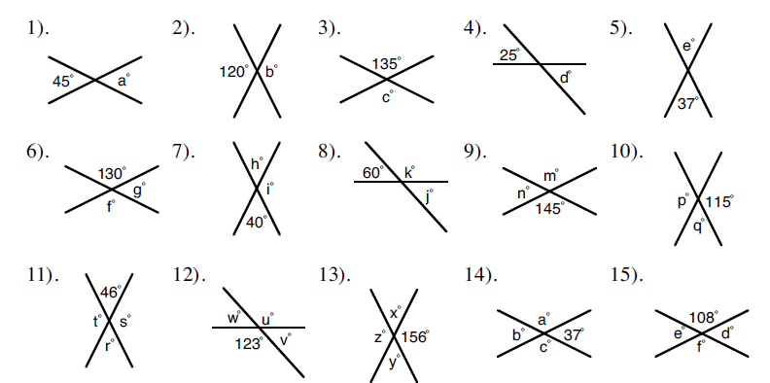

Slide 9
What have they done wrong?
a = 40°
because vertically opposite angles are equal
140°
40°
a°
How can you show that they are wrong?

Slide 10
Let’s trace the whole shape this time, and translate the tracing along one of the lines.
130°
50°
50°
130°

Slide 11
Let’s trace the whole shape this time, and translate the tracing along one of the lines.
130°
50°
50°
130°

Slide 12
What are the missing angles?
a°
130°
b°
50°
c°
50°
130°
d°
Which lines are parallel?
How do you know they are parallel?

Slide 13
Trace the whole shape, and translate the tracing along one of the lines.
35°

Slide 14
Let’s trace the whole shape this time, and translate the tracing along one of the lines.
35°

Slide 15
What are the missing angles?
Which lines are parallel?
How do you know they are parallel?
35°
c°
d°
b°
a°

Slide 16
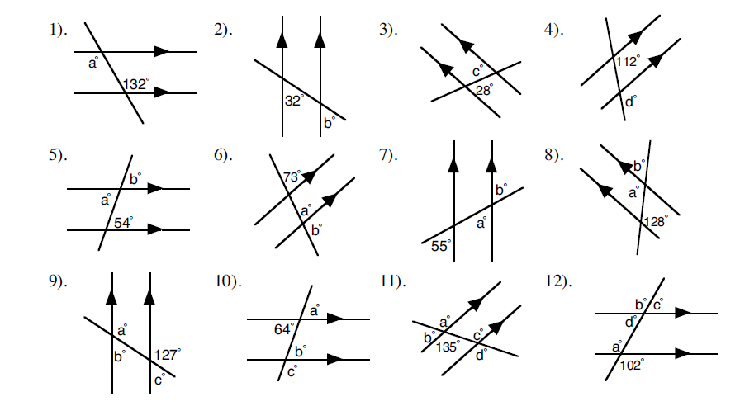
Title: Angles in parallel lines.
Find all of the missing angles.

Slide 17
Challenge
If this angle is x°, what are the sizes of all the other angles in the diagram?
If this angle is (y + 30)°, what are the sizes of all the other angles in the diagram?

