Slide 1
If you measured the angles for each diagram, how could you check your accuracy?
d
a
b
c
e
g
f
h
i
j

Slide 2
Two angles a and b form a straight line.
What size could each of the angles be?
The angles are not drawn accurately
a
b
Give as many combinations as you can in the time you have.
Give values of a and b that wouldn’t make a straight line.

Slide 3
On your whiteboards:
What is the missing angle, a?
a°
50°
a°
51°
52°
62°
a°
a°

Slide 4
On your whiteboards:
What is the missing angle, b?
b°
141°

Slide 5
On your whiteboards:
What is the missing angle, c?
48°
c°

Slide 6
On your whiteboards:
What is the missing angle, d?
d°
138°

Slide 7
On your whiteboards:
Write an expression for the missing angle, a.
a°
b°

Slide 8
Write a maths sentence involving a and b
The angles are not drawn accurately
a
b
Can you write another?

Slide 9
Three angles form a straight line. What size could each of the angles be?
The angles are not drawn accurately
b
a
c
Give as many combinations as you can in the time you have
Give an example that doesn’t work.

Slide 10
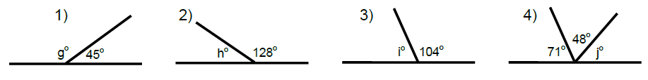
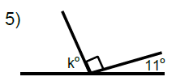
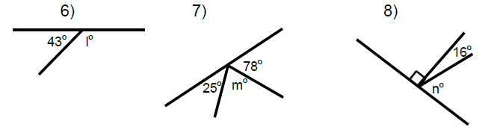
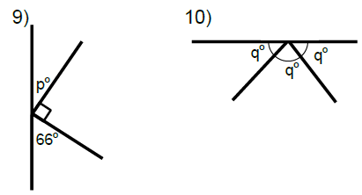



1)
2)
3)
4)
5)
6)
Angles on a Straight Line
For each diagram:
Write two maths sentences
Find the missing angle
7)
8)
p$°$
p$°$
100$°$

Slide 11
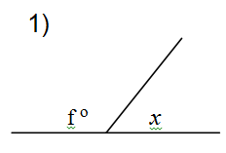
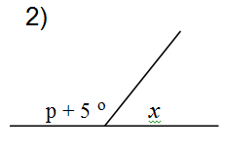
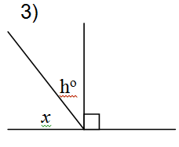
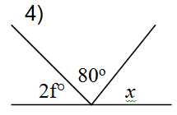
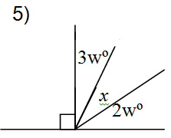









1)
2)
p$°$
x$°$
p$°+10°$
x$°$
3)
4)
p$°$
2$p°$
x$°$
x$°$
5)
Challenge
For each diagram:
Write a maths sentence starting with x =
x$°$

Slide 12
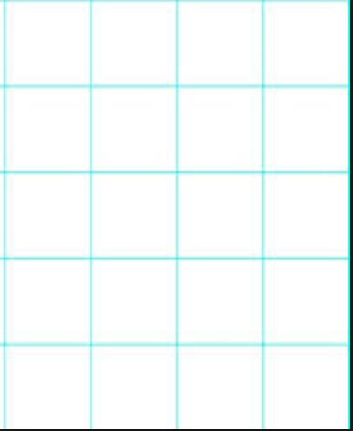
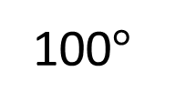
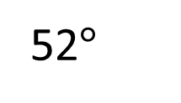
Exit ticket
What is the value of angle a?
100$°$
a
52$°$
The angles are not drawn accurately

