Slide 1
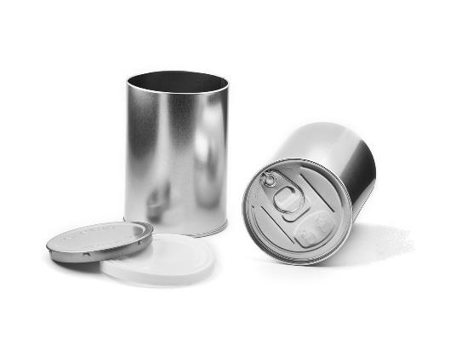
Which is bigger?
Twice the height, or once round the circumference?

Slide 2
How many times bigger…
…is the circumference than the diameter of the can?

Slide 3
Circumference of a Circle: Investigation
The aim of this investigation is to find the relationship between the circumference of a circle and its diameter.
To help you measure the circumference of each circle, you need to trace the circumference using the string. Mark the length on the string with a pencil then use a ruler to measure the length of the string.
Complete the table to show your results. Calculate the value of the last column using a calculator and give your answer to two decimal places.
After you have completed the table, answer the following questions in your book:
What do you notice about the last column?
Can you say how the circumference is related to the diameter?
Radius r (cm) | Diameter d (cm) | Circumference C (cm) | C ÷ d

Slide 4
Circumference of a Circle: Investigation
2 cm
3 cm
5 cm
4 cm
1.5 cm
4.5 cm
3.5 cm
2.5 cm

Slide 5
Example 1
How can we use what we have found to calculate the circumference of this circle
Circumference
= π × diameter
circumference
C = πD
4cm
Circumference
= π × 4
= 12·57cm (2 dp)

Slide 6
Example 2
Calculate the circumference of the circle
Circumference
= π × diameter
circumference
C = πD
8cm
Circumference
= π × 16
= 50.27cm (2 dp)

Slide 7
Task 1: Find the circumference of these circles.
3cm
6cm
4cm
8cm
What do you notice? Why is that the case?

Slide 8
Task 2: Without calculating, what is the relationship between the circumferences of these circles?.
6cm
6cm
12cm
6cm
Check by using calculations. Were you correct? If not, why not?

Slide 9
Challenge:
A circle has a circumference twice as long as this circle’s circumference.
3cm
What is its diameter? Explain your reasoning.
Convince me that you are right.

Slide 10
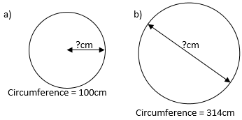
Challenge 2:
Work out the missing lengths.
How did you do it?
Write it up in your books.

Slide 11
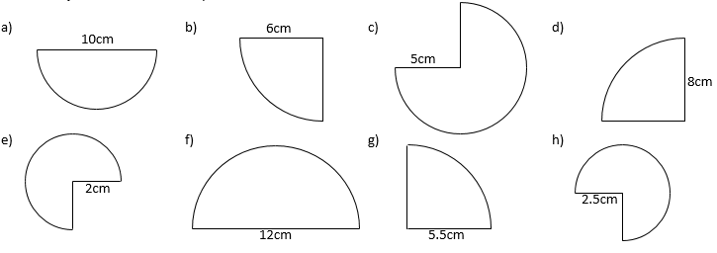
Task 3: The perimeters of these shapes are part circles and part straight lines. Calculate their perimeters.

Slide 12
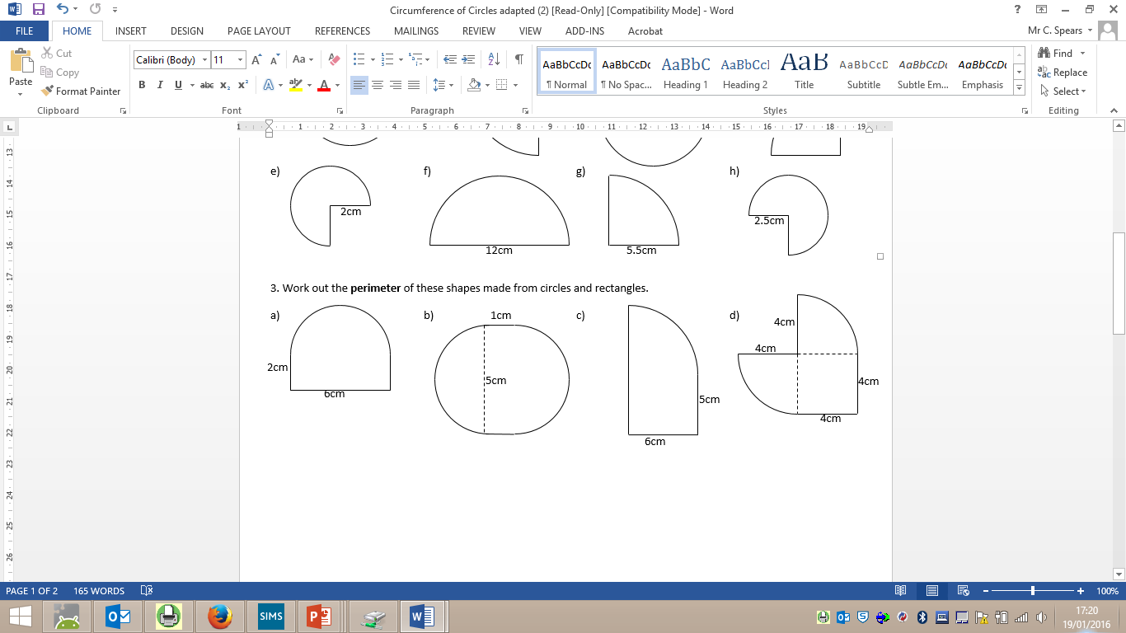
Challenges

Slide 13
