Slide 1
Check you have all these pieces.
Write the missing lengths on the pieces
8cm

Slide 2
You can make all of these shapes from the pieces you have in front of you.
Find the areas of the six shapes.

Slide 3
How did you make this shape?
Which other shape has the same area? Why does it have the same area?

Slide 4
How did you make this shape?
Which other shape has the same area? Why does it have the same area?

Slide 5
How did you make this shape?

Slide 6
How could you find the area of this shape?

Slide 7
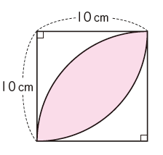
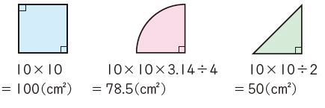
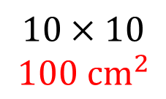
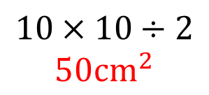
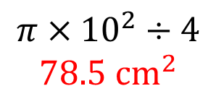
The shaded area can be found using some or all of these shapes
$$10×10$$
$$100 {cm}^{2}$$
$$π×{10}^{2}÷4$$
$$78.5 {cm}^{2}$$
$$10×10÷2$$
$$50{cm}^{2}$$

Slide 8
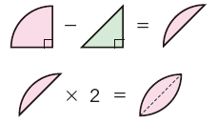
Here is one student’s working out
Write this down using calculations

Slide 9
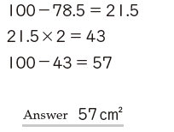
Here is another student’s working out
Write this down using diagrams

Slide 10
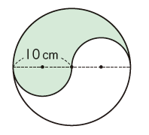
Find the area of this shape using diagrams and calculations

