Slide 1
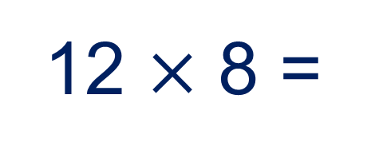

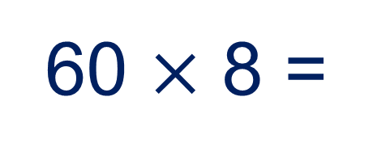
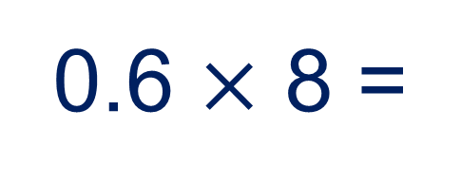
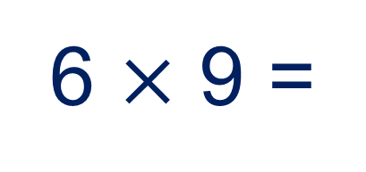
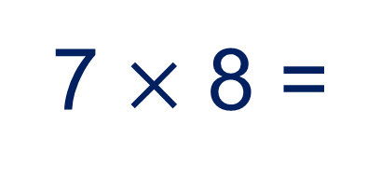
If I know 6$×$ 8 = 48 what else do I know?
7 $×$ 8 =
6 $×$ 9 =
12 $×$ 8 =
0.6 $×$ 8 =
60 $×$ 8 =

Slide 2

If I know 6 $×$ 8 = 48 what else do I know?
48 ÷ 8 =
48 ÷ 6 =
4.8 ÷ 8 =
4.8 ÷ 6 =
Let’s practice some on our whiteboards…
(Excel file)

Slide 3

If I know 15 $×$ 19 = 285 what else do I know?
16 × 19 =
The array is too big to draw.
Can you imagine what it would look like?
15 × 20 =
30 × 19 =
1.5 × 19 =
150 × 19 =

Slide 4
If I know 15 $×$ 19 = 285 what else do I know?
285 ÷ 19 =
The array is too big to draw.
Can you imagine what it would look like?
285 ÷ 15 =
28.5 ÷ 15 =
2.85 ÷ 15 =

Slide 5
If you didn’t have any information beforehand how could you calculate the multiplication and division involving decimals?
28.5 ÷ 5
Which number is the dividend?
Which number is the divisor?
Which related calculation could you use?
We can also calculate it using the algorithm, even though the dividend is a decimal number.

Slide 6
5
2 8 . 5
Group into 5’s
1
1
0.1
0.1
10
1
1
1
0.1
0.1
10
1
1
0.1
1

Slide 7
5
2 8 . 5
Group into 5’s
1
1
0.1
0.1
1
1
1
1
1
0.1
0.1
1
1
1
1
1
1
0.1
1
1
1
1
1
1
1
1
1
1
1
1
1

Slide 8
5
5
2 8 . 5
Group into 5’s
1
1
1
1
1
0.1
0.1
1
1
1
1
1
0.1
0.1
1
1
1
1
1
0.1
1
1
1
1
1
1
1
1
1
1
1
1
1

Slide 9
5
5
2 8 . 5
Group into 5’s
1
1
1
1
1
0.1
0.1
1
1
1
1
1
0.1
0.1
1
1
1
1
1
0.1
1
1
1
1
1
1
1
1
1
1
1
1
1

Slide 10
5
5
3
2 8 . 5
Group into 5’s
1
1
1
1
1
0.1
0.1
0.1
0.1
0.1
0.1
0.1
1
1
1
1
1
0.1
0.1
0.1
0.1
0.1
1
1
1
1
1
0.1
0.1
0.1
0.1
0.1
0.1
0.1
0.1
0.1
1
1
1
1
1
0.1
0.1
0.1
0.1
0.1
0.1
1
1
1
1
1
0.1
0.1
0.1
0.1
0.1
0.1
0.1
0.1

Slide 11
5
. 7
5
3
2 8 . 5
Group into 5’s
1
1
1
1
1
0.1
0.1
0.1
0.1
0.1
1
1
1
1
1
0.1
0.1
0.1
0.1
0.1
0.1
0.1
0.1
0.1
0.1
1
1
1
1
1
0.1
0.1
0.1
0.1
0.1
1
1
1
1
1
0.1
0.1
0.1
0.1
0.1
1
1
1
1
1
0.1
0.1
0.1
0.1
0.1
0.1
0.1
0.1
0.1
0.1

Slide 12
Use the division algorithm to find the quotients:
38.4 ÷ 3 =
38.4 ÷ 2 =
38.4 ÷ 4 =
Using your knowledge of divisibility rules, which other divisors will leave no remainder?
Check that you are correct.

Slide 13
What if the divisor is a decimal?
96 ÷ 0.8 =
Can you find a related calculation?

Slide 14
What about multiplying decimals?
1.5 × 19 =
Can you find a related calculation?

Slide 15
What about multiplying decimals?
1.5 × 19 =
How can we use our multiplication algorithms?

