Slide 1
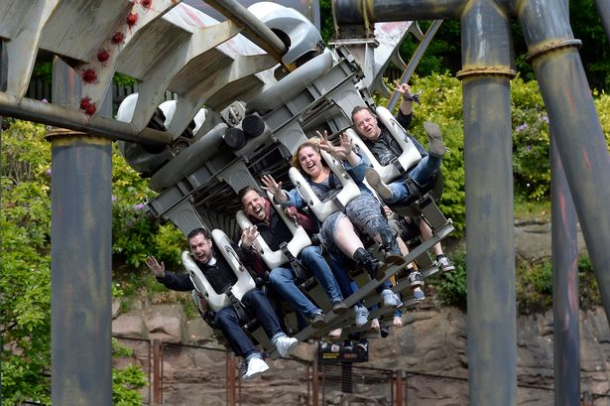
98 year 7’s are on a school trip to Alton Towers.
They are queuing up to go on Nemesis.
There is space on each row for four people.
How many rows will they fill?
What is the calculation?
Which number is the dividend?
Which number is the divisor?

Slide 2
98 year 7’s are on a school trip to Alton Towers.
They are queuing up to go on Nemesis.
There is space on each row for four people.
How many rows will they fill?
4
9 8
dividend
divisor

Slide 3
4
9 8
Group into 4’s
1
10
10
1
1
10
10
10
1
1
10
10
1
10
1
10
1

Slide 4
4
9 8
1
10
10
1
1
10
10
10
1
1
10
10
1
10
1
10
1

Slide 5
2
What shall I do with this one that isn’t in a group?
4
9 8
1
10
10
1
1
10
10
10
1
1
10
10
1
1
10
10
1

Slide 6
2
Exchange for ten 1’s
4
9 8
1
10
10
1
1
10
10
1
10
1
10
10
1
1
10
10
1

Slide 7
2
Now put these counters into groups of 4
How many counters are in this column now?
4
1
9 8
1
1
10
10
1
1
1
1
1
10
10
1
1
1
1
1
10
10
1
1
1
1
10
10
1
1

Slide 8
2
4
What do these two counters represent in the context of the problem?
4
1
9 8
10
10
1
1
1
1
1
10
10
1
1
1
1
10
10
1
1
1
1
1
10
10
1
1
1
1

Slide 9
98 year 7’s are on a school trip to Alton Towers.
They are queuing up to go on Nemesis.
There is space on each row for four people.
How many rows will they fill?
quotient
2
4
4
1
9 8
dividend
divisor
Remainder = 2
So the 98 year 7 students will fill 24 rows.

Slide 10
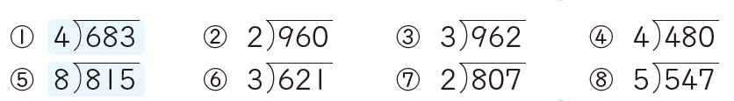
Which of these calculations will have a remainder?
How do you know?
In your pairs:
Choose a question. You are going to find the quotient and the remainder.
You should plan how you would explain it to a pupil in year 4 who has never used the division algorithm before.
You should use the counters (or draw them) to help explain the algorithm.

Slide 11
98 year 7’s are on a school trip to Alton Towers.
They are queuing up to go on Nemesis.
There is space on each row for four people.
How many rows will they fill?
quotient
2
4
4
1
9 8
dividend
divisor
Remainder = 2
So the 98 year 7 students will fill 24 rows.

Slide 12
What if the question was worded slightly differently?
98 year 7’s are on a school trip to Alton Towers.
They are queuing up to go on Nemesis.
There is space on each row for four people.
How many rows will they need to seat all the students?
2
4
4
1
9 8
Remainder = 2
So the 98 year 7 students will fill 24 rows with 2 left over – so 25 rows are needed to seat all the students.

Slide 13
In your pairs:
Work through the word problems on the sheet.
Once you are happy with your explanation and answer for each question, write it in your book.

Slide 14
A restaurant bill for four friends came to £98. How much did each friend have to pay?
quotient
What is the calculation?
2
4
4
9 8
1
dividend
Which number is the dividend?
divisor
Which number is the divisor?
Remainder = 2
Look familiar?
Why is a remainder of 2 not appropriate this time?

Slide 15
2
4
What should I exchange these to?
4
1
9 8
10
10
1
1
1
1
1
10
10
1
1
1
1
1
10
10
1
1
1
1
10
10
1
1
1
1

Slide 16
2
4
.
How many counters are in this column now?
Now put these counters into groups of 4
4
1
20
9 8
10
10
1
1
1
1
0.1
0.1
0.1
0.1
0.1
0.1
10
10
1
1
1
1
0.1
0.1
0.1
0.1
0.1
0.1
10
10
1
1
1
1
0.1
0.1
0.1
0.1
0.1
0.1
0.1
0.1
10
10
1
1
1
1
0.1

Slide 17
2
4
.
5
4
1
20
9 8
10
10
1
1
1
1
0.1
0.1
0.1
0.1
0.1
10
10
1
1
1
1
0.1
0.1
0.1
0.1
0.1
10
10
1
1
1
1
0.1
0.1
0.1
0.1
0.1
10
10
1
1
1
1
0.1
0.1
0.1
0.1
0.1

Slide 18
A restaurant bill for four friends came to £98. How much did each friend have to pay?
quotient
2
4. 5
4
9 8
1
dividend
divisor
How much does each friend have to pay?

Slide 19
2
4
Another way to deal with the remainder is to cut it into pieces
4
1
9 8
10
10
1
1
1
1
1
10
10
1
1
1
1
1
10
10
1
1
1
1
10
10
1
1
1
1

Slide 20
2
4
How many pieces should I cut them into?
4
1
9 8
10
10
1
1
1
1
1
10
10
1
1
1
1
1
10
10
1
1
1
1
10
10
1
1
1
1

Slide 21

2
4
$$\frac{1}{2}$$
4
1
9 8
10
10
1
1
1
1
10
10
1
1
1
1
10
10
1
1
1
1
10
10
1
1
1
1
Each person will get two quarters each

Slide 22

Calculate these divisions, rewriting the remainder as both a decimal and a fraction.

