Slide 1
On your whiteboards:
Write down all you can about this shape
Irregular quadrilateral
One pair of opposite sides the same length
2 acute angles, 2 obtuse

Slide 2
On your whiteboards:
Write down all you can about this shape
Irregular heptagon
One pair of parallel sides
1 acute angles, 5 obtuse, 1 reflex.

Slide 3
On your whiteboards:
Write down all you can about this shape
Appears to be a regular octagon (how can you check that it is?)
All sides the same length
All angles the same size
4 lines of reflective symmetry
Order 8 rotational symmetry

Slide 4
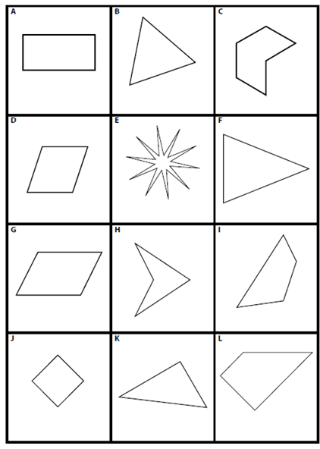
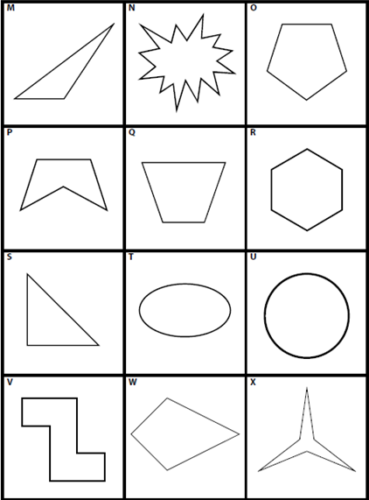
Look at the cards in front of you.
Sort them into two groups, choosing your own criteria.

Slide 5
Write a description of your groups onto the blank group 1 and group 2 cards.

Slide 6
What criteria did you come up with for your two groups?

Slide 7
Now choose a way to sort group 1 into two groups.
Write the descriptions of your two new categories on the blank cards for group 3 and group 4
Now sort your group 2 using the criteria for groups 3 and 4

Slide 8
Arrange your card like this:
Group 1
Group 2
Group 3
Group 4
Can you draw a new shape that would fit in each quadrant?

