Slide 1

Exploring equations
For the problem below, use three different integers from 1 to 9 to find the greatest value for x that you can.
Repeat to find the smallest value for x that you can.
Notes:
Hint:
Where do you want to put the 9? Where should the 1 go or NOT go?
Answers:
1x – 9 = 8 and 1x – 8 = 9 both have a solution of 17.
9x – 1 = 2 and 9x – 2 = 1 both have a solution of 1/3.

Slide 2
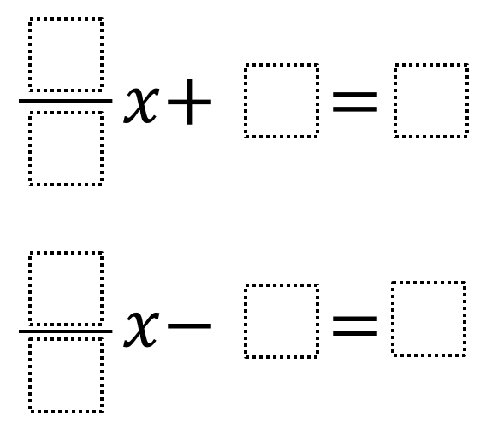
Exploring equations
For each problem below, use four different integers from 1 to 9 to find the greatest value for x that you can.
Notes:
Hint:
Where should the 9 go or not go? Where should the 1 go or not go? Explore “Two-Step Equations” problem first. How can we use our learning from that problem to tackle this problem?
Answers:
(1/8)x + 2 = 9 yields a solution of 56.
(1/9)x – 8 = 7 and (1/9)x – 7 = 8 both have a solution of 135.

Slide 3

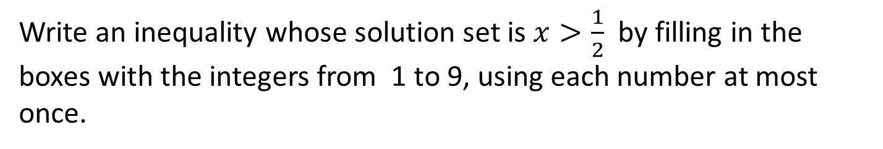
Exploring equations
Write an inequality whose solution set is $x>\frac{1}{2}$ by filling in the boxes with the integers from 1 to 9, using each number at most once.
Notes:
Hint:
How can you use the 1/2 to help you write an inequality?
Answers:
There are many correct answers. Some possible responses could be:
4x + 5 > 2x + 6 ;
7x + 5> 1x + 8;
5x + 6 < 9x + 4
Answers:
(1/8)x + 2 = 9 yields a solution of 56.
(1/9)x – 8 = 7 and (1/9)x – 7 = 8 both have a solution of 135.

