Slide 1
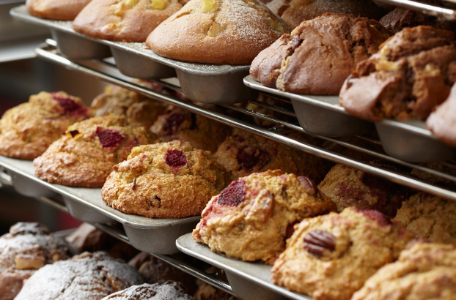

Slide 2
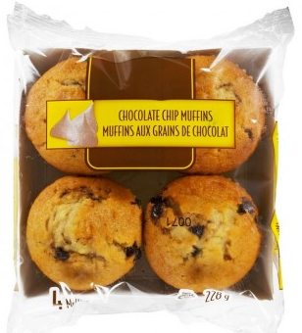

Slide 3
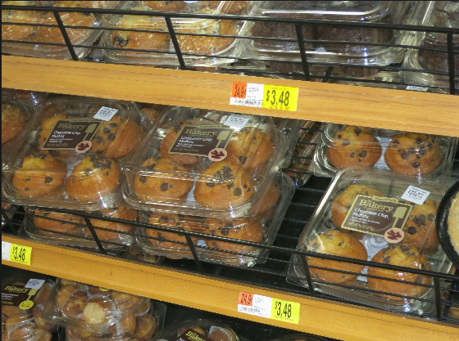
Muffins normally come in packets of 4

Slide 4
If I had muffins how many packets could I make?

Slide 5
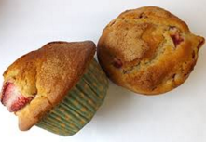
Rachel has 2 muffins left over at the end of her shift.
In your pairs - discuss
How many muffins might she have started with? Can you explain your reasons?

Slide 6
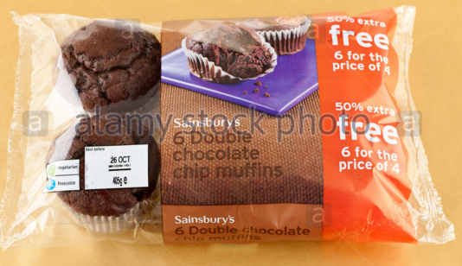
A supermarket has a deal where they are selling 6 muffins for the price of 4.
The shop has 848 muffins to sell.
Can they get rid of them all using this offer?

Slide 7
A supermarket has a deal where they are selling 6 muffins for the price of 4.
What calculation can you do to check?

Slide 8
Try this calculation on your whiteboard
1
4
1
Remainder 2
6
2
8 4 8

Slide 9
Key vocabulary:
Quotient
1
4
1
Remainder 2
6
2
Divisor
8 4 8
Dividend

Slide 10
A supermarket has a deal where they are selling 6 muffins for the price of 4.
The shop has muffins to sell.
Can they get rid of them all using this offer?

Slide 11
In your pairs…
Can you create me a division question with a remainder of 2?
Can you create me a division question with a remainder of 5?
Can you create me a division question with a remainder of 3?
Now write them in your books. You should draw a diagram to represent your question.

Slide 12
In your books
Write down your three problems in your books.
Draw a diagram to represent your question.
Show the calculation to show the remainder.

Slide 13
Problems
I am thinking of a number that is 1 more than a multiple of 7.
I am now thinking of a number that is 1 more than a multiple of 4.
Could I be thinking of the same number?
I am thinking of a number that is 3 more than a multiple of 5.
I am now thinking of a number that is 8 more than a multiple of 10.
Could I be thinking of the same number?

Slide 14
Problems
I am thinking of a number that is 3 more than a multiple of 6.
I am now thinking of a number that is 2 more than a multiple of 4.
Could I be thinking of the same number?
I am thinking of a number that is 4 more than a multiple of 7.
I am now thinking of a number that is 6 more than a multiple of 9.
Could I be thinking of the same number?

Slide 15
Challenge
We know that
When 59 is divided by 5, the remainder is 4
When 59 is divided by 4, the remainder is 3
When 59 is divided by 3, the remainder is 2
When 59 is divided by 2, the remainder is 1
Can you find the smallest number with the property that when it is divided by each of the numbers 2 to 10, the remainder is always one less than the number it has been divided by?
Don’t forget to explain your reasoning.

