Slide 1
If you have 8 square cm, in how many ways can you arrange them into rectangles?
1
2
4
8
There are two factor pairs of 8:
2 x 4 and 1 x 8

Slide 2
If you have 8 square cm, in how many ways can you arrange them into rectangles?
1
2
4
8
There are four factors of 8:
1, 2 ,4 and 8

Slide 3
If you have 8 square cm, in how many ways can you arrange them into rectangles?
1
2
4
8
The multiplicand and the multiplier are factors of the product

Slide 4
Show how many factor pairs there are of 18 by drawing rectangles.
How many factors does 18 have?

Slide 5
Show how many factor pairs there are of 16 by drawing rectangles.
How many factors does 16 have?
16 is a square number

Slide 6
Show how many factor pairs there are of 13 by drawing rectangles.
How many factors does 13 have?
A prime number only has one factor pair: itself and 1.
A prime number has exactly two factors.

Slide 7
For all of the numbers from 1 to 20:
Draw rectangle diagrams to show all of their factors
(You don’t have to make the 1 x … to scale so they can fit on your page)
Highlight and square numbers.
Highlight any prime numbers.

Slide 8
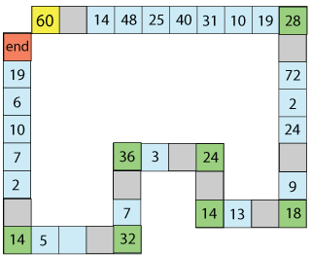
Factor Track
Factor Track is not a race but a game of skill.
The idea is to move round the track in as few moves as possible, keeping to the rules.

Slide 9
Factor Track
You must start on yellow
Make your way to the red square
You must land exactly on each green square, so you can't go round
corners in one move.

Slide 10
Factor Track
What step could you make for your first move?

Slide 11
Factor Track
You need to convince your partner that it is a factor.
How could you do that?

Slide 12
Factor Track
Practice playing on the training track.
When you are confident, move onto the advanced track.
Try to complete the track in as few moves as possible.

Slide 13
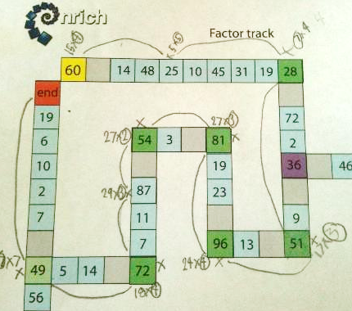
Here is another student’s write up. They needed 10 steps

Slide 14
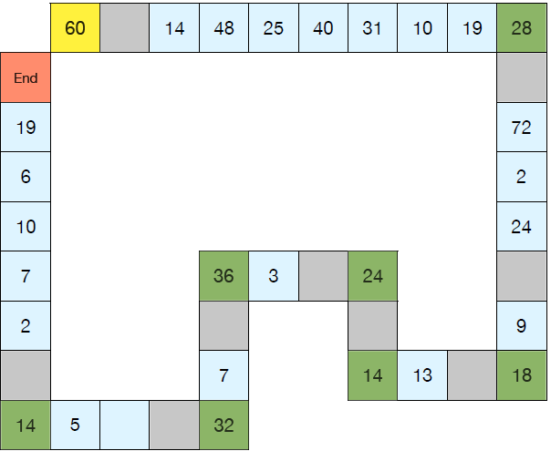
Notes:
Easier factor track

Slide 15
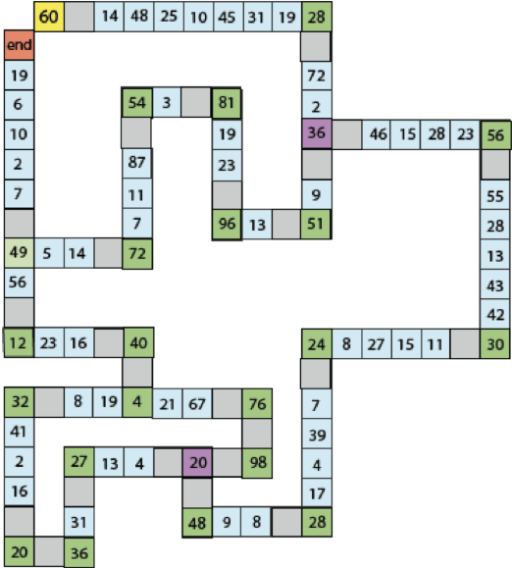
Notes:
Print this for advanced track

