Slide 1
Divisibility
6 and 7 are factors of 42.
42 is said to be divisible by 6
42 is also divisible by 7
On your whiteboard, write down another number that 42 is divisible by.

Slide 2
Divisibility
On your whiteboards:
Write down a number that is divisible by 5.
And another
And another…
Look around the room – what can you say about numbers that are divisible by 5?

Slide 3
Divisibility
On your whiteboards:
Write down a number that is divisible by 10.
And another
And another…
Look around the room – what can you say about numbers that are divisible by 10?

Slide 4
Divisibility
We have looked at two divisibility rules.
Do you know any others?

Slide 5
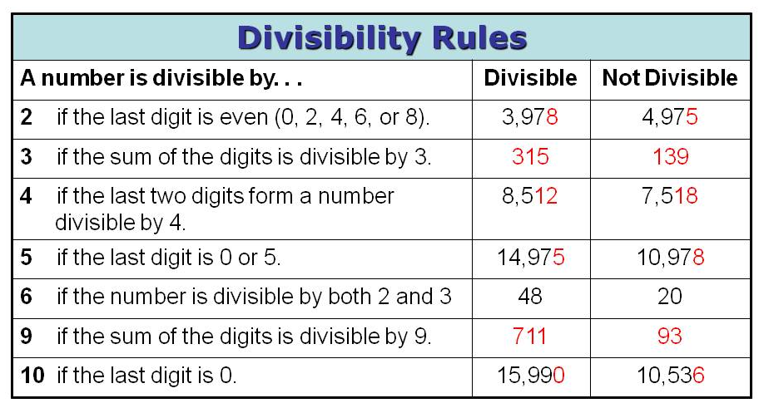

Slide 6
Divisibility
Use the information in the table to answer the questions.
On your whiteboards, show me…
A 3 digit number that is divisible by 5

Slide 7
Divisibility
Use the information in the table to answer the questions.
On your whiteboards, show me…
A 3 digit number that is divisible by 4

Slide 8
Divisibility
Use the information in the table to answer the questions.
On your whiteboards, show me…
A 4 digit number that is divisible by 3

Slide 9
Divisibility
Use the information in the table to answer the questions.
On your whiteboards, show me…
A 4 digit number that is divisible by 9

Slide 10
Divisibility
Use the information in the table to answer the questions.
On your whiteboards, show me…
A 6 digit number that is divisible by 3

Slide 11
Divisibility
Use the information in the table to answer the questions.
On your whiteboards, show me…
A 6 digit number that is divisible by 3 and 2
What other number is this divisible by?

Slide 12
Divisibility
Use the information in the table to answer the questions.
On your whiteboards, show me…
A 5 digit number that is divisible by 9 and 2 and 5
What other number is this divisible by?

Slide 13
Divisibility Puzzles
In your pairs:
What is the number?
It is between 110 and 140
It is divisible by 5 and 9
What strategy did you use to work out your answer?

Slide 14
Divisibility Puzzles
In your pairs:
What is the number?
Is divisible by 4
It is divisible by 3 and 9
The tens digit is double the ones digit.
What strategy did you use to work out your answer?

Slide 15
Divisibility Puzzles
In your pairs:
Find a number that…
Is greater than 200, but less than 1000
Is divisible by 4
The tens digit larger than the ones digit.
How many different answers can you find?

Slide 16


Divisibility Puzzles
In your pairs:
Three different digits are represented by and
The two digit number is divisible by 9
The two digit number is odd and divisible by 5
is divisible by
The three digit number is odd
What are the digits and
Is there more than one solution? How do you know?

Slide 17
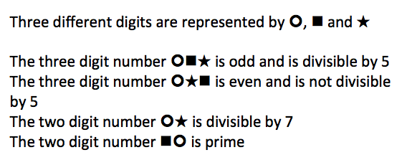
Divisibility Puzzles
What are the digits and
Is there more than one solution? How do you know?

Slide 18
Divisibility Puzzles
In the number
371a175
try to replace a by a digit so that the result is divisible by 3.
Find all possible answers

Slide 19
Answers
3713175,
3716175,
3719175,
and 3710175

Slide 20
Divisibility Puzzles
In the number
72a3b
Replace a and b so that the answer is divisible by 15.
(Think… if a number is divisible by 15, then it is also divisible by…)
How many answers are there?

Slide 21
Answer
72030,
72330,
72630,
72930,
72135,
72435,
72735.

Slide 22
Divisibility Rules
The criterion for divisibility by 11
A natural number is divisible by 11 if the sum of its digits in odd positions minus the sum of its digits in even positions is either equal to zero or divisible by eleven.
Example:
56937142251
is divisible by 11,
because the sum (5+9+7+4+2+1) – (6+3+1+2+5) = 11,
which is divisible by 11.

Slide 23
Divisibility Puzzles
SUPER CHALLENGE
Peter wrote down a three digit number ABC,
Jean added the same digits in the reverse order ABCCBA
Prove that Jean’s number is divisible by 11.

Slide 24
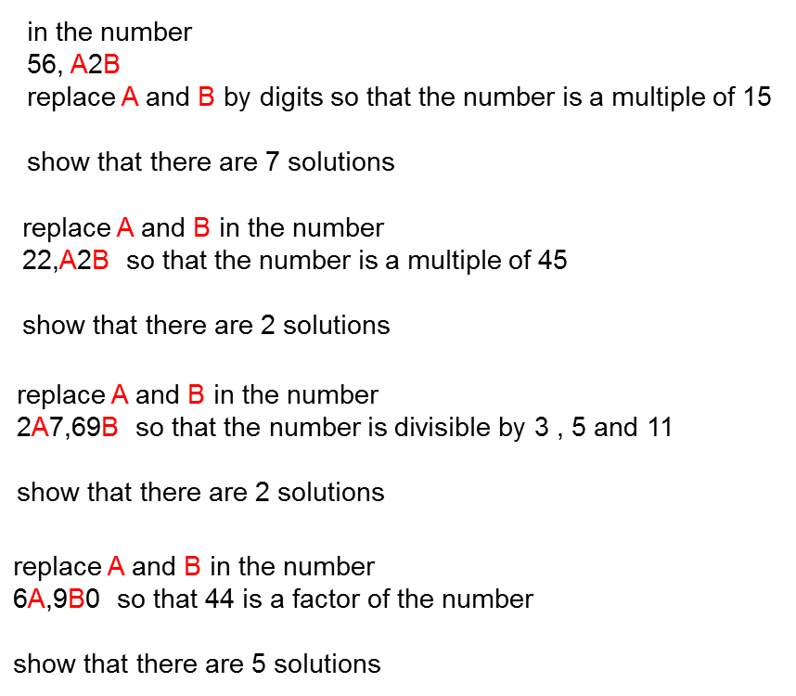
1.
2.
3.
4.
5.

