Slide 1
Faculty Meeting
Keeping on track
New units of work
  Year 7 – Multiplication and area
  Year 8 – Multiplying and factorising with one bracket

Slide 2
Year 7
Starting multiplication and division
Year 8
Starting
Year 9
First week of Angles and Polygons
Year 10
Graphs 1
Year 11
Mock Exams

Slide 3
Thank you for marking and inputting all data so far.
Final Deadlines:
Year 7 Prior knowledge audit
Input by Friday 11th November
Years 7 – 10
Data into Go 4 Schools by Friday 11th November
Year 11 mock
Marked and input by Friday 18th November

Slide 4
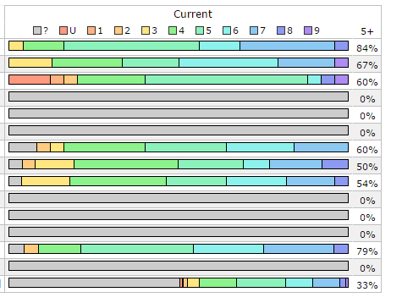
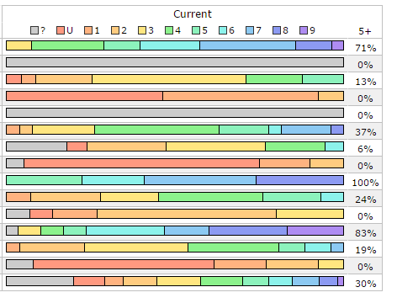

Slide 5
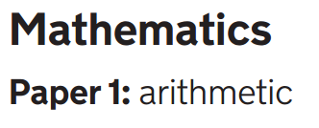
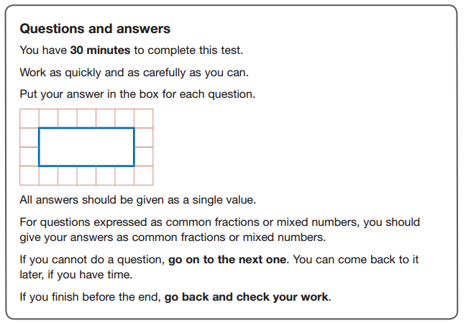

Slide 6
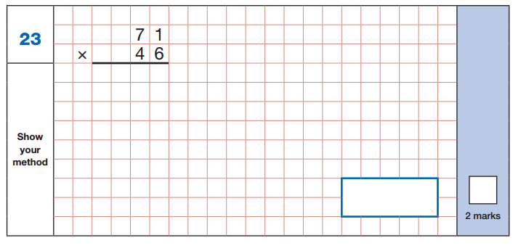
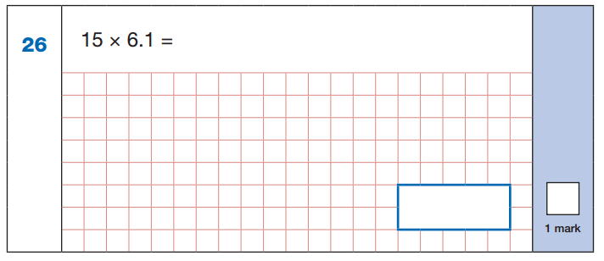

Slide 7
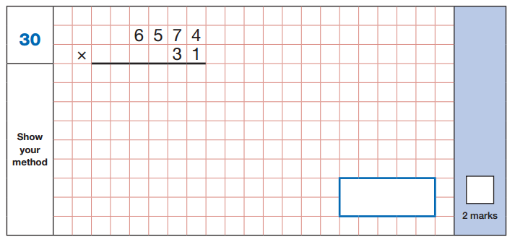
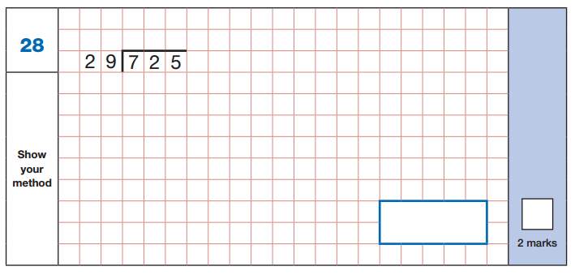

Slide 8
Year 7 will have spent a significant amount of time on long multiplication, so the aim here isn’t to spend lots of time practising unless it is required.
However, it is good to show the different methods so that students know that it’s ok to use any. This is particularly true for EAL students who may have different methods from the ones shown too.
The three methods shown in the lesson on comparing methods are:
Grid method – will be helpful when finding areas/ multiplying brackets/multiplying surds etc.
Standard Algorithm – they may well have been drilled in this, do they understand how it works?
Gelosia/ Chinese/ Lattice method – really quick method that they may not have seen, but many prefer over time.
Moving from Grid to a Column Method
Good Practice in Primary Schools

Slide 9
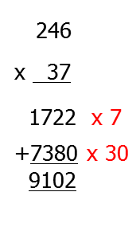
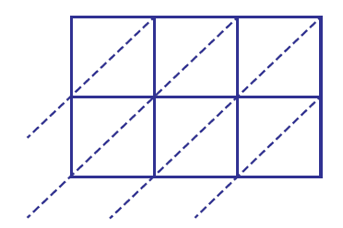
Comparing Methods of Multiplication
x | 200 | 40 | 6
30 | 6000 | 1200 | 180 | 6000+1200+180 = 7380
7 | 1400 | 280 | 42 | 1400+280+42 = 1722
 |  |  |  | Answer= 9102
3
4
+
1
1
1
1
2 4 6
6
0
1
1
What’s the same?
What’s different?
6
2
8
3
7
1
2
4
Answer is 9102
9
4
8
2
2
1
0
2
1
2
2
Notes:
Good practice in primary mathematics: evidence from 20 successful schools Nov 2011 Ofsted
http://www.ofsted.gov.uk/resources/good-practice-primary-mathematics-evidence-20-successful-schools

Slide 10
Year 7 Scheme overview
Year 8 Scheme overview

Slide 11
Always a multiple introduction video.
On your whiteboards:
Think of a two-digit number and write it down.
Reverse the digits and add your answer to your original number.
What answers did you get?
Look around the room
What do you notice?

Slide 12
On your whiteboards:
Think of a two-digit number and write it down.
Reverse the digits and add your answer to your original number.
What answers did you get?
Look around the room
What do you notice?

Slide 13
In your pairs:
Without trying all possible two-digit numbers, try to find a convincing explanation why it will always work.

Slide 14
Alison’s explanation
Charlie’s explanation

Slide 15
In your pairs:
Choose one of the problems below to investigate.
Take any two-digit number. Reverse the digits, and subtract your answer from your original number. What do you notice? | Take any two-digit number. Add its digits, and subtract your answer from your original number. What do you notice?
Take any three-digit number. Reverse the digits, and subtract your answer from your original number. What do you notice? | Take any five-digit number. Reverse the digits, and subtract your answer from your original number. What do you notice?

Slide 16
x + y = xy
What does this statement say in words?
Do you think it is true?

Slide 17
x + y = xy
Can you find any values of x and y which will prove that the statement is not always true?

Slide 18
x + y = xy
Can you spot any values that make the statement true?

Slide 19
x + y = xy
We have found that this statement is SOMETIMES TRUE

Slide 20
You will now consider a collection of statements in a similar way.
The objective of the session is for each pair to produce a poster which shows each statement classified according to whether it is always true, sometimes true, or never true

Slide 21
If it is sometimes true, then write examples around the statement to show when it is true and when it is not true;
if it is always true, then to give a variety of examples demonstrating that it is true, using large numbers, decimals, fractions and negative numbers if possible;
if it is never true, then to say how we can be sure of this.

