Slide 1
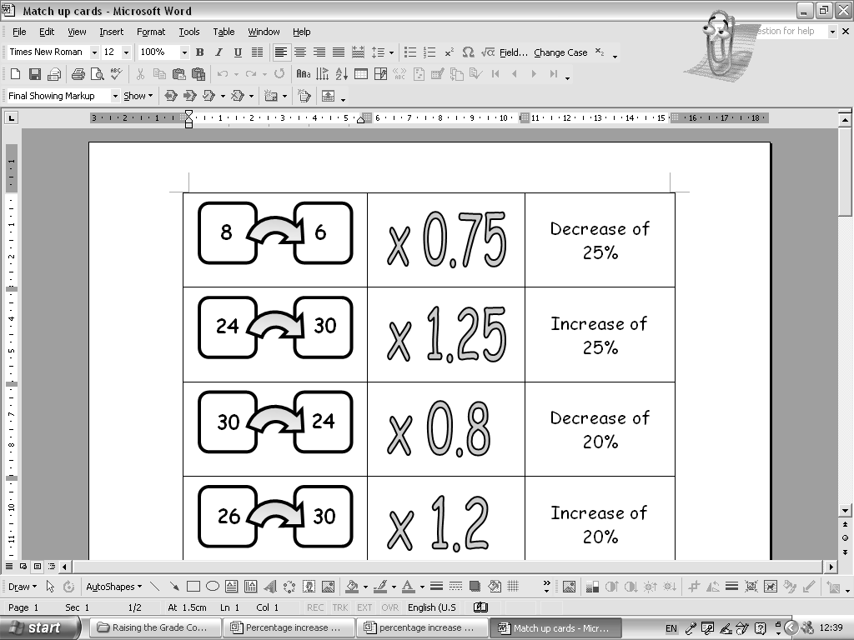
Sort the cards into groups of three
Now complete the rest.

Slide 2
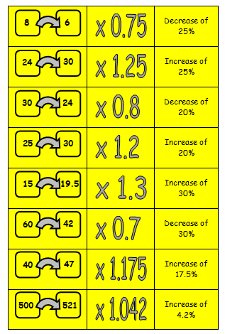

Slide 3
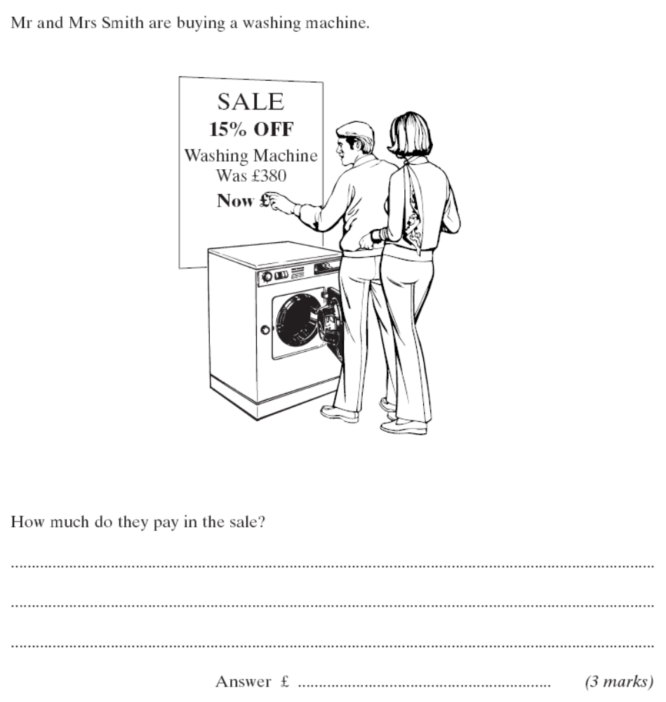
380
323
x0.85

Slide 4
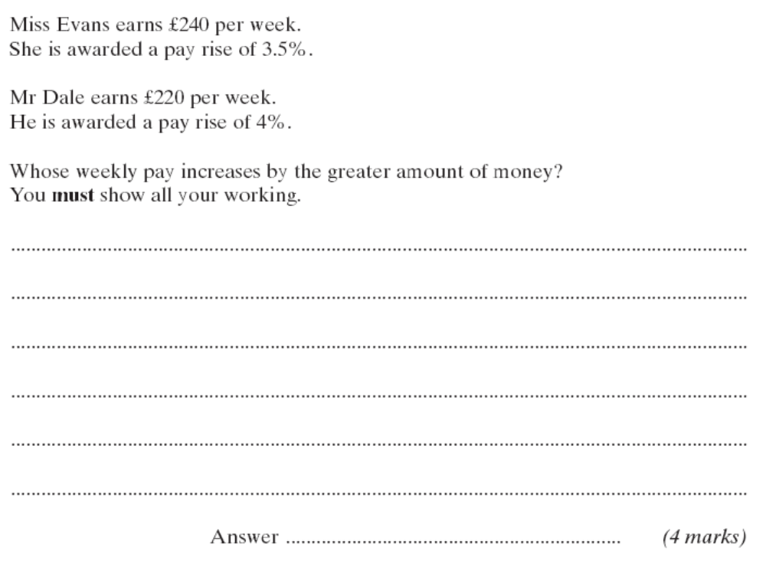
240
x1.035
248.40
220
x1.04
228.80
An increase of £8.40
An increase of £8.80
Mr Dale

Slide 5
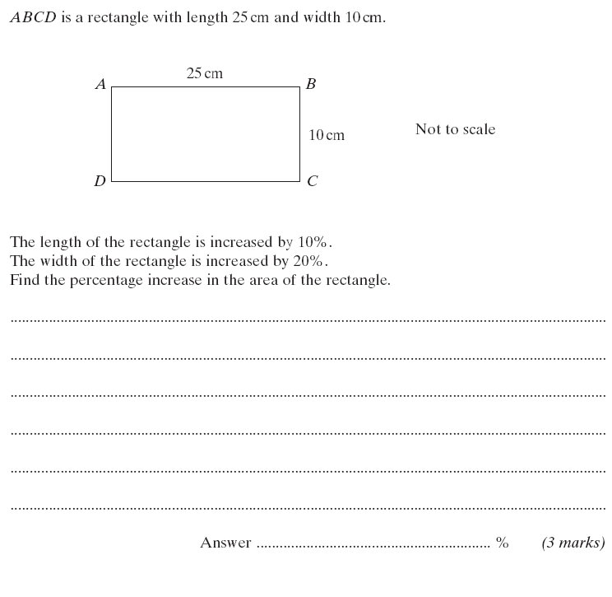
25
27.5
10
12
x1.1
x1.2
Old Area = 25 x 10 = 250cm²
New Area = 27.5 x 12 = 330cm²
80cm²

Slide 6
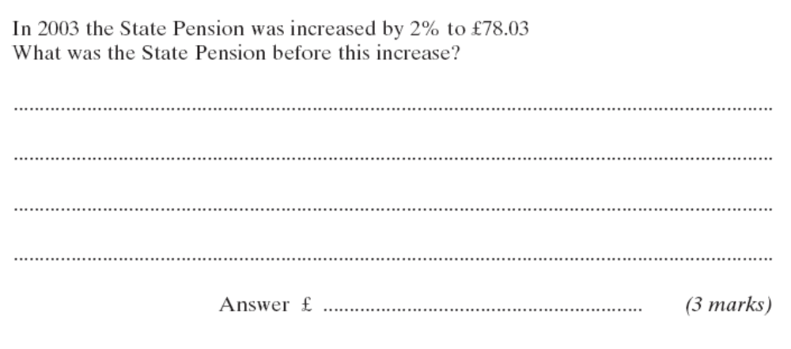
This one is a bit different. How?
76.50
78.03
x1.02
Going backwards: 78.03 ÷ 1.02

Slide 7
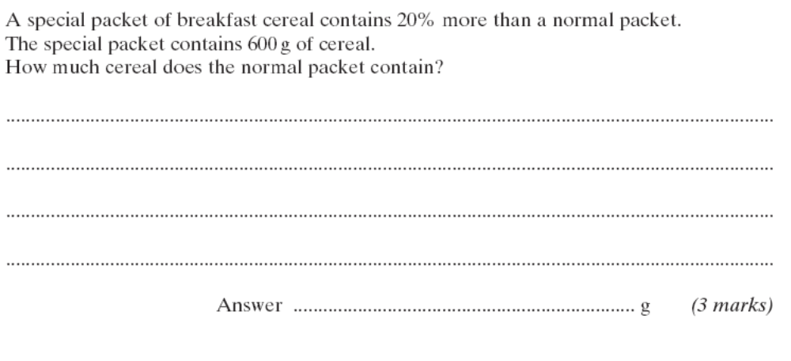
500
x1.2
600
Going backwards: 600 ÷ 1.2

Slide 8
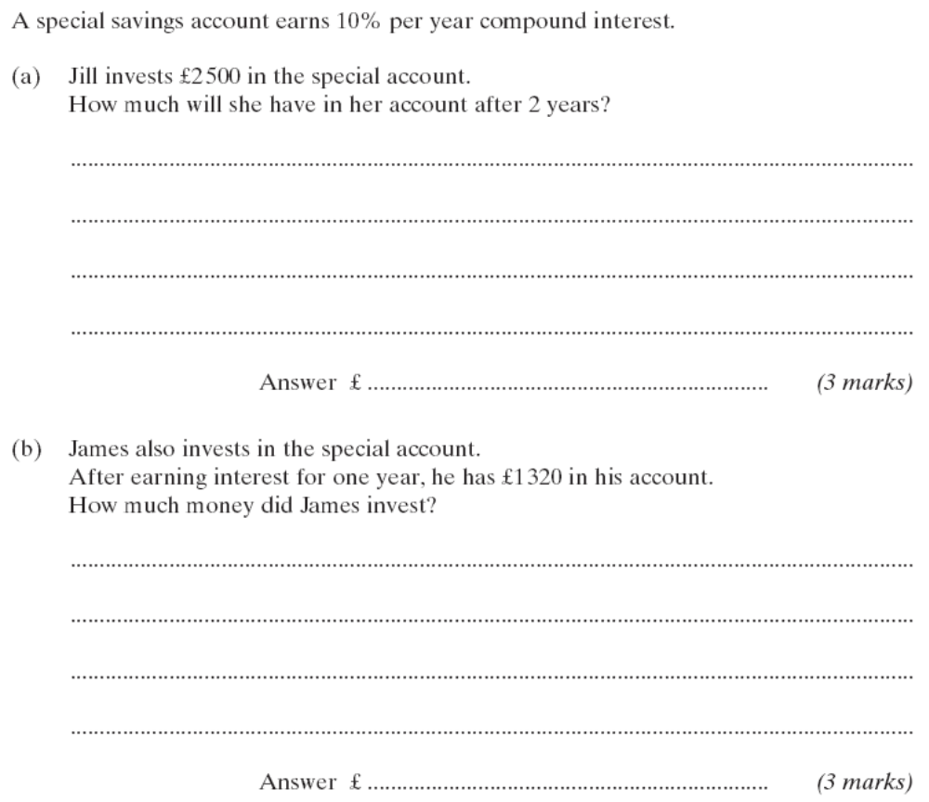
1200
1320
x1.1
Going backwards: 1320 ÷ 1.1

Slide 9
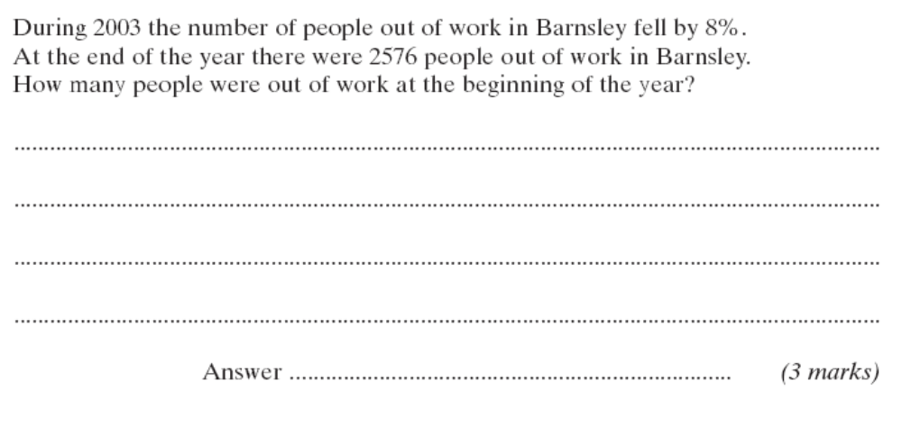
2800
2576
x0.92
Going backwards: 2576 ÷ 0.92

