Slide 1
Starter:
There are 25 prime numbers under 100.
Write them down on your whiteboard.

Slide 2
The Fundamental Theorem of Arithmetic
The Basic Idea
The Basic Idea is that any integer above 1 is either a Prime Number, or can be made by multiplying Prime Numbers together, also known as Prime Number Decomposition
So:
2 is prime
3 is prime
4 = 2 x 2
5 is prime
6 is 2 x 3
…

Slide 3
Prime Number Decomposition
Some Prime number decompositions are easy:
For example
Which prime numbers multiply together to make 15?
Which prime numbers multiply together to make 21?
Others are a bit more difficult.
We can use factor trees to work it out…

Slide 4


Factor Trees
60
12
5
Can you write your answer in a different way?
3
4
2
2
2 2 3 5
x
x
x

Slide 5
72
Can you write your answer in a different way?
8
9
2
3
4
3
2
2
x
x
x
x

Slide 6
360

Slide 7
261
Can’t find a factor?
Hint:
Can you remember divisibility rules from year 7?
What do the digits add up to?

Slide 8
In how many different ways can you find the prime number decomposition of
90
How do you know you have got all of the different ways?

Slide 9
In your books…
Find the prime number decomposition of:
a) 24 b) 48 c) 96
d) What do you notice about the last three answers?
Can you explain why that has happened?
Without using a ‘tree’ and using the answers above, can you write down the prime number decompositions of:
a) 12 b) 36 c) 108
Find the prime number decomposition of:
a) 80 b) 64 c) 125 d) 1225 e) 624

Slide 10
Challenge questions
135000 = 2ª x 3^{b} x 5^{c}
What are the values of a, b and c?
If 45 = 3² x 5, what is 45² written as a product of its prime factors?
6. If x = 2² x 5² x 11⁴, which of the below is the square root of x?
a) 110 b) 128 c) 1210 d) 732 050

Slide 11
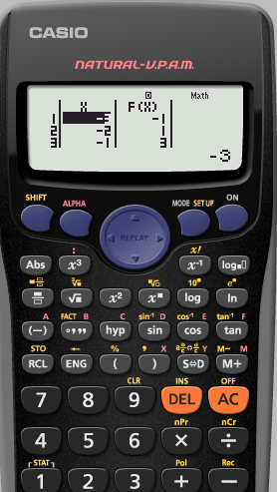
If you have the CASIO calculator that we recommend, you can actually check your answers on your calculator using the FACT button.
Can you find it?
Press your number, then the = button.
Now press SHIFT then FACT.
Use it to check your answers for question 3.

