Slide 1
Use your knowledge of times tables to calculate the following:
7 x 6 =
(7 x 2) + (7 x 4) =
(7 x 1) + (7 x 5) =
(3 x 6) + (4 x 6)
(2 x 6) + (5 x 6)
(3 x 2) + (3 x 4) + (4 x 2) + (4 x 4) =
Use arrays to see why all of these give the same answer

Slide 2
7 x 6 =

Slide 3
(7 x 2) + (7 x 4) =
7
2
4

Slide 4
(7 x 1) + (7 x 5) =
7
1
5

Slide 5
(3 x 6) + (4 x 6)
3
4
6

Slide 6
(2 x 6) + (5 x 6)
2
5
6

Slide 7
(3 x 2) + (3 x 4) + (4 x 2) + (4 x 4) =
3
4
2
4

Slide 8
How many different ways can you get the answer 234 by partitioning 18 x 13 ?
18
13

Slide 9
If you were asked to find 18 x 13 in your head, which would be the best way to partition?
10
8
10
100
80
3
30
24

Slide 10
Instead of drawing an array, which is very time consuming, a grid could be used instead.
10
8
10
1 0 0
8 0
3
3 0
2 4

Slide 11
Using a grid show that 18 x 13 = 234
10
8
10
1 0 0
8 0
1 8 0
3
3 0
2 4
5 4
2 3 4

Slide 12
On your whiteboards:
Show me a grid you would use to partition:
45 x 78

Slide 13
On your whiteboards:
Show me a grid you would use to partition:
45 x 79

Slide 14
On your whiteboards:
Show me a grid you would use to partition:
44 x 79

Slide 15
On your whiteboards:
Show me a grid you would use to partition:
144 x 79

Slide 16
On your whiteboards:
Show me a grid you would use to partition:
144 x 279

Slide 17
On your whiteboards:
Now work out:
246 x 37

Slide 18
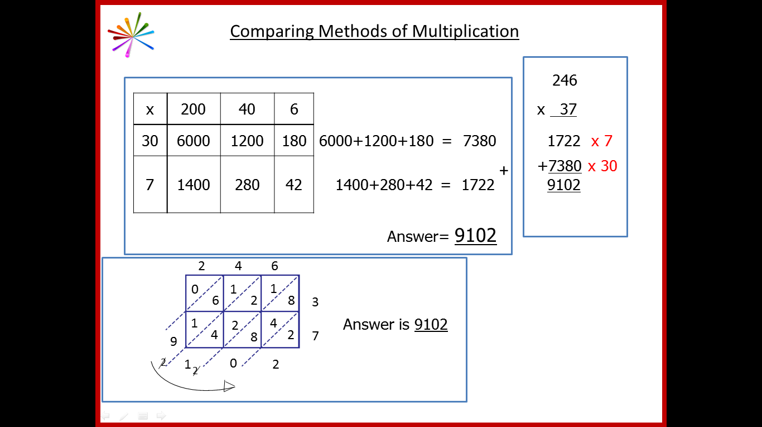
Comparing Methods of Multiplication
Let’s check your answer
x | 200 | 40 | 6
30 | 6000 | 1200 | 180 | 6000+1200+180 = 7380
7 | 1400 | 280 | 42 | 1400+280+42 = 1722
 |  |  |  | Answer= 9102
3
4
+
1
1
1
1
At primary school, you will have learnt long multiplication using the standard algorithm
What’s the same?
What’s different?
Notes:
Good practice in primary mathematics: evidence from 20 successful schools Nov 2011 Ofsted
http://www.ofsted.gov.uk/resources/good-practice-primary-mathematics-evidence-20-successful-schools

Slide 19
Comparing Methods of Multiplication
Where can you see…
x | 200 | 40 | 6
30 | 6000 | 1200 | 180 | 6000+1200+180 = 7380
7 | 1400 | 280 | 42 | 1400+280+42 = 1722
 |  |  |  | Answer= 9102
3
4
+
1
1
1
1
6 x 7 in each method?
Notes:
Good practice in primary mathematics: evidence from 20 successful schools Nov 2011 Ofsted
http://www.ofsted.gov.uk/resources/good-practice-primary-mathematics-evidence-20-successful-schools

Slide 20
Comparing Methods of Multiplication
Where can you see…
x | 200 | 40 | 6
30 | 6000 | 1200 | 180 | 6000+1200+180 = 7380
7 | 1400 | 280 | 42 | 1400+280+42 = 1722
 |  |  |  | Answer= 9102
3
4
+
1
1
1
1
30 x 6 in each method?
Notes:
Good practice in primary mathematics: evidence from 20 successful schools Nov 2011 Ofsted
http://www.ofsted.gov.uk/resources/good-practice-primary-mathematics-evidence-20-successful-schools

Slide 21
Comparing Methods of Multiplication
Where can you see…
x | 200 | 40 | 6
30 | 6000 | 1200 | 180 | 6000+1200+180 = 7380
7 | 1400 | 280 | 42 | 1400+280+42 = 1722
 |  |  |  | Answer= 9102
3
4
+
1
1
1
1
7 x 200 in each method?
Notes:
Good practice in primary mathematics: evidence from 20 successful schools Nov 2011 Ofsted
http://www.ofsted.gov.uk/resources/good-practice-primary-mathematics-evidence-20-successful-schools

Slide 22
Comparing Methods of Multiplication
Where can you see…
x | 200 | 40 | 6
30 | 6000 | 1200 | 180 | 6000+1200+180 = 7380
7 | 1400 | 280 | 42 | 1400+280+42 = 1722
 |  |  |  | Answer= 9102
3
4
+
1
1
1
1
Why is it difficult to see 30 x 200 in the standard algorithm?
Notes:
Good practice in primary mathematics: evidence from 20 successful schools Nov 2011 Ofsted
http://www.ofsted.gov.uk/resources/good-practice-primary-mathematics-evidence-20-successful-schools

Slide 23
On your whiteboards in your pairs:
32 x 68
You must show your answer using both the column method and the standard algorithm.
When you are happy with the answer, copy both into your books as an explanation of how to use both methods.
You should write it as if you are explaining the methods to someone who wasn’t in today’s lesson

Slide 24
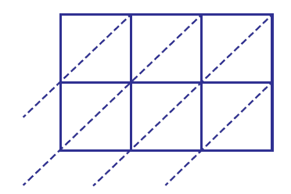
Chinese Lattice Multiplication
246 x 37 =
Video

Slide 25
Comparing Methods of Multiplication
x | 200 | 40 | 6
30 | 6000 | 1200 | 180 | 6000+1200+180 = 7380
7 | 1400 | 280 | 42 | 1400+280+42 = 1722
 |  |  |  | Answer= 9102
3
4
+
1
1
1
1
2 4 6
6
0
1
1
What’s the same?
What’s different?
6
2
8
3
7
1
2
4
Answer is 9102
9
4
8
2
2
1
0
2
1
2
2
Notes:
Good practice in primary mathematics: evidence from 20 successful schools Nov 2011 Ofsted
http://www.ofsted.gov.uk/resources/good-practice-primary-mathematics-evidence-20-successful-schools

Slide 26
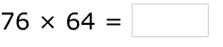
Comparing Methods of Multiplication
Can you use all three methods to calculate the answer to this?

Slide 27
