Slide 1
Multiplication Vocabulary
3 x 4
There are 3 in each group
3 is the multiplicand
There are 4 of these groups
4 is the multiplier
The product is 12
3
×
4

Slide 2
Commutative Law
3 x 4
3
×
4
4
×
3
What calculation does this represent now?

Slide 3
Multiplication Vocabulary
4 x 3
There are 4 in each group
4 is the multiplicand
There are 3 of these groups
3 is the multiplier
What happens to the
product?
4
×
3

Slide 4
On whiteboards…
6 X 4
What calculation does this represent?
What is the multiplicand?
What is the multiplier?
What is the product?
What other calculation is this the same as this?

Slide 5
On whiteboards…
6 X 4
6 X 5
How does the calculation change if we add another row?
The multiplier increases by 1
The product increases by 6

Slide 6
On whiteboards…
6 X 4
7 X 4
How would you change the array if the multiplicand had been increased by 1?

Slide 7
On whiteboards…
6 X 4
5 X 4
How would you change the array if the multiplicand had been decreased by 1?

Slide 8
On whiteboards…
If you know
8 x 4 = 32
What else do you know?
(Think about how you can alter the array)

Slide 9
On whiteboards…
If you know
23 x 5 = 115
What else do you know?

Slide 10
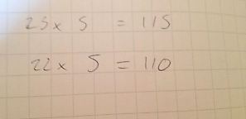
On whiteboards…
If you know 23 x 5 = 115
Sophie wrote…
Is she correct?
What do you think she has done?

Slide 11
On whiteboards…
If you know
56 x 4 = 224
What else do you know?
Can you work out 56 x 8 using this?
Can you use an array to help you work this out?

Slide 12
And finally…
If you know
326 x 32 = 10 432
What else do I know?
What other impressive multiplication facts can you give?

Slide 13
326 x 32 = 10 432
A selection of some you might have found
32 x 326 = 10 432
326 x 16 = 5216
326 x 64 = 20864
326 x 33 = 10 758
327 x 32 = 10 464

Slide 14
Challenge
True or False
7 x 6 = 7 x 5 + 7
Can you explain your reasoning?

Slide 15
Challenge
True or False
9 x 12 = 12 x 10 - 12
Can you explain your reasoning?

Slide 16
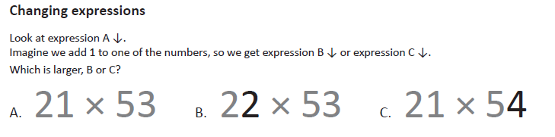
Challenge

