Slide 1
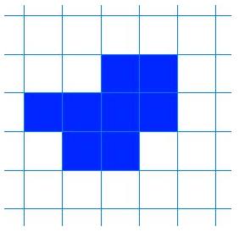
On your squared paper, shade in squares to make a different shape with the same area as mine

Slide 2
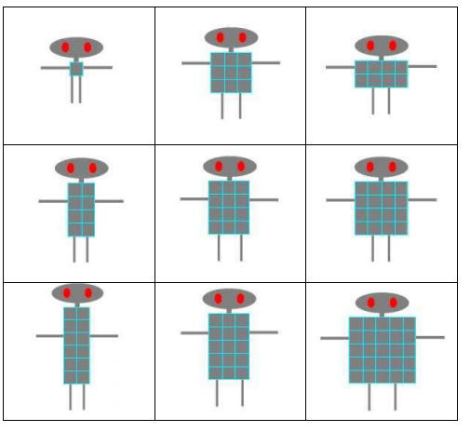
On this picture the robots have been arranged according to two of their attributes.
Can you work out how they have been arranged?

Slide 3
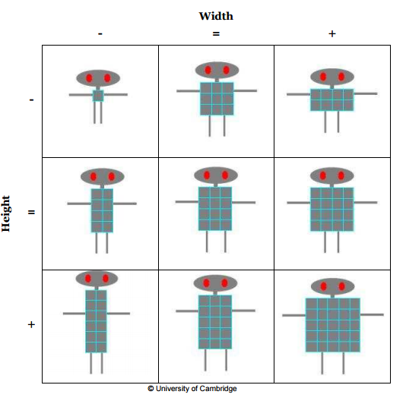

Slide 4
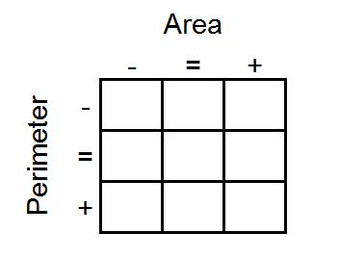

Slide 5
