Slide 1
Find the area
On your whiteboards…
6cm
3cm

Slide 2
On your whiteboards…
Find the area
5cm
9cm

Slide 3
On your whiteboards…
Find the area
4cm
4cm
8cm

Slide 4
On your whiteboards…
Find the area
6cm
6cm
What is special about this one?

Slide 5
On your whiteboards…
Find the area
12cm
4cm
4cm
12cm

Slide 6
On your whiteboards…
Find the area
7cm
30mm
What is different here?

Slide 7
On your whiteboards…
Find the area
8cm
50mm

Slide 8
Find the area
On your whiteboards…
5cm
0.2m

Slide 9
On your whiteboards…
Find the area
24cm²
? cm
8cm
How did you work it out?

Slide 10
What about if the multiplication is more difficult?
10cm
18cm
8cm
10cm
100cm²
80cm²
14cm
252cm²
4cm
40cm²
32cm²
What calculation do you need to do?
Could you use what we did in a previous lesson to help?
Let’s partition the rectangle to help

Slide 11
Find the area of the following rectangles (using partitioning to help).
Draw them into your books.
52cm
46cm
13cm
27cm

Slide 12
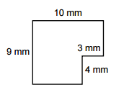
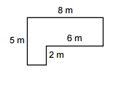
Challenge:
Could you partition these shapes to find their areas?

Slide 13
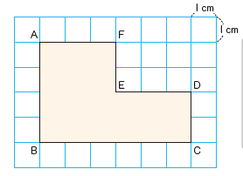
How could we find the area of this shape?
Can we calculate its area using what we have done so far?
We can partition the shape to make it easier
How many ways are there to do this?

Slide 14
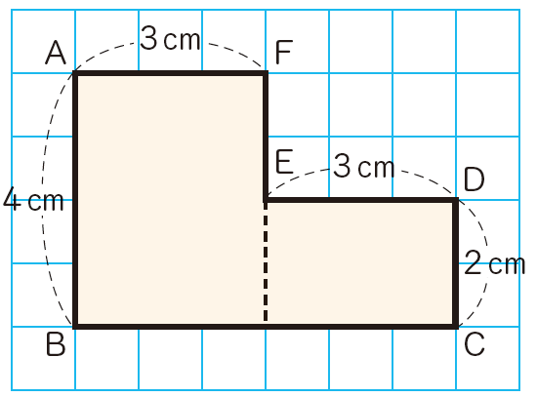
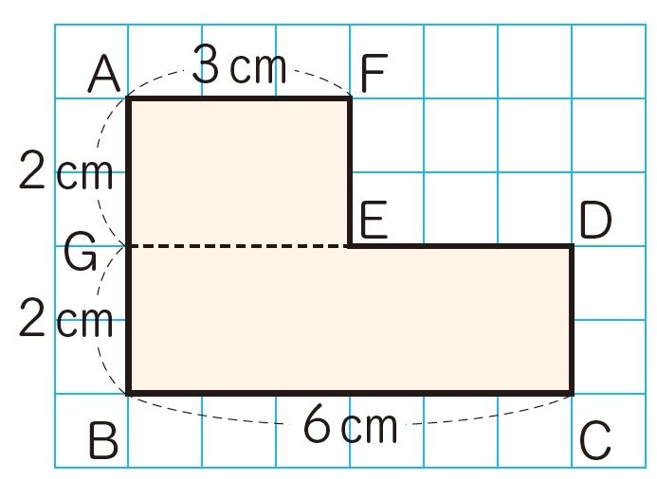
This is how two students partitioned their shapes.
What are the calculations for each?
Do they give the same final area?
Is there another way?

Slide 15
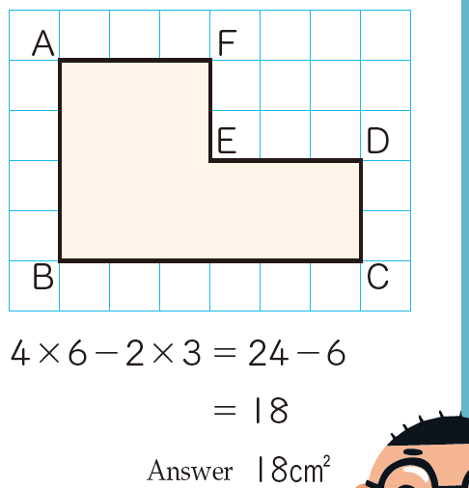
How did this student find the area of their shape?

Slide 16
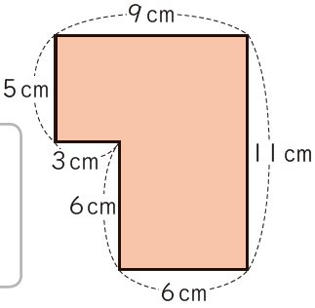
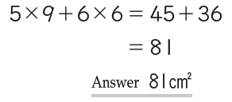
Question 1.
Look at the working out below.
a) Can you explain how the shape was partitioned to find the area
b) Find the area using a different method

Slide 17
Question 2.
Find the area of these shapes in as many different ways as possible.

Slide 18
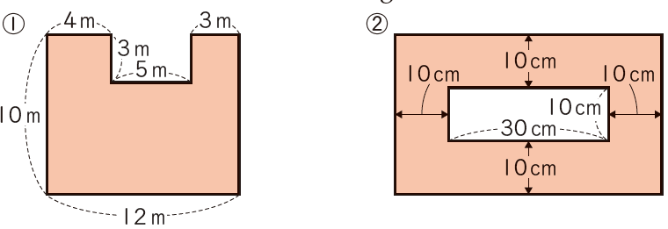
Question 3.
Find the area of these shapes in as many different ways as possible.

Slide 19
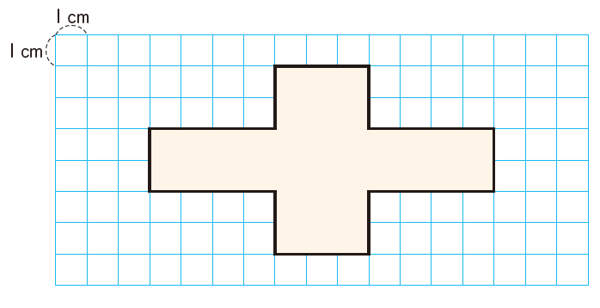
Question 4.
Find the area of this shape in as many different ways as possible.

