Slide 1
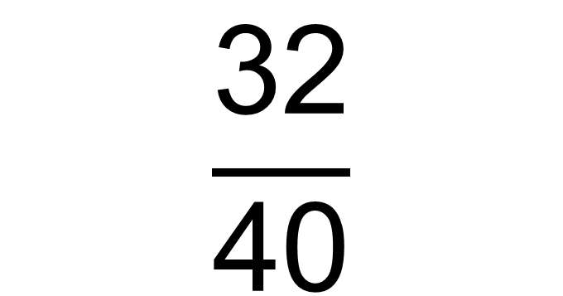
How would you cancel down this fraction?
$$\frac{\text{32}}{\text{40}}$$

Slide 2
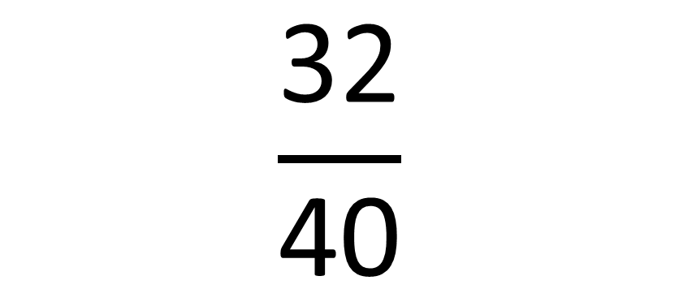
Write the numerator and denominator as a product of prime factors (not in index form)
$$\frac{\text{32}}{\text{40}}$$

Slide 3
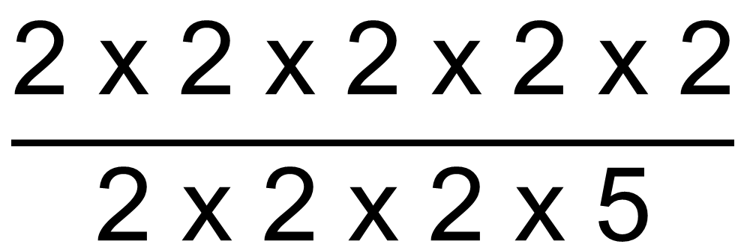
Write the numerator and denominator as a product of prime factors (not in index form)
$$\frac{\text{2 }\text{x}\text{ 2 }\text{x}\text{ 2 }\text{x}\text{ 2 }\text{x}\text{ 2}}{\text{2 }\text{x}\text{ 2 }\text{x}\text{ 2 }\text{x}\text{ 5}}$$
How can this help you to cancel down?

Slide 4
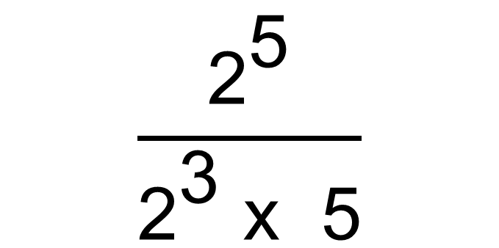
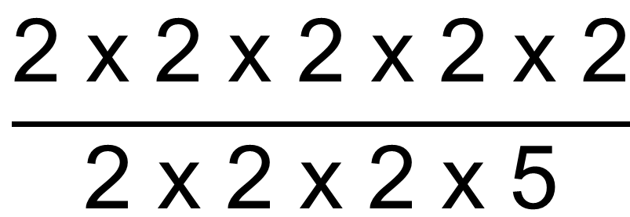
What if it was written in index form?
$$\frac{{\text{2}}^{\text{5}}}{{\text{2}}^{\text{3}} \text{x}\text{ 5}}$$
$$\frac{\text{2 }\text{x}\text{ 2 }\text{x}\text{ 2 }\text{x}\text{ 2 }\text{x}\text{ 2}}{\text{2 }\text{x}\text{ 2 }\text{x}\text{ 2 }\text{x}\text{ 5}}$$
What power of 2 will you be left with?

Slide 5








On your whiteboards:
$$\frac{{\text{2}}^{\text{7}}}{{\text{2}}^{\text{2}} }$$
7
3
a
a
$$÷$$
m
n
6
6
6
2
$$÷$$
2
2
$$÷$$
7
m
n
5
5
y
y
$$÷$$
$$÷$$
$$\frac{{\text{2}}^{\text{6}}}{{\text{2}}^{\text{5}} }$$
$$\frac{{\text{y}}^{\text{m}}}{{\text{y}}^{\text{n}} }$$

Slide 6

True or False?
9
3
6
2
2
2
$$÷$$
=

Slide 7

True or False?
6
5
y
y
y
$$÷$$
=

Slide 8

True or False?
6
3
3
4
2
4
$$÷$$
=

Slide 9
True or False?
6
3
2
a
a
a
$$÷$$
=

Slide 10

True or False?
6
3
3
4a
2a
2a
$$÷$$
=

Slide 11
True or False?
3
5
2
2
2
2
$$÷$$
=

Slide 12
True or False?
3
3
1
2
2
$$÷$$
=

Slide 13




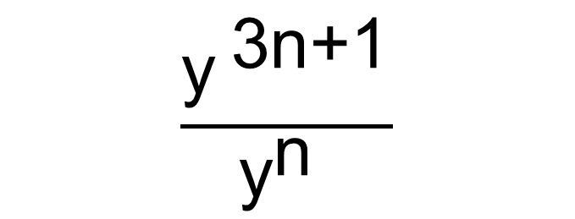
In your books:
$$\frac{{\text{3}}^{\text{7}}}{{\text{3}}^{\text{3}} }$$
½
6
a
a
$$÷$$
$$\frac{{\text{(}\text{a}\text{ + }\text{b}\text{)}}^{\text{m}}}{{\text{(}\text{b}\text{ + }\text{a})}^{\text{n}} }$$
6
2
a
a
$$÷$$
7
5
5
$$÷$$
$$\frac{{\text{y}}^{ \text{3}\text{n}\text{+1}}}{{\text{y}}^{\text{n}} }$$
8
6
(0.2)
(1/5)
$$÷$$

Slide 14






Recap:
6
2
4
4
$$÷$$
=
9
a
a
$$÷$$
=
8
4
3
(a
a )
a
$$÷$$
$$÷$$
=
3m
m
y
y
$$÷$$
=
4
2
1
2
$$÷$$
=

Slide 15
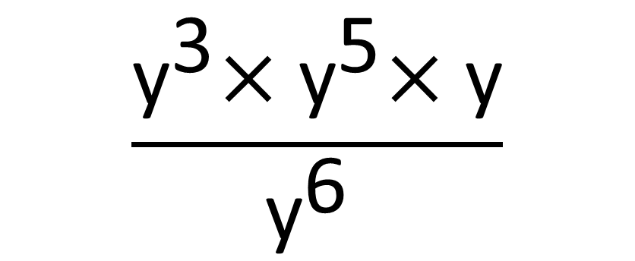
Challenge:
Simplify
$$\frac{{\text{y}}^{\text{3}}\text{×} {\text{y}}^{\text{5}}\text{×} \text{y}}{{\text{y}}^{\text{6}} }$$

Slide 16
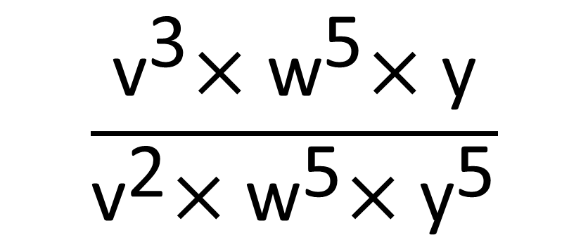
Challenge:
Simplify
$$\frac{{\text{v}}^{\text{3}}\text{×} {\text{w}}^{\text{5}}\text{×} \text{y}}{{\text{v}}^{\text{2}}\text{×} {\text{w}}^{\text{5}}\text{×}{ \text{y}}^{\text{5}}}$$

Slide 17
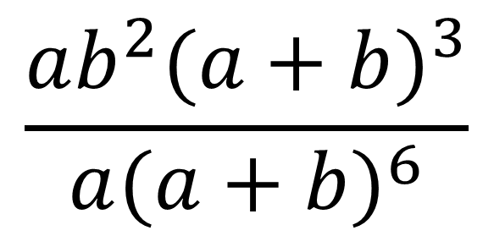
Challenge:
Simplify
$$\frac{ab^{2}{(a+b)}^{3}}{a{(a+b)}^{6}}$$

Slide 18
Challenge:
Write three challenges of your own.
Write them in order of increasing difficulty.
Why have you ordered them in the way that you have?

