Slide 1

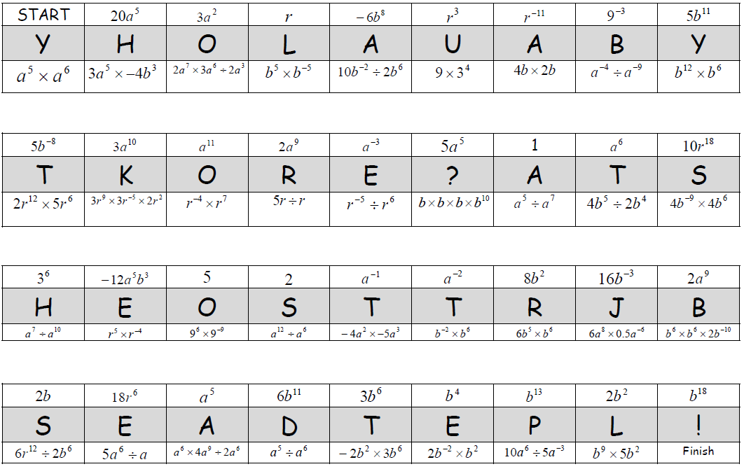
a¹¹
-12a⁵b³
3a¹⁰
1
5b⁻⁸
3⁶
8b²
a⁵
b¹⁸
10r¹⁸
18r⁶
r³
5
r⁻ ⁻¹¹
b¹³
a⁻²
2b
16b⁻³
2a¹⁰
a⁻³
r
9⁻³
a⁶
20a⁵
b⁴
6b¹¹
3a²
2b²
6b¹² ÷ 2b⁶
2a⁵
3b⁶
5a⁵
2a¹⁰
a⁻¹
-6b⁸
2
2a⁹
5b¹¹

Slide 2
1
10
24
12
20
3
6
31
35
a¹¹
-12a⁵b³
3a¹⁰
1
5b⁻⁸
3⁶
8b²
a⁵
b¹⁸
You heard the latest stats joke? Probably!
21
25
2
29
5
27
13
17
22
10r¹⁸
18r⁶
r³
5
r⁻ ⁻¹¹
b¹³
a⁻²
2b
16b⁻³
4
11
30
16
9
14
7
23
33
2a⁹ (2nd)
a⁻³
r
9⁻³
a⁶
20a⁵
b⁴
6b¹¹
3a²
2b²
18
26
32
8
19
15
28
34
36
6b¹² ÷ 2b⁶
2a⁵
3b⁶
5a⁵
2a¹⁰
a⁻¹
-6b⁸
2
2a⁹
5b¹¹

