Slide 1
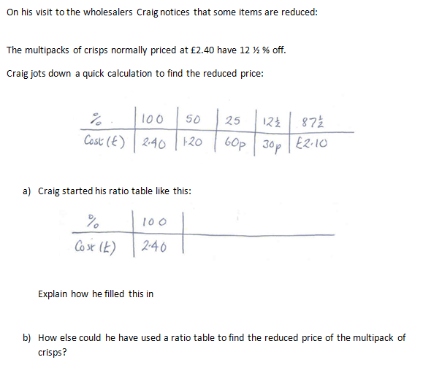
£2.40
£2.10
X0.875
What if Craig doesn’t have a calculator?

Slide 2
Explain how he filled it in

Slide 3
In 2015 a car cost £12500.
In 2016, the cost has risen by 12%
What percentage is there once 12% has been added?
112%
Draw a ratio table to find the cost in 2016
Percentage | 100% |  |  | 112%
Price (£) | 12500 |  |  | ?
(You can add more columns if you need to)

Slide 4
In 2015 a car cost £12500.
In 2016, the cost has risen by 12%
Percentage | 100% | 112%
Price (£) | 12500 | ?
X 1.12
What if we had a calculator?
What would the multiplier be?

Slide 5
In 2015 a season ticket cost £780.
In 2016, the cost has risen by 6%
Percentage | 100% | 106%
Price (£) | 12500 | ?
X 1.06
What would the multiplier be?

Slide 6
Complete these sentences:
1. To find a 15% increase, the multiplier is…
2. To find a 22% increase, the multiplier is…
3. To find a 6% increase, the multiplier is…
4. To find a 2.5% increase, the multiplier is…
5. To find a 150% increase, the multiplier is…

Slide 7
On your whiteboards:
Use your calculator to increase £200 by 7%
£200
£214
X1.07

Slide 8
On your whiteboards:
Use your calculator to increase £258 by 12%
258
288.96
X1.12

Slide 9
On your whiteboards:
Use your calculator to increase £81 by 6%
81
85.86
x 1.06

Slide 10
On your whiteboards:
Use a ratio table to increase £36 by 15%
Percentage | 100% |  |  | 115%
Price (£) | 36 |  |  | ?
(You can add more columns if you need to)

Slide 11
On your whiteboards:
Use a ratio table to increase £304 by 35%
Percentage | 100% |  |  | 135%
Price (£) | 36 |  |  | ?
(You can add more columns if you need to)

Slide 12
Complete the worksheet by finding the percentage increase or decrease using a ratio table (without a calculator) and a multiplier (with a calculator).
*Be careful to check whether it is a percentage increase or decrease.

Slide 13
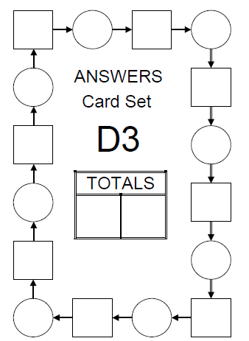
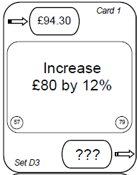
Find Card 1…
Write your card number here
1
Work out the answer on your whiteboard.
Find the answer which will appear at the top of another card that you have to find then repeat.
When you have found all of the cards, add up the numbers in the squares and write them in one box. Then put the total for the circles
in the other box

