Slide 1
Using a calculator to find percentage decrease
We drew bars to help us find percentage decreases without a calculator:
A washing machine normally costs £320.
How much does it cost in the sale if there is a 12% reduction?
0%
100%
88%
£0
£320
What percentage is left when 12% is removed?
88%

Slide 2
Using a calculator to find percentage decrease
We drew bars to help us find percentage decreases without a calculator:
A washing machine normally costs £320.
How much does it cost in the sale if there is a 12% reduction?
0%
100%
88%
£0
£320
So finding a 12% reduction is the same as finding
88%.
Which is the same as multiplying by 0.88

Slide 3
Using a calculator to find percentage decrease
0%
100%
Complete these sentences:
1. Finding a 15% reduction is the same as finding ………. %,
which is the same as multiplying by …….
2. Finding a 45% reduction is the same as finding ………. %,
which is the same as multiplying by …….
3. Finding a 68% reduction is the same as finding ………. %,
which is the same as multiplying by …….

Slide 4
Using a calculator to find percentage decrease
0%
100%
Complete these sentences:
1. Finding a 15% reduction is the same as finding 85%,
which is the same as multiplying by 0.85
2. Finding a 45% reduction is the same as finding 55%,
which is the same as multiplying by 0.55
3. Finding a 68% reduction is the same as finding 32%,
which is the same as multiplying by 0.32

Slide 5
Using a calculator to find percentage decrease
A washing machine normally costs £320.
How much does it cost in the sale if there is a 12% reduction?
0%
100%
88%
£0
£320
To find a 12% reduction, multiply by 0.88
Original amount
x 0.88
£320
Multiplier

Slide 6
On your whiteboards:
Decrease £200 by 7%
£200
£186
X0.93

Slide 7
On your whiteboards:
Decrease £258 by 12%
258
227.04
X0.88

Slide 8
On your whiteboards:
Decrease £81 by 6%
81
76.14
x 0.94

Slide 9
On your whiteboards:
Decrease £37 by 15%
37
31.45
x0.85

Slide 10
On your whiteboards:
Decrease £304 by 35%
£304
£197.60
X0.65

Slide 11
Pair work:
Rally Coach: Percentage Decrease
In your pairs decide on partner A and partner B.
Partner A – you should answer your first question while partner B watches. Once both of you are happy, put your hand up.
Now Partner B answer your first question while partner A watches. Once you are both happy put your hands up.
Now continue to take it in turns to answer the rest while the ‘coach’ checks the answers, or gives clues.

Slide 12
Silent independent work:
In your books…
For each of the three questions on the sheet:
Draw the boxes diagram, showing the multiplier clearly on the arrow. Is your answer sensible?
Make up your own questions and answer in the same way.

Slide 13
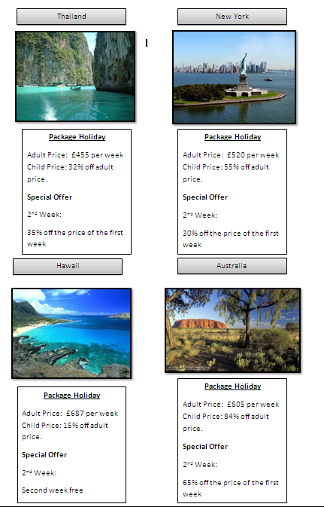
Holiday Challenge
I need some help to book my summer holiday.
There are four possible destinations to choose from but I want to find the cheapest deal.
I want to go away for 2 weeks. The holiday is for 2 adults and 2 children.
Work out the cost of each holiday and decide which is the best value.

Slide 14
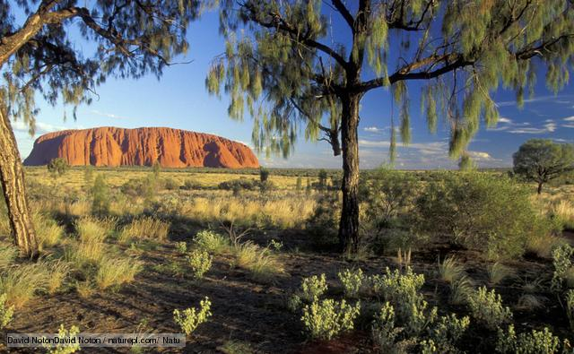


Which holiday?
Thailand - £2522.52
New York - £2563.60
Hawaii - £2541.90
Australia - £2521.26
Cheapest holiday is Australia at £2521.26 for 2 adults and 2 children for 2 weeks.

