Slide 1
Faculty Meeting
Keeping on track
PiXL Curve targetted questions:
  Trigonometry – The unit circle
  Ratio tables

Slide 2
Year 7
Between Cryptarithms and Charges
Year 8
Between Best Buys and Percentage Decrease
Year 9
First week of Angles and Polygons
Year 10
First week of Factors, Powers and Roots

Slide 3
PiXL Curve
June 2016

Slide 4
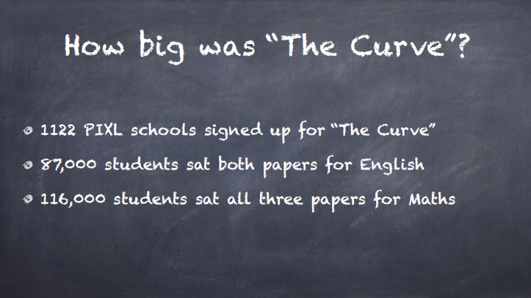

Slide 5


Slide 6
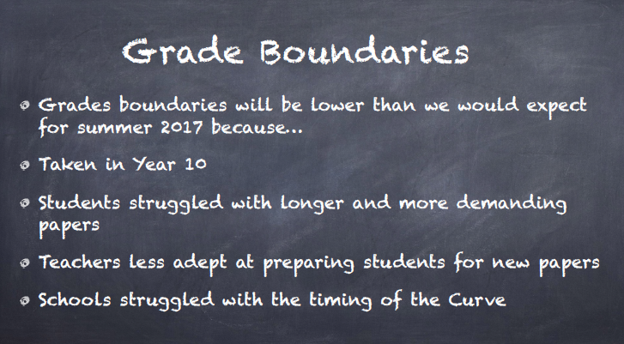

Slide 7
Foundation (out of 240) Higher
0-10 = U, 0-10 = U,
11-33 = '1', 11-25 = '4',
34-57 = '2', 26-41 = '5',
58-81 = '3', 41-71 = '6',
82-105 = '4', 72-104 = '7',
106-240 = '5'. 105-137 = '8',
138-240 = '9'.

Slide 8
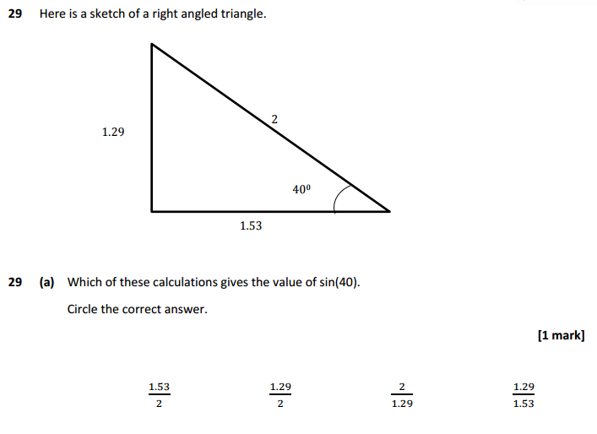
From PiXL Curve Paper 1 F & H
73% Zero marks F (Q29)
34% Zero marks H (Q9)

Slide 9
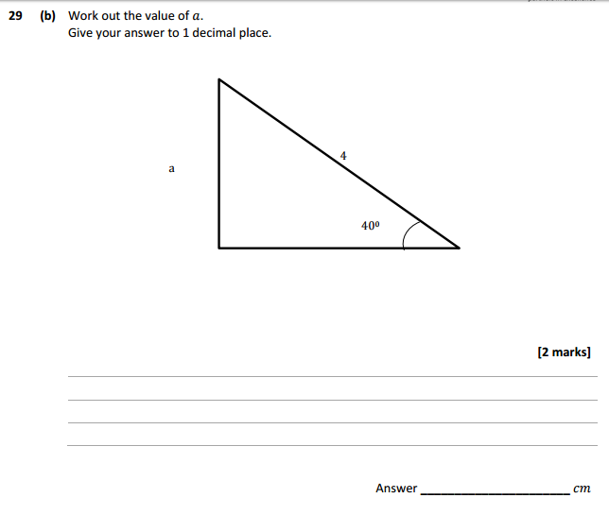
From PiXL Curve Paper 1 F & H

Slide 10
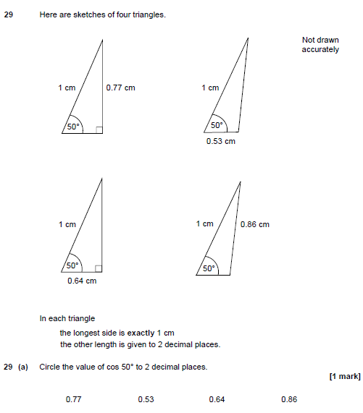
Based on this question
From AQA Specimen Paper 1
F & H

Slide 11
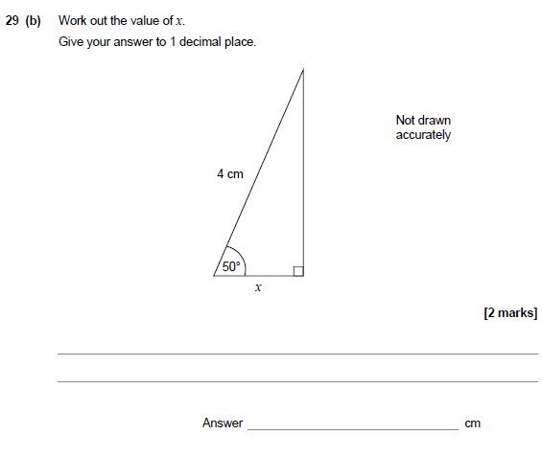
From AQA Specimen Paper 1
F & H

Slide 12
Consider a circle with centre O and radius 1.
This is called a unit circle
1
O

Slide 13

Consider also the point P on the circle whose coordinates are (x,y).
The angle between the x-axis and the line OP is θ
P(x,y)
1
O

Slide 14
Now consider the triangle OPQ
The x coordinate is the length OQ
The y coordinate is the length QP
P(x,y)
1
O
Q

Slide 15
From a unit circle
The x coordinate is cosine (cos) θ
The y coordinate is sine (sin) θ
P(x,y)
1
O
Q

Slide 16
Now imagine that θ = 50°
The x coordinate is cos 50°. This is the length OQ
The y coordinate is sin 50°. This is the length QP
P(x,y)
Find the values on your calculator
1
sin 50°
50°
O
Q
cos 50°

Slide 17
Now imagine that θ = 50°
The x coordinate is cos 50°. This is the length OQ
The y coordinate is sin 50°. This is the length QP
P(x,y)
Find the values on your calculator
1
0.7660444431…
What will happen to the x coordinate as θ increases ?
50°
O
Q
0.6427876097…
Try some values on your calculator.

Slide 18
Now imagine that θ = 50°
The x coordinate is cos 50°. This is the length OQ
The y coordinate is sin 50°. This is the length QP
P(x,y)
What will happen to the y coordinate as θ increases ?
1
0.7660444431…
Try some values on your calculator.
50°
O
Q
0.6427876097…

Slide 19
Find the length of the vertical and horizontal lengths in these right angled triangles
1
1
1
42º
37º
60º
What if the radius of the circle wasn’t 1?
2
7.3
6
42º
37º
60º

Slide 20
What about these?
H
H
6
30º
θ º
θ º

Slide 21
Can you find the missing lengths in these?
?
3
2.4
5
?
5
36º
22º
60º
?
6
?
60º
?
22º
36º
?
Why did I choose these questions?
4.8

Slide 22
In general:
H
O = H sin θ
θ º
A= H cos θ
Can you rearrange the formula above to make sin θ the subject?
Can you rearrange the formula above to make cos θ the subject?

Slide 23
From AQA Specimen Paper 1
F & H

Slide 24
From AQA Specimen Paper 1
F & H

Slide 25
Taking it further…
What do you get when you apply Pythagoras’ Theorem to the triangle?
P(x,y)
1
sin θ °
θ °
O
Q
cos θ °
Can you find another point on the circle that has the same x coordinate?/y-coordinate?
If you were to plot a graph of cos θ from 0°
to 360°
, what do you predict it will look like? Why?

Slide 26
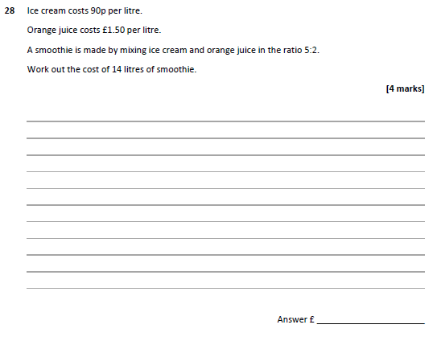
From PiXL Curve Paper 1 F only
86% Zero marks F (Q28)

Slide 27
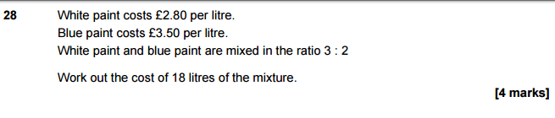
From AQA Specimen
Paper 1 F & H
The real specimen is actually more difficult

Slide 28
NCETM
National Research Project in Multiplicative Reasoning

Slide 29
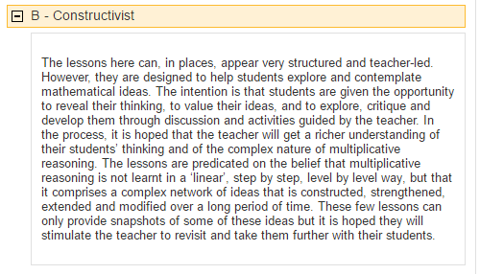

Dr Dietmar Küchemann
Kings College London

Slide 30
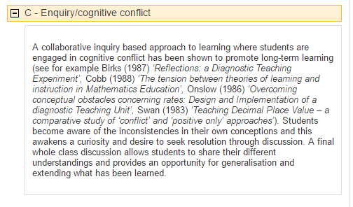

Malcolm Swan
Nottingham University

Slide 31
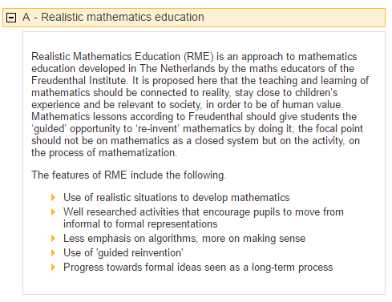

Sue Hough
Manchester Metropolitan University

Slide 32
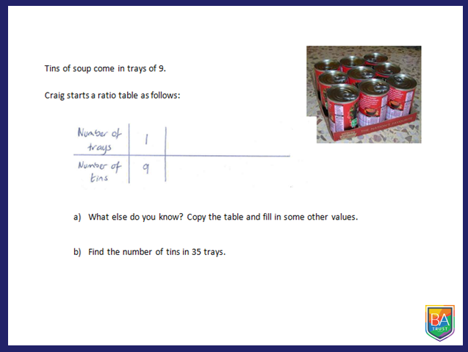
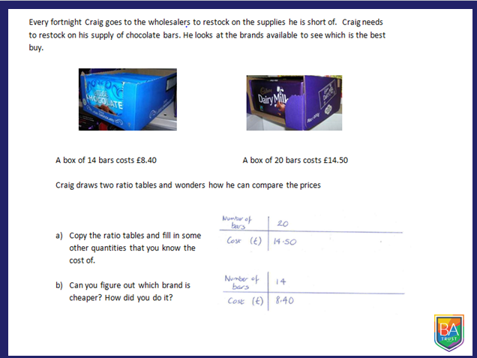
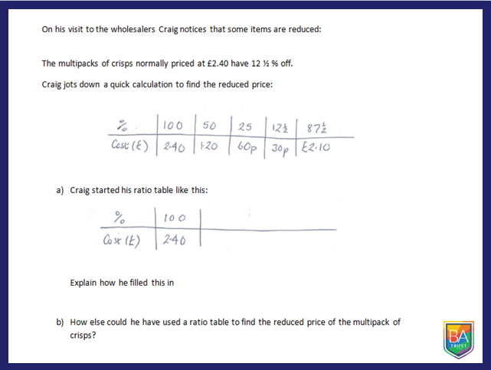
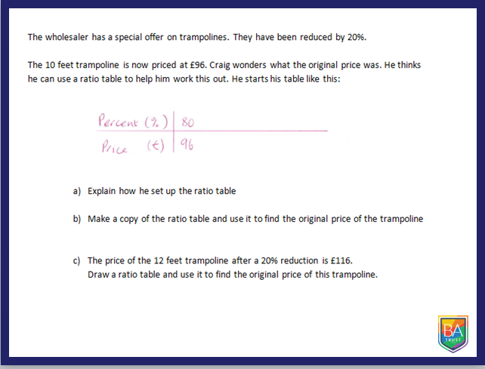
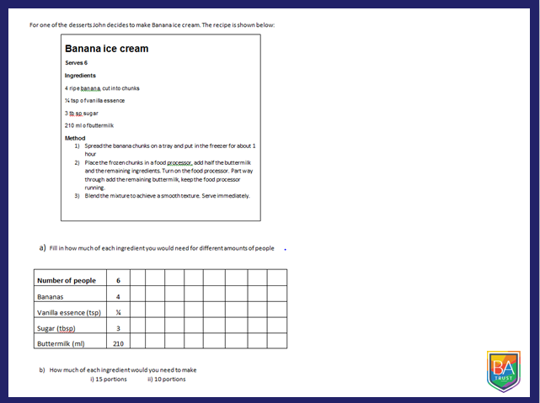
Percentage Increase/Decrease
Multiplying
Best Buy
Reverse Percentage Increase/Decrease
Recipes

Slide 33
Pie Charts

Slide 34
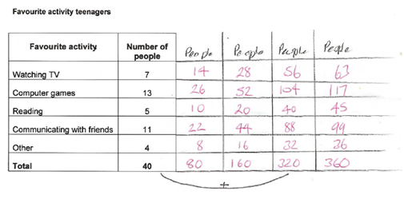


Slide 35
Selecting an Appropriate Method

Slide 36
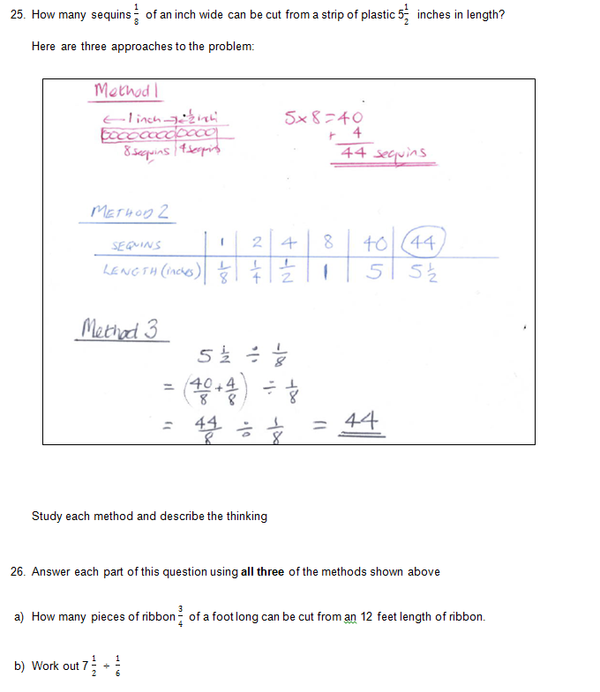

Slide 37
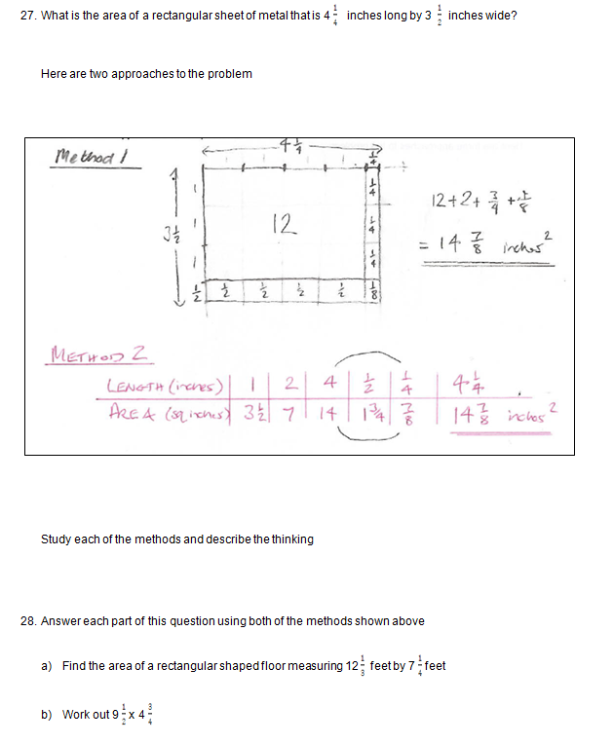

Slide 38
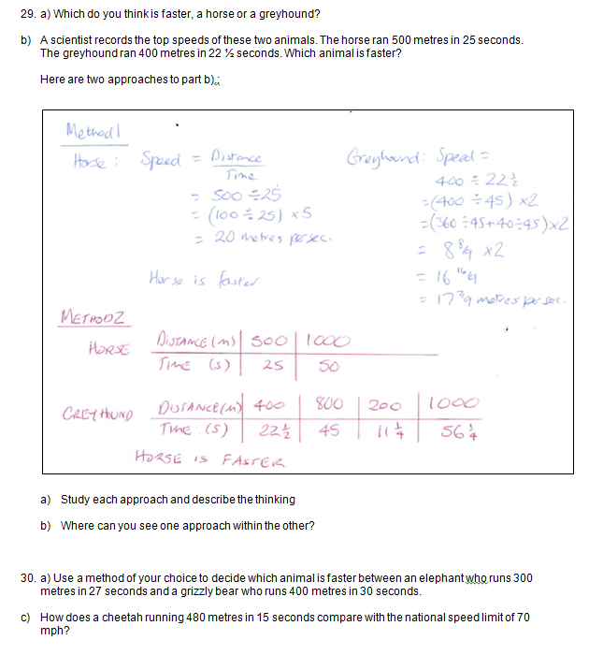

Slide 39
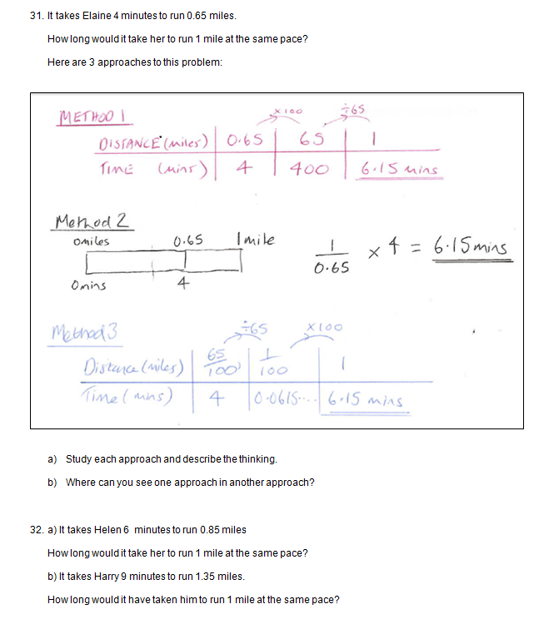

Slide 40
GCSE Questions

Slide 41
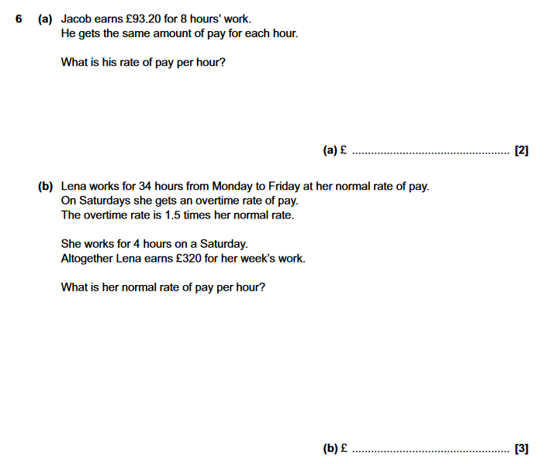
From OCR Specimen
Foundation

Slide 42
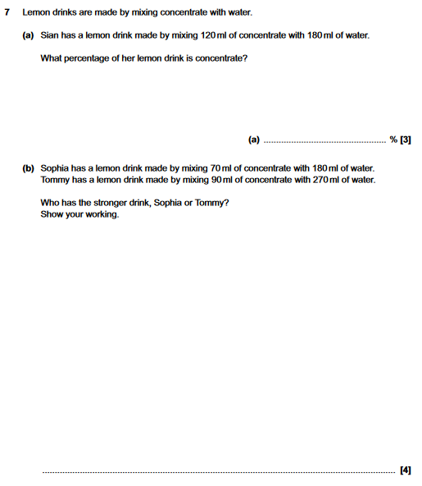
From OCR Specimen
Foundation

Slide 43
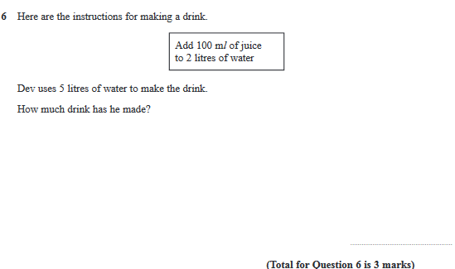
From EDXCEL Specimen
Foundation

Slide 44
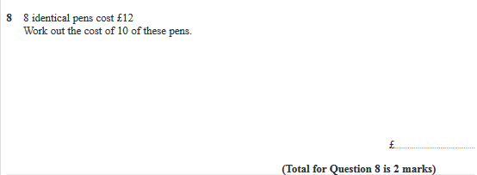
From EDXCEL Specimen
Foundation

Slide 45
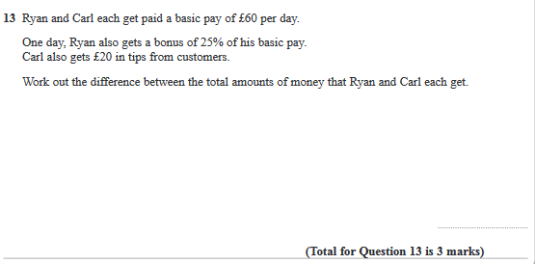
From EDXCEL Specimen
Foundation

Slide 46
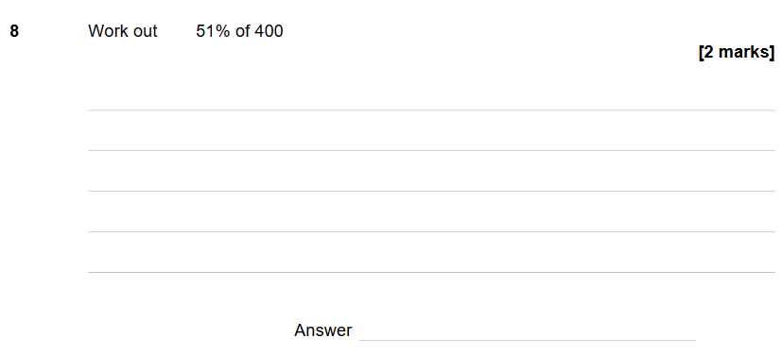
From AQA Specimen
Foundation

Slide 47
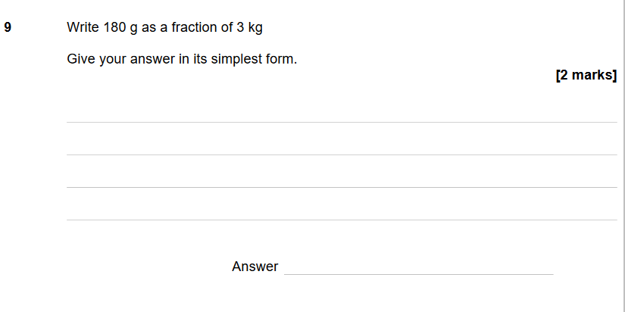
From AQA Specimen
Foundation

Slide 48
From PiXL Curve Paper 1 F only
86% Zero marks F (Q28)

Slide 49
From AQA Specimen
Paper 1 F & H
The real specimen is actually more difficult

