Slide 1
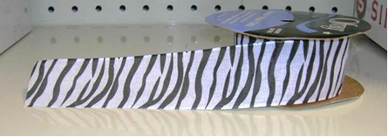
More ribbons:
Ellie buys 40cm of this ribbon and it costs her 62p
Draw a bar to represent the ribbon and use it to work out the cost of
(i) 90cm of the ribbon
(ii) 340cm of the ribbon

Slide 2
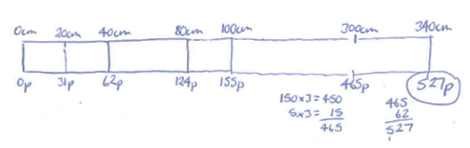
Here is the bar Ellie drew to find the cost of 340cm of ribbon
In what order do you think Ellie filled in her bar?

Slide 3

The table shown below is another way of recording the information about the ribbon
Make a copy of this table on your whiteboards and fill in some other values that you know to be true.

Slide 4
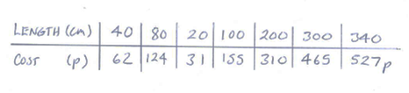
The shop assistant does a quick calculation to find the cost of 340cm of ribbon. This is shown below:
How does this table compare with the bar you drew? And the table?

Slide 5
In your books:
Ellie buys 40cm of this ribbon and it costs her 62p
Draw a table like the shop assistant did to help you work out the cost of:
(i) 620cm of the ribbon
(ii) 510cm of the ribbon

Slide 6
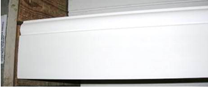
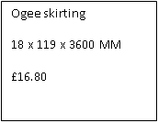
Ellie calls at the DIY store. She has a builder coming to put new skirting board and beading in her bedroom. She chooses the ogee style:
The ticket details for this skirting board are shown in the box above.
Which parts of the skirting board do the measurements refer to?

Slide 7
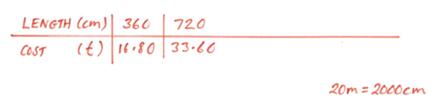
The distance around the walls of Ellie’s bedroom is 20m.
Ellie can’t decide whether to do her calculations in metres, centimetres or millimetres
We are going to use this ratio table (or one of your own) to work out how much it will cost Ellie to buy enough skirting board to go around her bedroom walls.

Slide 8
The distance around the walls of Ellie’s bedroom is 20m.
Ellie can’t decide whether to do her calculations in metres, centimetres or millimetres
What value would you like to fill in next?
What would be a useful value to find?
In your pairs find out how much it will cost.

Slide 9
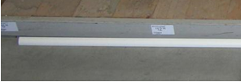
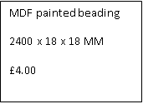
Ellie chooses the beading shown below.
She decides to bead only the two outside walls of the room as these are the draughtiest. This is a distance of 10.8m.
Use a ratio table to work out how much it will cost Ellie to buy enough beading to cover the two outside walls.

