Slide 1
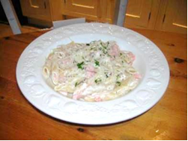
Recipes
John is planning a party for a group of his friends. He wants dishes that are easy and quick to make.
He decides on ‘Smoked Salmon Pasta’ as the main course.
The recipe is shown below:
Smoked Salmon Pasta
Serves 8
Ingredients
500 g smoked salmon, cut into small pieces
600 g pasta
300 ml single cream
Juice of 2 lemons
1 tbl sp parmesan cheese
Parsley to taste
Method
Cook and drain the pasta
Add the smoked salmon and the lemon juice to the pasta, cover and leave to stand for 2 minutes
Return to a low heat and stir in the cream
Spoon the smoked salmon pasta into warm bowls and sprinkle with parsley and parmesan cheese

Slide 2
Recipes
John uses a ratio table like the one below to work out how much of each ingredient he will need. If everyone comes then there will be 22 people.
Number of people | 8
Salmon (g) | 500
Pasta (g) | 600
Cream (ml) | 300
Lemons | 2
Parmesan (tsp) | 1
You can find a copy of this table on your worksheet.
Fill in how much of each ingredient you would need for different amounts of people
Work out how much of each ingredient is needed for 22 people.

Slide 3
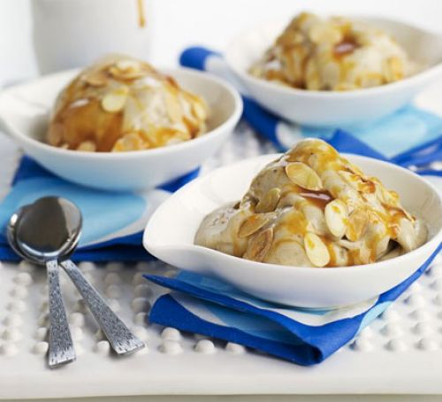
Recipes
For one of the desserts John decides to make Banana ice cream. The recipe is shown below:
Banana ice cream
Serves 6
Ingredients
4 ripe banana, cut into chunks
¼ tsp of vanilla essence
3 tbsp sugar
210 ml of buttermilk
Method
Spread the banana chunks on a tray and put in the freezer for about 1 hour
Place the frozen chunks in a food processor, add half the buttermilk and the remaining ingredients. Turn on the food processor. Part way through add the remaining buttermilk, keep the food processor running.
Blend the mixture to achieve a smooth texture. Serve immediately.

Slide 4
Banana ice cream
The ratio table for Banana ice cream is shown below:
Number of people | 6
Bananas | 4
Vanilla essence (tsp) | ¼
Sugar (tbsp) | 3
Buttermilk (ml) | 210
The ratio table for this recipe is on the worksheet.
Fill in some other quantities.
b) How much of each ingredient would you need to make
i) 15 portions ii) 10 portions

Slide 5
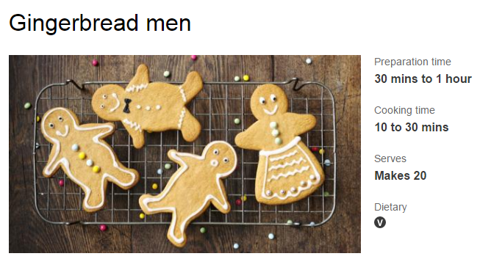
You want to make 32 gingerbread men.
Make your own ratio table to calculate the amounts of each ingredient.

Slide 6
