Slide 1
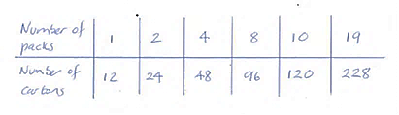
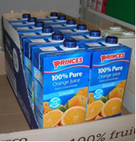
Buying in bulk: The ‘Open later’ store.
Craig is the manager of an ‘Open later’ convenience store. Every Monday morning he does a stock check and places orders for products he is running short of.
Supplies of pure orange juice are running low. The cartons of juice come in packs of 12. Craig uses a ratio table to work out how many cartons of juice he will get if he orders 19 packs. His working is shown below:

Slide 2
Craig started his ratio table like this:
Make a copy of the start of Craig’s ratio table and use it to find the number of drinks in 28 packs.

Slide 3
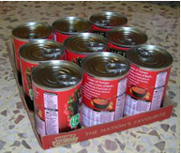
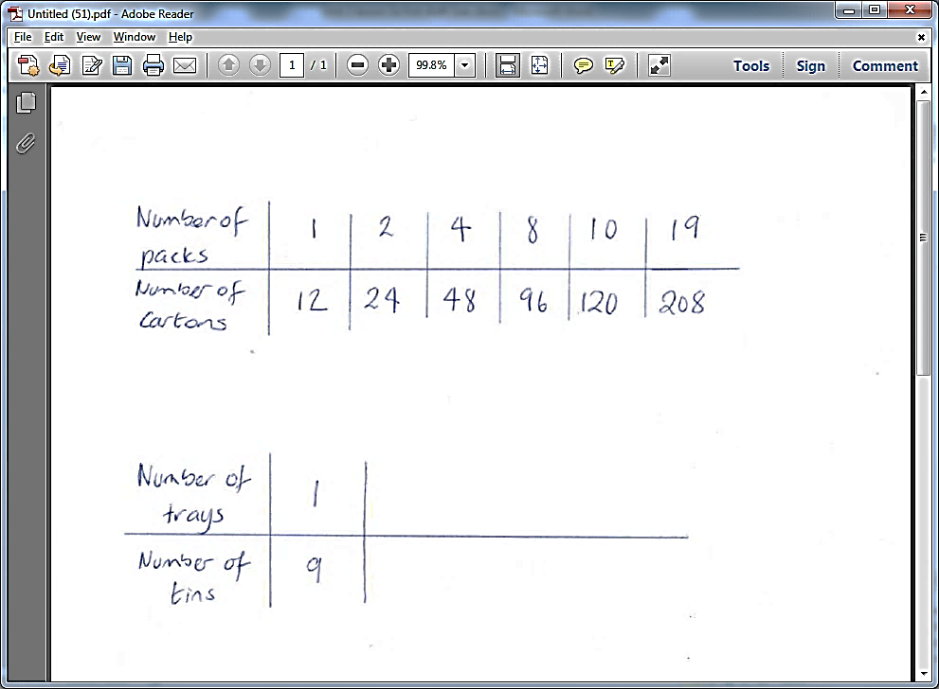
Individual work in your books:
Tins of soup come in trays of 9
Craig starts a ratio table as follows:
Now answer all of the questions
What else do you know? Copy the table and fill in some other values
b) Find the number of tins in 35 trays.

Slide 4
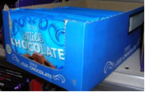
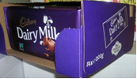
At the wholesalers
Every fortnight Craig goes to the wholesalers to restock on supplies. Craig needs to restock on his supply of chocolate bars. He looks at the brands available to see which is the best buy.
A box of 14 bar costs £8.40 A box of 20 bars costs £14.50
Craig draws two ratio tables and wonders how he can compare the prices:

Slide 5


At the wholesalers
a) Copy the ratio tables and fill in some other quantities that you know the cost of.
b) Can you figure out which brand is cheaper? How did you do it?

Slide 6
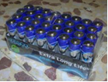

Craig is wondering which brand of batteries to go for
A box of 24 batteries costs £14.40
A box of 32 batteries costs £16.60
a) Make two ratio tables and fill in some other quantities of batteries that you know the cost of.
b) Which brand is cheaper?

Slide 7
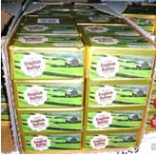
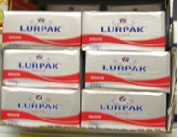
The wholesale prices for two brands of butter are as follows:
A box of 40 packs costs £48.00
A box of 36 packs costs £45.00
a) Make two ratio tables and fill in some other quantities of butter that you know the cost of.
b) Which brand is cheaper?

Slide 8
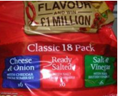
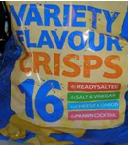
The wholesale prices for two multipacks of crisps are as follows:
Blue brand: 16 packs cost £2.40
Red brand : 18 packs cost £2.70
a) Make two ratio tables and fill in some other quantities of crisps that you know the cost of.
b) Which brand is cheaper?

Slide 9
The Summer Fair
The local primary school are preparing for their summer fair. The head of the PTA asks Craig if he can order some sweets and crisps from the wholesalers for the PTA to sell at the school fair.
Below are the details of what the PTA would like Craig to buy:
 | Number per pack | Number required
Packets of crisps | 16 | 400
Wafer biscuits | 12 | 350
Chocolate bars | 25 | 650
Ice lollies | 15 | 280
Sort drinks | 8 | 600
Strawberry laces | 14 | 180

Slide 10
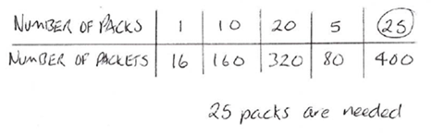
Craig uses a ratio table to work out how many multipacks of crisps he will need to order to get 400 packets of crisps. This is shown below
a) How did Craig start off his ratio table
b) Explain how he filled in the numbers in the other columns.
c) How did he know when to stop?

Slide 11
The Summer Fair
Draw ratio tables to help you work out how many packs Craig will need to buy of the other items in the list.
 | Number per pack | Number required
Packets of crisps | 16 | 400
Wafer biscuits | 12 | 350
Chocolate bars | 25 | 650
Ice lollies | 15 | 280
Sort drinks | 8 | 600
Strawberry laces | 14 | 180

