Slide 1

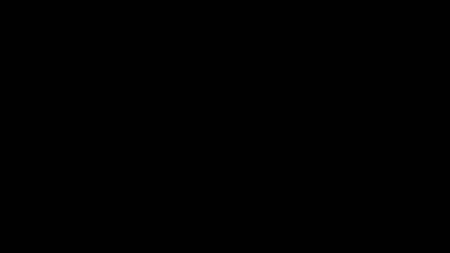

Slide 2
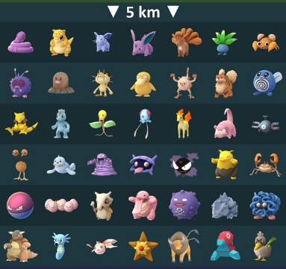
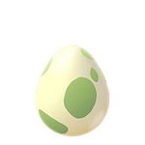
5km egg

Slide 3
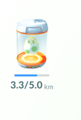
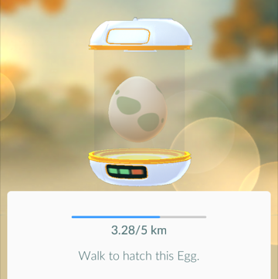
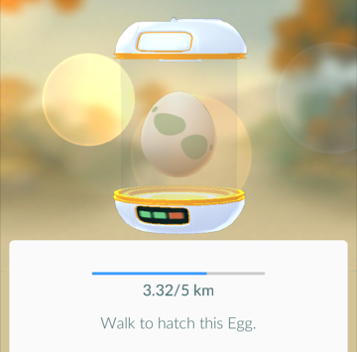
After walking for a while, I decide to check the progress of the egg…
When I clicked on the egg it gave me more detail. The first time I clicked it showed this.
The second time showed this.

Slide 4
Both 3.28km and 3.32km have been rounded to 3.3km
What other distances would be rounded off to 3.3km?

Slide 5
Which of the lengths shown will round to 3.3 km?

a

b
c

d
e

f
3.1
3.2
3.3
3.4
km
All 4 strips that measured 3.3 km were within the range 3.25 to 3.35 cm.

Slide 6
Which of the lengths shown will round to 3.3 km?

a

b
c

d
e

f
3.1
3.2
3.3
3.4
km
The lowest value that a measurement can take is sometimes referred to as the lower bound.
The highest value that a measurement can take is sometimes referred to as the Upper bound.
Lower bound = 3.25 km
Upper bound = 3.35 km

Slide 7
Anything that falls between 3.25 km (including 3.25) and 3.35 km (not including 3.35) rounds off to 3.3km
3.1
3.2
3.3
3.4
km
Lower bound = 3.25 km
Upper bound = 3.35 km

Slide 8
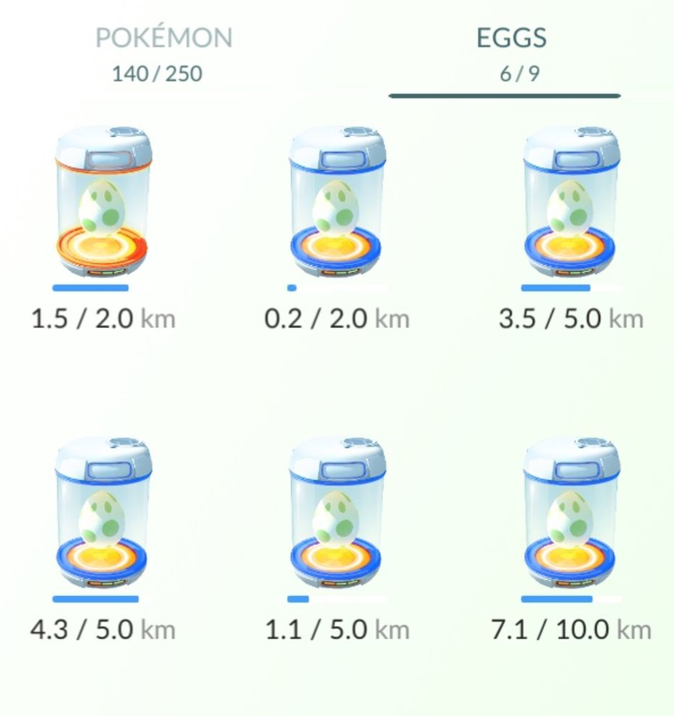
Answer the following questions on your worksheet.
For each incubator:
Plot the distance on the number line
Write the upper and lower bounds
Write three values that round off to the distance.
a
b
c
d
e
f

Slide 9
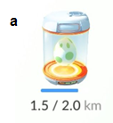
1.4
1.5
1.6
km
LB
UB
1.45
1.55
Three possible values that round off to 1.5 km:

Slide 10
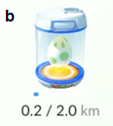
0.1
0.2
0.3
km
LB
UB
0.15
0.25
Three possible values that round off to 0.2 km:

Slide 11
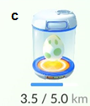
3.4
3.5
3.6
km
LB
UB
3.45
3.55
Three possible values that round off to 3.5 km:

Slide 12
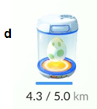
4.2
4.3
4.4
km
LB
UB
4.25
4.35
Three possible values that round off to 4.3 km:

Slide 13
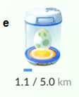
1.0
1.1
1.2
km
LB
UB
1.05
1.15
Three possible values that round off to 1.1 km:

Slide 14
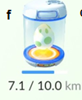
7.0
7.1
7.2
km
LB
UB
7.05
7.15
Three possible values that round off to 7.1 km:

Slide 15
What would this distance round to, to 1decimal place?
6.68
Between which two values does it lie?
6.6
6.7
km
Which is it closer to?
6.68 rounds to 6.7 (1dp)

Slide 16
Round all of these distances off to 1 decimal place
(Use the number line if you need to)
On your whiteboards
km
6.52 km
10.41 km
9.56 km
9.98 km

Slide 17
Use the number line to round these other measurements
On your whiteboards
35.2 m to the nearest metre
462 kg to the nearest 10 kg
430 m to the nearest 100 m
7.832 to 2 decimal places

Slide 18
Measurement | Round to | Lies between |  | Closest to
10.63 | 1 dp | 10.6 | 10.7 | 10.6
548 | Nearest 100
78 | Nearest 10
97 | Nearest 10
7.324 | 2 dp
0.39 | 1 dp
5370 | Nearest 100
5300 | Nearest 1000
 | Nearest 10 | 70 | 80 | 80
 | Nearest 100 | 1200 | 1300 | 1200
 | 1 dp | 5.5 | 5.6 | 5.6
 | 2 dp | 0.24 | 0.25 | 0.24

Slide 19
Measurement | Round to | Lies between |  | Closest to
10.63 | 1 dp | 10.6 | 10.7 | 10.6
548 | Nearest 100 | 500 | 600 | 500
78 | Nearest 10 | 70 | 80 | 80
97 | Nearest 10 | 90 | 100 | 100
7.324 | 2 dp | 7.32 | 7.33 | 7.32
0.39 | 1 dp | 0.3 | 0.4 | 0.4
5370 | Nearest 100 | 5300 | 5400 | 5400
5300 | Nearest 1000 | 5000 | 6000 | 5000
75, 76, 77, 78, 79 | Nearest 10 | 70 | 80 | 80
1200<n<1250 | Nearest 100 | 1200 | 1300 | 1200
5.55<n<5.6 | 1 dp | 5.5 | 5.6 | 5.6
0.24<n<0.245 | 2 dp | 0.24 | 0.25 | 0.24

