Slide 1
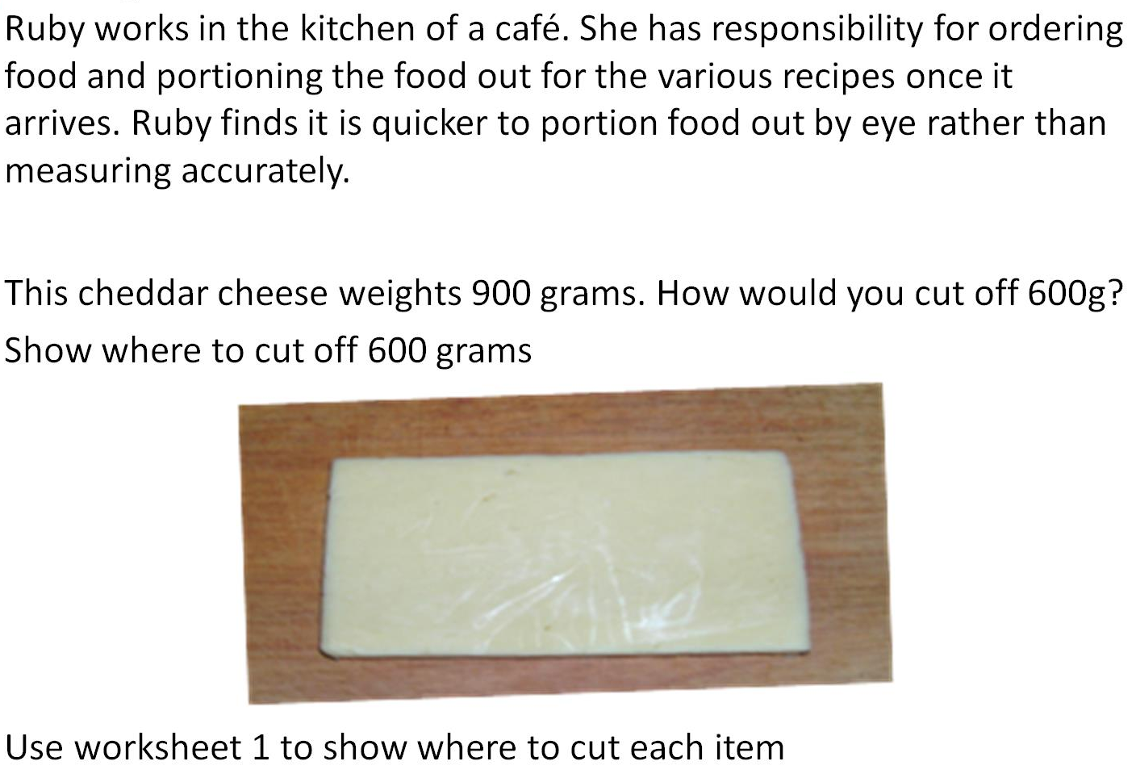
Catering

Slide 2
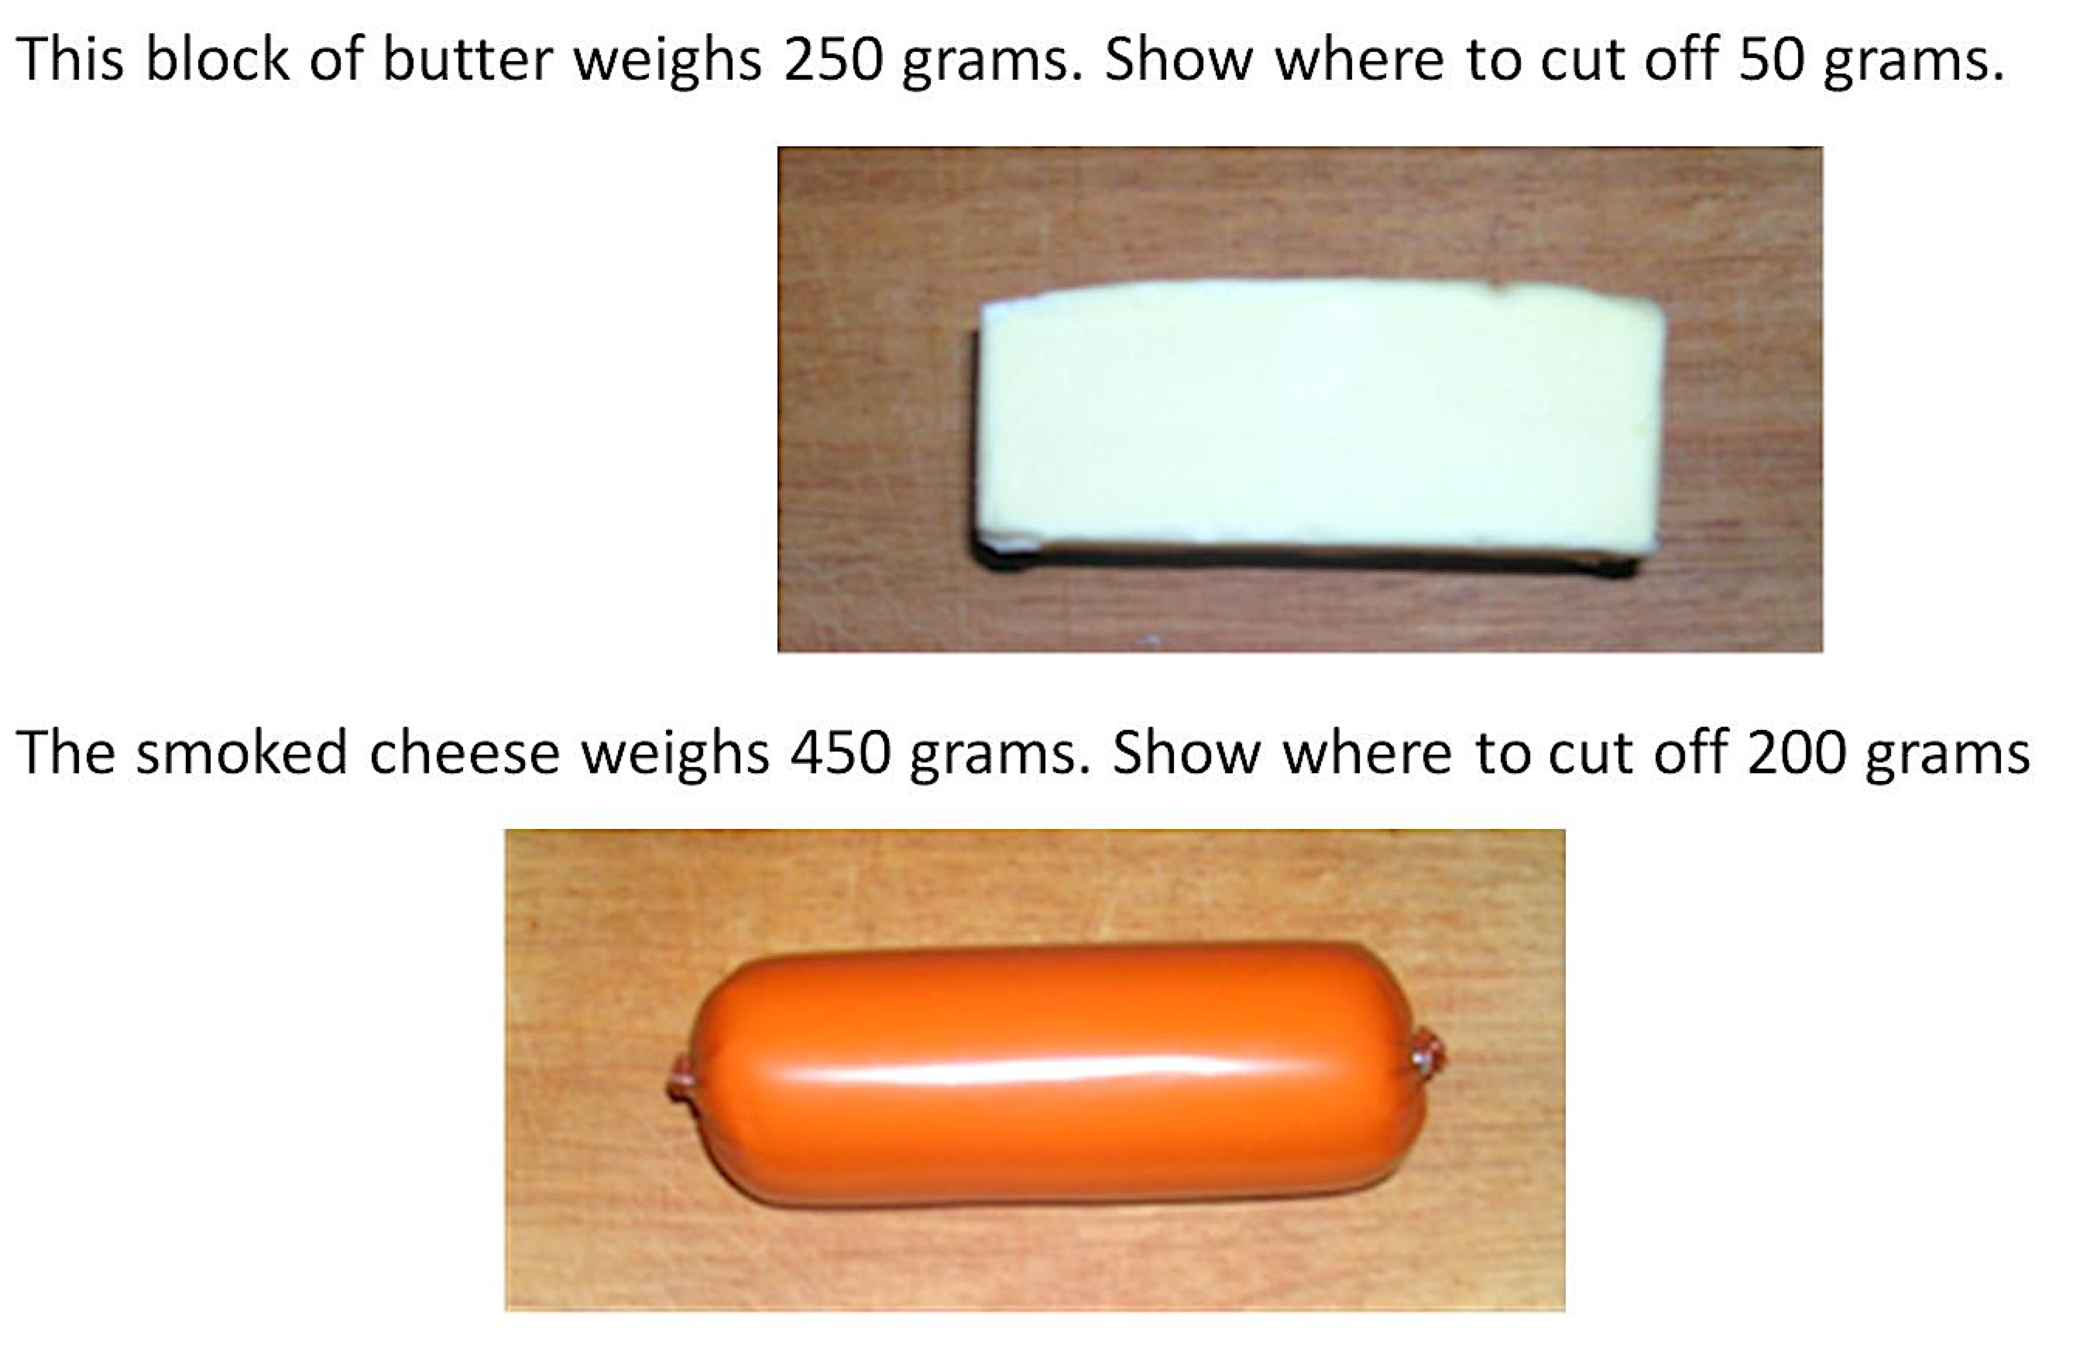
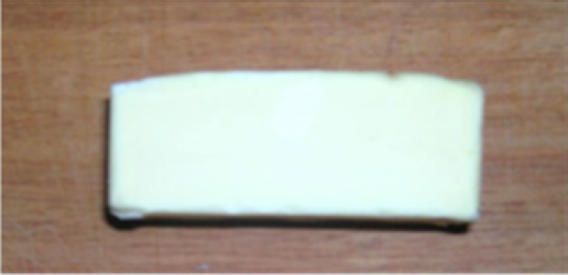
Compare Strategies for Cutting

Slide 3
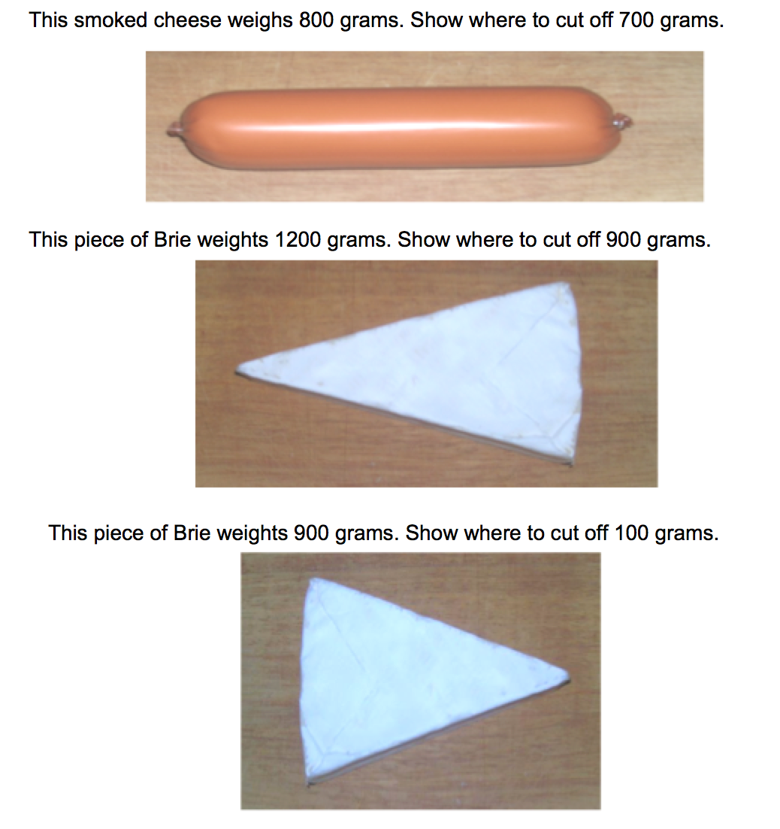

Slide 4
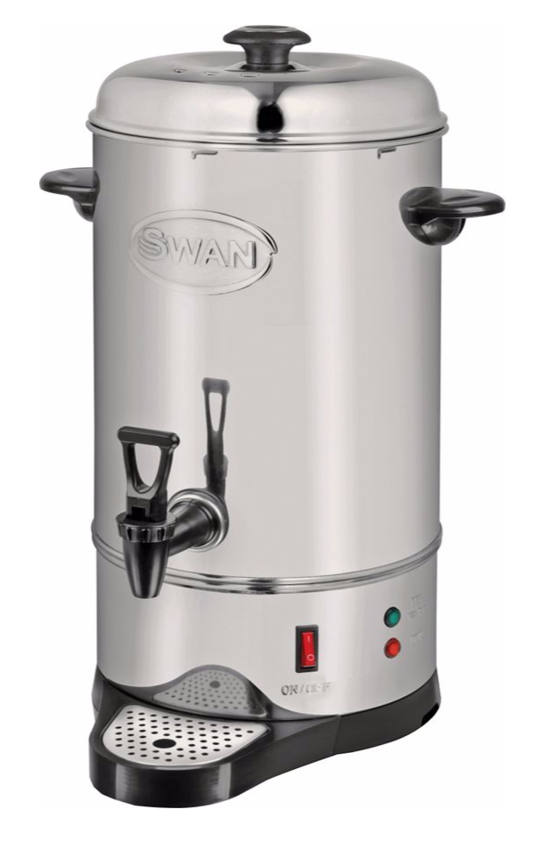
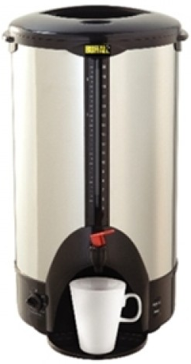
The Maths department need a new urn.
Which one should we get and why? What are the benefits of your recommendation?

Slide 5
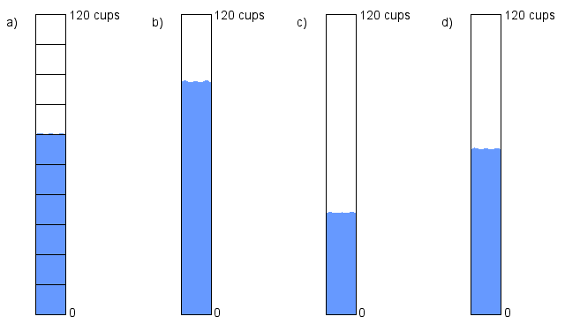
The Hot Water Urn
The Maths department ending up buying this one…
When it is full, the urn can supply 120 cups.
The pictures show the gauge at various stages of the day

Slide 6
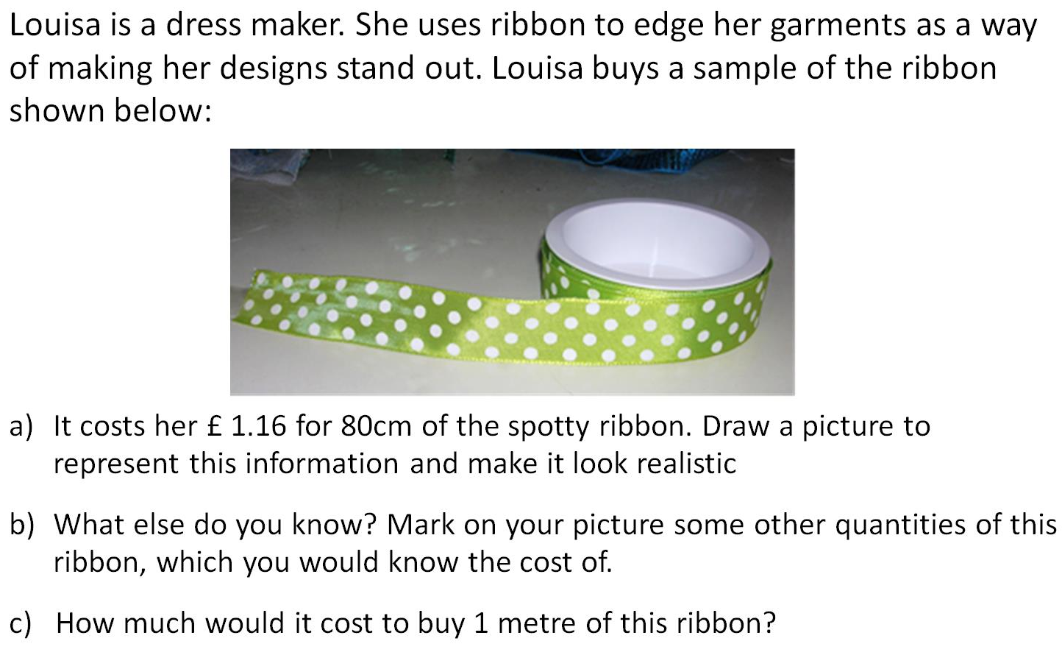
Buying Ribbon
.

Slide 7
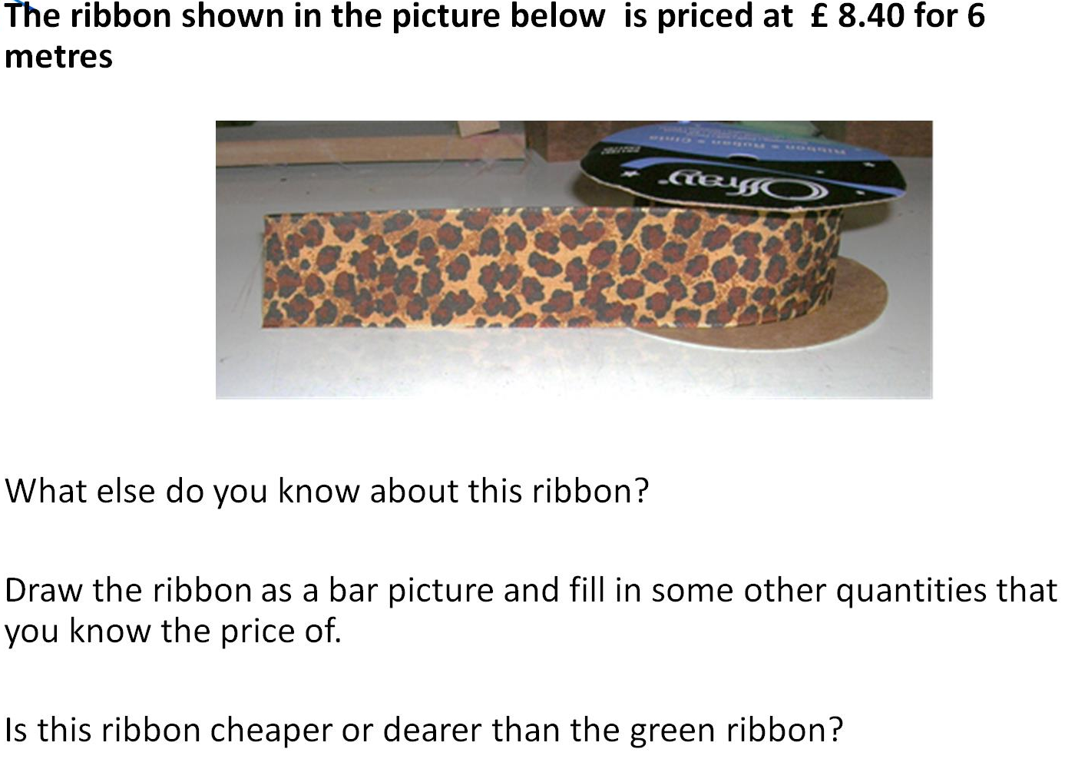
Buying Ribbon

Slide 8
