Slide 1
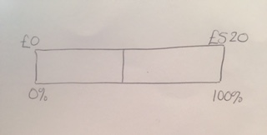
Sale Prices
Dad wants to buy a laptop for his son for Christmas. He uses the internet to compare the price in various stores. In PC Express the laptop is priced at £479, whereas LAP Gear are offering the same laptop for £520 with a 12.5% reduction.
Dad sketches a bar to help him work out the price in LAP Gear. He starts like this:

Slide 2
Sale Prices
On your whiteboards:
Copy the bar and complete his calculation.

Slide 3
Sale Prices
Which company sells the laptop cheaper?

Slide 4
Sale Prices
Draw bars to help you work out
The price of a £1500 computer after a 15% reduction
b) The price of a £600 dishwasher after a 12% reduction
c) The price of a £ 1250 holiday with 8% off
d) The price of a £2500 car with 21% off

Slide 5
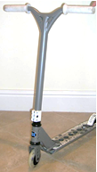
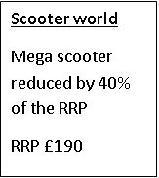

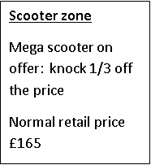
Sue is looking to buy a scooter for her daughter.
She finds the one she wants on offer in three different on line stores.
The offers are as follows:
Sale Prices - challenge
Which store is the cheapest for this scooter?

Slide 6
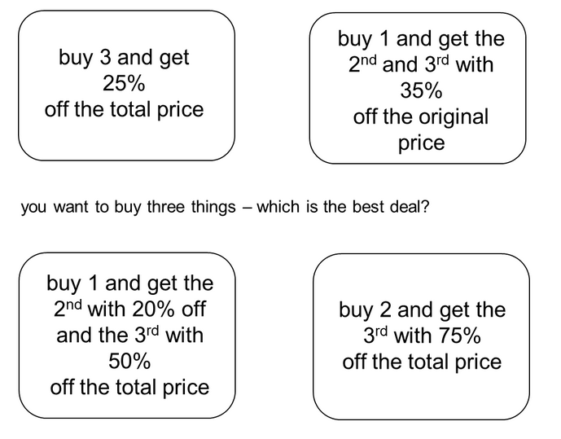
Sale Prices - challenge
Is it the best deal for any starting price?
How do you know?

Slide 7
Find the error…
Question:
In a sale, a television has 25% off. The sale price is £600.
What was the price before the sale?
A student says the answer is £750 and explains:
“If 25% was taken off, then 25% must be added on.
25% of £600 is a quarter of £600, which is £150, so if you add that on, it is £750.”
The teacher says this is incorrect.
Can you use a bar to show why it is incorrect, and find the correct answer?

Slide 8
Working backwards
Draw bars to help you work out
The price of a £ computer after a 40%
reduction is £450
The price of a £ dishwasher after a 20%
reduction is £480
The price of a £ holiday with 15% off
is now £680

