Slide 1
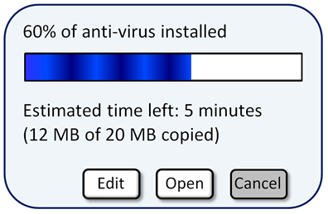
Downloading software
Is the blue bar accurate?
How could you check?

Slide 2
Downloading software
How could you work out the total time the anti-virus should take to install?

Slide 3

Downloading software
After 12 minutes downloading a new game, the download bar looks like this:
How can you figure out how long is left to download?
Use your copy of the bar and show how you can use it to figure out how long is left.

Slide 4
Downloading software
After 12 minutes downloading a new game, the download bar looks like this:
It can be useful to put some other numbers on the bar…
0
12 mins
0
80%

Slide 5
Supermarket fundraising
A major supermarket has a new fund raising scheme aimed at supporting local communities. Shoppers can earn tokens to give to a charity of their choice. The number of tokens gained depends upon how much the shopper spends.
The checkout worker issues the tokens to the shopper, who then chooses which of the three local organisations they would like the tokens to go. The supermarket converts the tokens into money and when the target amount is reached, they present the local organisation with a cheque.

Slide 6
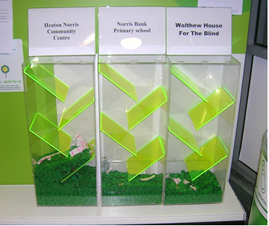
Supermarket fundraising
According to the picture, which charity has raised the most so far?
Why do you think that is?

Slide 7

Supermarket fund raising
Once a week, the manager empties the tokens and updates the record of the total amount of money raised for each organisation towards their target. He puts this information in a table and fills in a percentage bar. This update is posted on the notice board each week, so that interested customers can follow the progress of the donations.
How would you fill in the percentage bar for the Community centre?
Try it on your whiteboard.
How did you decide where to put the line?
Community centre
Aim: to update the security lighting
Money raised so far | £1494
Target amount | £2500
£0
£2500

Slide 8
Comparing methods
£0
£2500
£0
£2500
£0
£2500

Slide 9
Supermarket fundraising
Use your preferred method to fill in the first bar on the sheet.
Use your whiteboard to decide where to place your lines in the next two bars before you draw it on the worksheet

Slide 10
Comparing methods
£0
£3200
£0
£3200
£0
£3200

Slide 11
Comparing methods
£0
£2100
£0
£2100
£0
£2100

Slide 12
Supermarket fundraising
A different supermarket uses thermometers to display how much they have raised.
Use the information in the tables to fill in the thermometers

