Slide 1
Worded questions
Adam and Kevin share the running costs of the car in the ratio 1 : 3.
Last year it cost £1860 to run the car.
How much did Kevin pay?
Can you draw a diagram to help you to solve this question?

Slide 2
Today we will be using the bar model to solve more difficult ratio problems

Slide 3
Worded questions
To make suet you need fat to flour in the ratio 1:3.
Yasmin has 180g of flour.
How much fat does she need to make the suet?
Can you draw a diagram to help you to solve this question?
How was this question different to the other?

Slide 4
Worded questions
Adam and Kevin share the running costs of the car in the ratio 1 : 3.
Last year it cost £1860 to run the car.
How much did Kevin pay?
To make suet you need fat to flour in the ratio 1:3.
Yasmin has 180g of flour.
How much fat does she need to make the suet?
Adam
Fat
£1860
Kevin
Flour
£180
Given a total
Given a part

Slide 5
Sort these questions into two piles: ‘Given a total’ or ‘given a part.’ Then answer the questions in your book using the correct diagrams.
Green paint is made by mixing blue and yellow paint in the ratio 3:5.
How much of each colour is needed to make 80 litres of green paint?
Money is split between Phoebe and Monica in the ratio 5:6.
Monica gets £30.
How much does Phoebe receive?
The ages of a mother and daughter are in the ratio 8:3. If the mother is 48 years old, how old is the daughter?
Mr Happy has an orchard of apple and pear trees. The trees are planted in a ratio of 3:2. He has a total of 60 trees. How many trees are pear trees.
Pocket money is split between Jude, Luke and Lola in the ratio 4:5:6. Dad pays out £60. How much does each person get?
A model farm is made using a scale of 1:24.
The height of a model cow is 5 cm. What is the height of the real cow?

Slide 6
More difficult questions…
A sum of money is shared among Fred, George and Harry in the ratio 3:4:5.
Express Fred’s share as a fraction of George’s share.
Express Harry’s share as a fraction of the whole sum of money.
If Fred received £40 less than Harry, how much was the sum of money?
Fred
George
Harry

Slide 7
More difficult questions…
Liam, Sarah and Emily shared some money in the ratio 2 : 3 : 7
Emily got £80 more than Liam.
How much money did Sarah get?

Slide 8
More difficult questions…
The ratio of Superman’s money to Batman’s money was 5:3 at first.
After Superman spent ½ of his money, he had £15 less than Batman.
How much money did Superman spend?
What was the total amount the superheroes had at the beginning?

Slide 9
More difficult questions…
The ratio of Henry’s height to Jack’s height is 4 : 5.
The ratio of Jack’s height to Mark’s height is 10 : 9.
If Mark is 15 cm taller than Henry, how tall is Henry?

Slide 10
More difficult questions…
The ratio of Charlotte’s savings to Lorna’s savings is 3 : 4.
The ratio of Lorna’s savings to Craig’s savings is 8 : 9.
If Charlotte’s savings is £15 less than Craig’s, how much do the 3 of them save together?

Slide 11
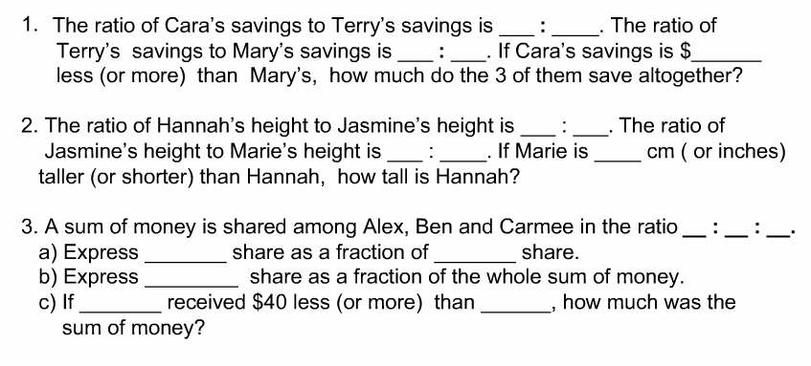
Question Creation
Create your own questions and solutions using the guidelines below.
£
£

