Slide 1
Objective:
Today we will explain the reasoning behind column addition and subtraction

Slide 2
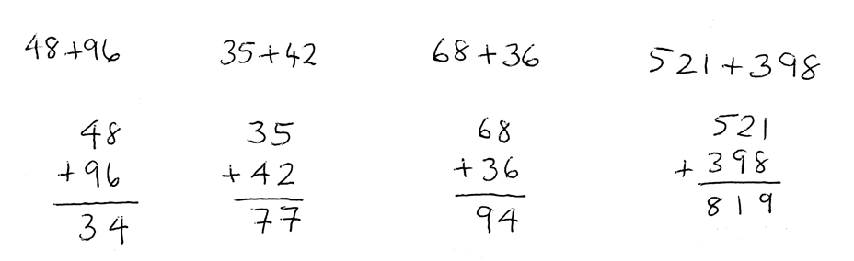
In your pairs:
A student in a different class has used column addition to work out the missing letter. They have used the same method for each one.
Which are correct and which are incorrect?
For the ones that are incorrect, what was their error?
b
36
398
a
68
521
42
48
96
35
c
d

Slide 3
To better understand column addition, we can use place value counters:
152 +324
10
10
1
10
1
100
10
10
100
1
1
10
1
100
10
1
100

Slide 4
Let’s use this to explain why the 4th example was wrong
521 + 398
10
1
100
100
10
100
100
10
1
1
10
100
1
10
1
10
10
1
1
10
10
1
1
100
10
100
100
10

Slide 5
Let’s use this to explain why the 4th example was wrong
How can we see this in our algorithm?
521 + 398
10
1
100
100
100
10
100
100
10
1
1
10
100
1
10
1
10
10
1
1
10
10
1
1
100
10
100
100
10

Slide 6
In your pairs use the place value counters and boards to complete the following question.
One person must use the place value counters whilst the other person records what you are doing on a white board.
203 + 155
What about this one?
206 + 155

Slide 7
206 + 155
1
1
100
100
1
1
1
1
10
10
1
1
1
100
10
10
10
1
1

Slide 8
206 + 155
1
1
100
100
1
1
1
1
10
10
10
1
1
1
100
10
10
10
1
1

Slide 9
Challenge:
Can you write down a sum of two three digit numbers where there will need to be an exchange to the hundreds but not the tens?
Can you write one that will carry over in the tens, hundreds and thousands?

Slide 10
In your pairs use the place value counters and boards to complete the following question.
One person must use the place value counters whilst the other person records what you are doing on a white board.
19.4 + 6.5
0.8 + 0.47

Slide 11
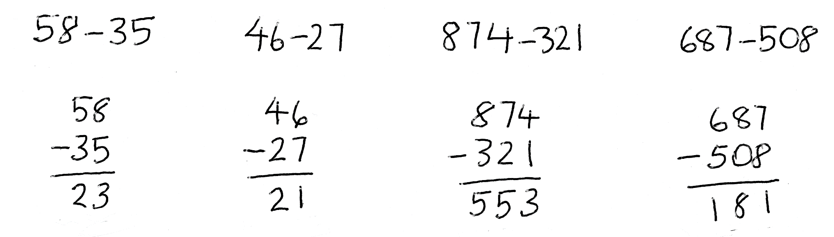
In your pairs:
The same student in my other class also answered some subtraction questions. They have used the same method for each one.
Which are correct and which are incorrect and why?
For the ones that are incorrect, can you use the place value counters to explain to them how they should alter their method and why.

Slide 12
To finish…
Decimals Tarsia
Can you join up the pieces to make a large hexagon?

Slide 13
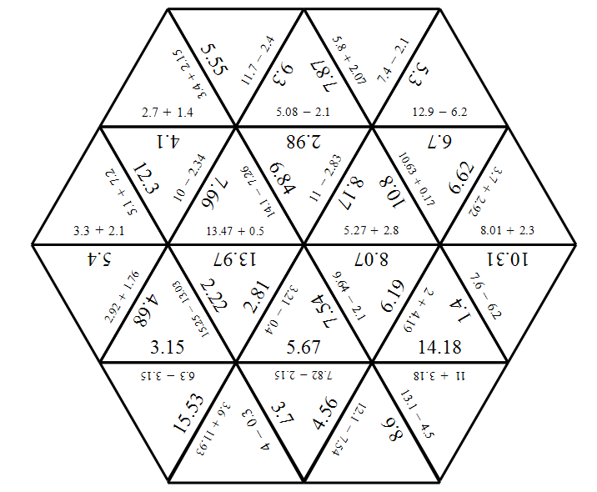
Answer

